Slide 1
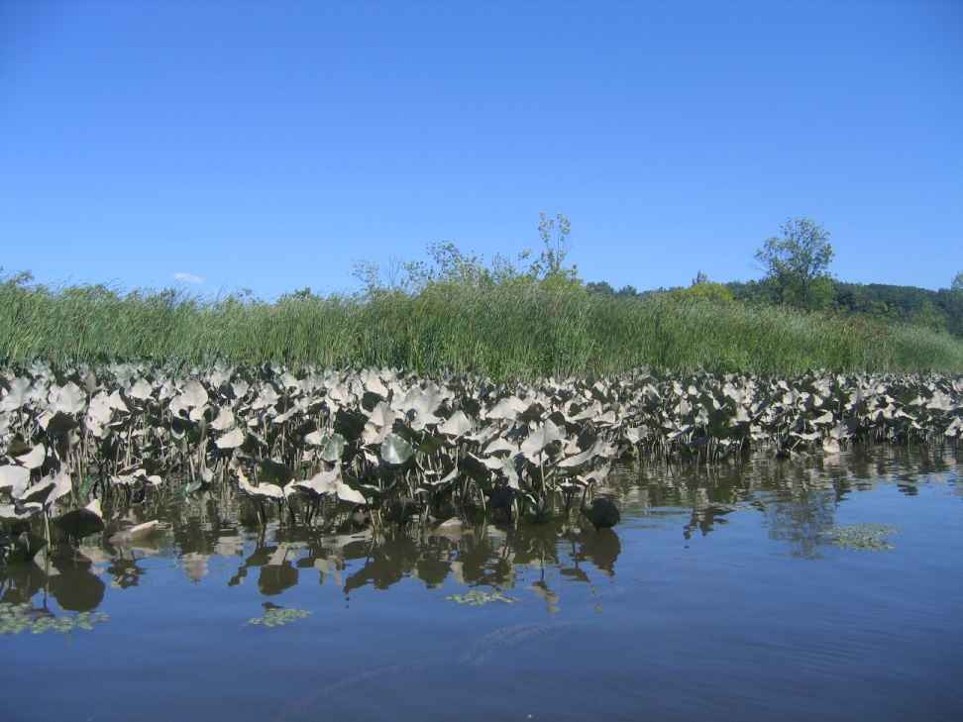
Freshwater Tidal Marsh Field Guide
As you navigate through a freshwater tidal marsh, you will see many plants and animals that interact with each other to form the diverse ecosystem that surrounds you.
This field guide describes physical characteristics of plants and animals found in freshwater tidal marshes. Use the descriptions and drawings to help you identify what you see. All plants are native, unless marked with an asterisk (*).
The plants are divided into three groups: graminoid, broadleaf, & submerged. The animals are divided into mammals, birds, reptiles and amphibians, fish, and invertebrates.
Photos courtesy of Alan Wells, Steve Stanne (Hudson River Estuary Program), and the Creative Commons.

Slide 2
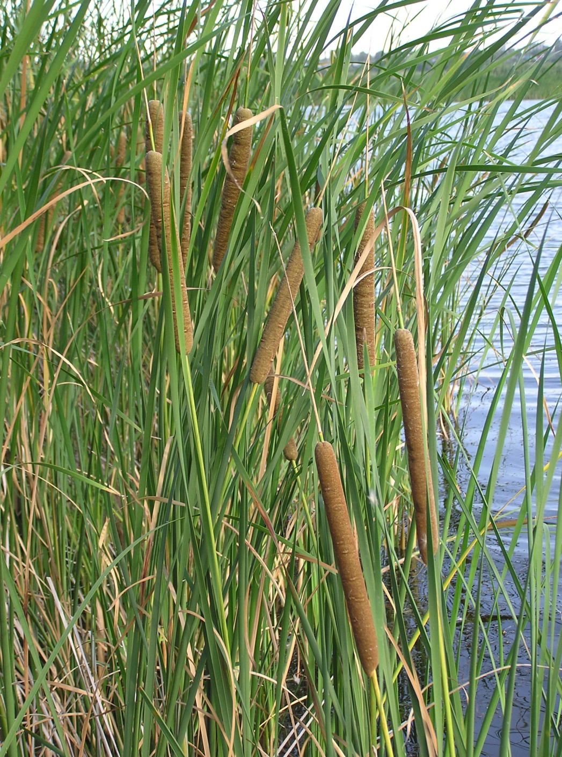
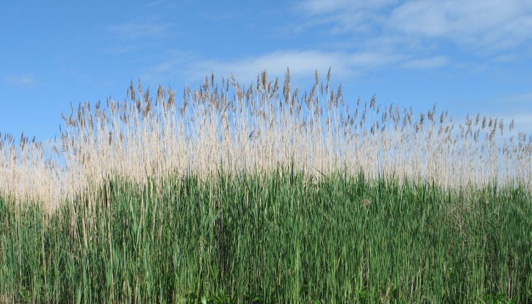
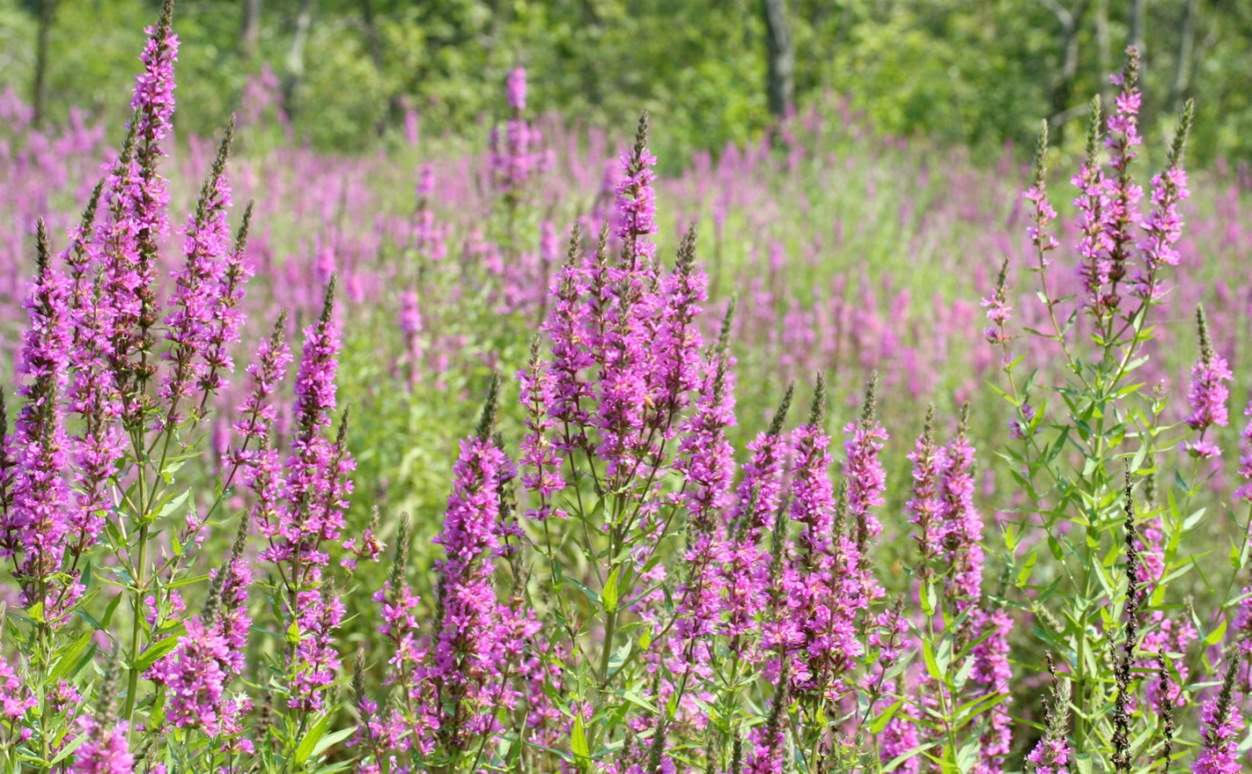
Plants
Graminoid
Broadleaf cattail (Typha latifolia) is a tall, thin grass with narrow leaves that mostly form on the bottom of the plant. The flowering stalks on top of the stem are dense ‘racemes’ that look like hot dogs. *Photo courtesy of the creative commons.
Common reed (*Phragmites australis) is a tall, thin grass that grows to be 12 to 18 feet tall. It grows in dense packs, and has fluffy flower heads that make it look like really tall wheat. *Photo courtesy of Steve Stanne.
Purple loosestrife (*Lythrum salicaria) has long, thin flowering heads comprised of many beautiful, purple, 5-petaled flowers. This plant has a tap root system which can support 30 - 50 stems. *Photo courtesy of Steve Stanne.

Slide 3
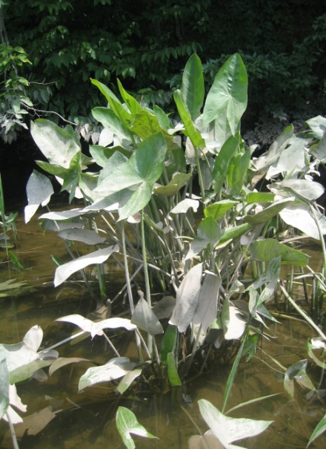
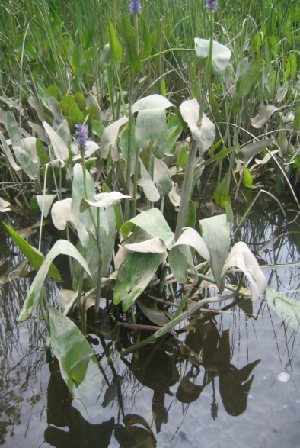
Broadleaf
Arrow arum (Peltandra virginica) has arrow-shaped leaf pads that sit atop a network of long stems. The leaves have pinnate venation, characterized by a central vein with lateral veins. *Photo courtesy of Steve Stanne.
Pickerelweed (Pontederia cordata) is a leafy plant, with a stem that terminates upward into a flowering purple head. The leaves have a bowed venation, characterized by curved veins. *Photo courtesy of Steve Stanne.

Slide 4
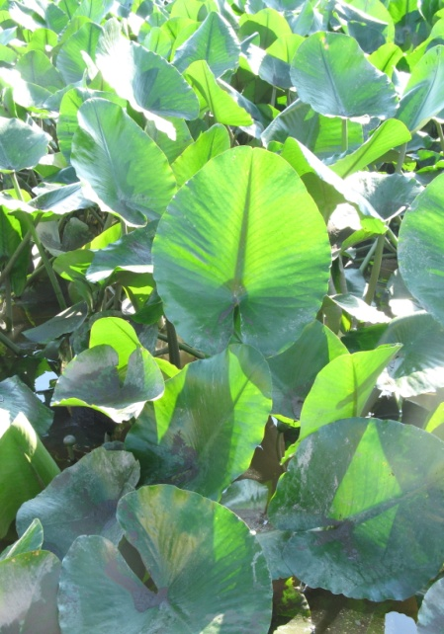
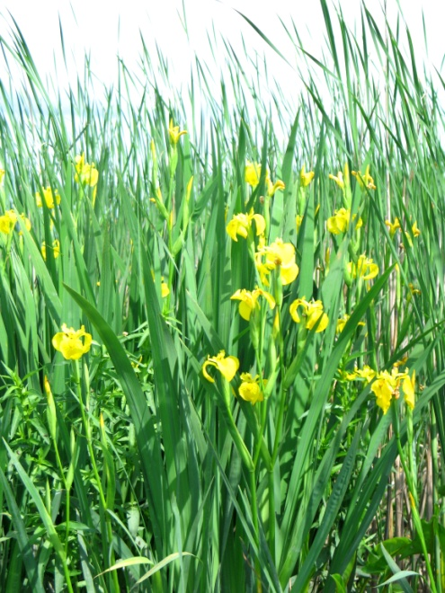
Spatterdock (Nuphar advena) has heart-shaped leaves that sit atop the waters’ surface, from which bloom yellow bulb-like flowers. The leaves have pinnate venation that dichotomously braches toward the tip.*Photo courtesy of Steve Stanne.
Yellow flag iris (*Iris pseudacorus) has bright yellow flowers with 3 small petals and 3 large, drooping petals. This non-native plant grows to be around 3 feet tall. *Photo courtesy of Steve Stanne.

Slide 5
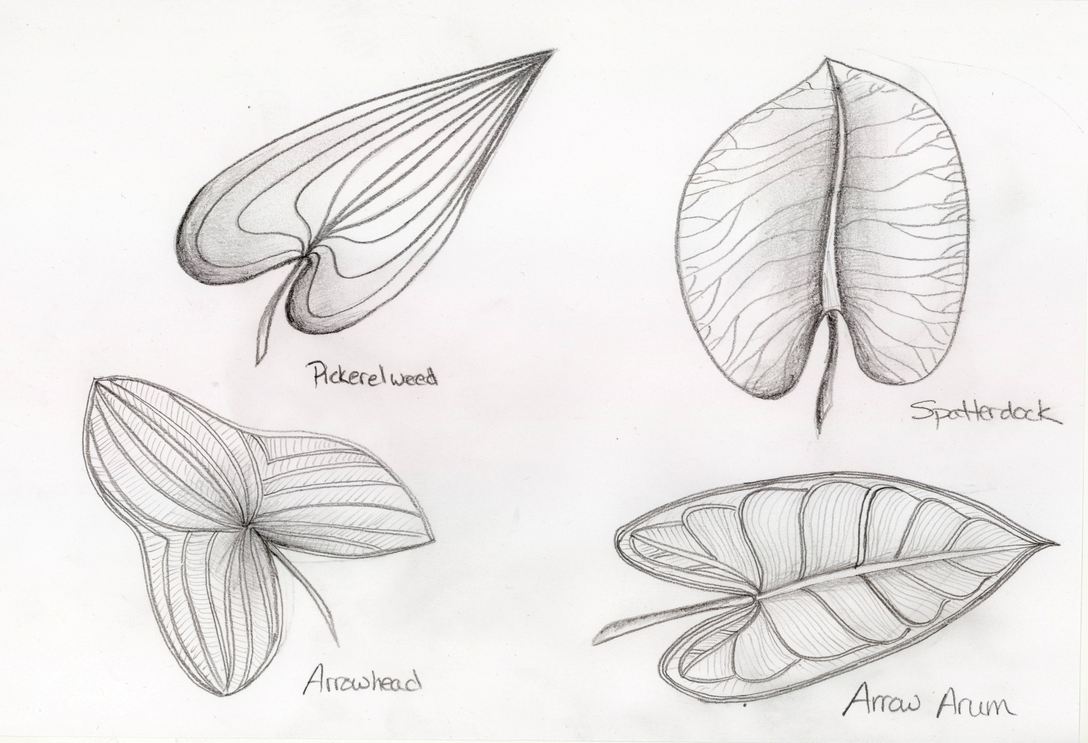
Comparison of broadleaf plants
Pickerelweed
Pickerelweed
Spatterdock
Arrowhead
Arrow arum
Drawings courtesy of C. Harris

Slide 6
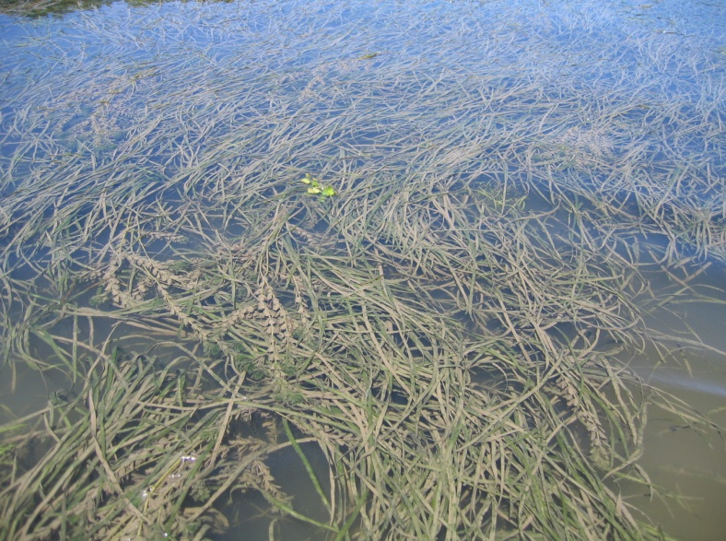
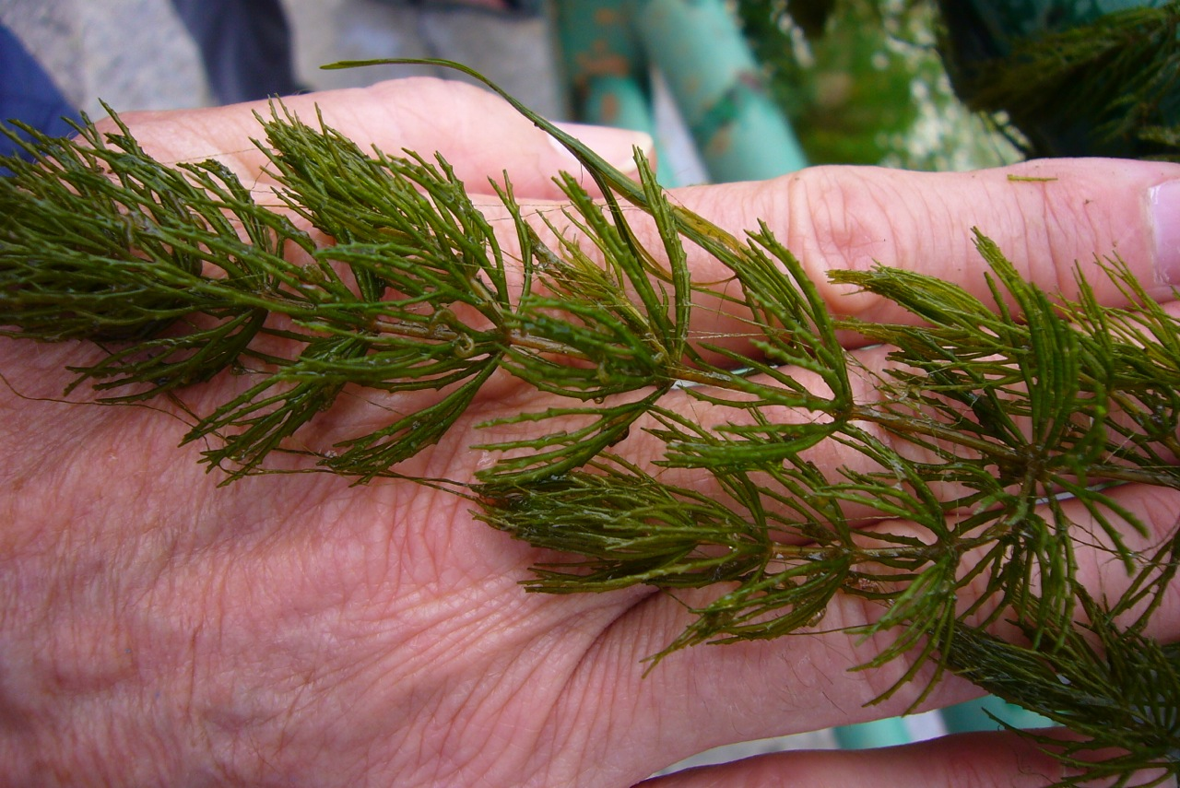
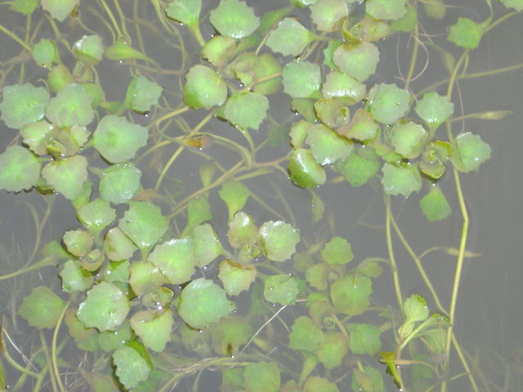
Submerged
Wild celery (Vallisneria americana) is a type of tape grass that is long and flat. The leaves of Wild celery sprout in clusters and can be several feet in length. The leaves also have a tip that is rounded in shape. *Photo courtesy of Steve Stanne.
Coontail (Ceratophyllum demersum) has long stems from which stem many shoots, which have multiple leaves per shoot. The leaves have a pine-needle appearance. *Photo courtesy of the creative commons.
Water-chestnut (*Trapa natans) has floating leaves attached to tough, rooted stems. The upper side of the leaves is waxy and shiny, while the underside is coated with fine hairs. *Photo courtesy of Steve Stanne.
Notes:
Photo credit??

Slide 7
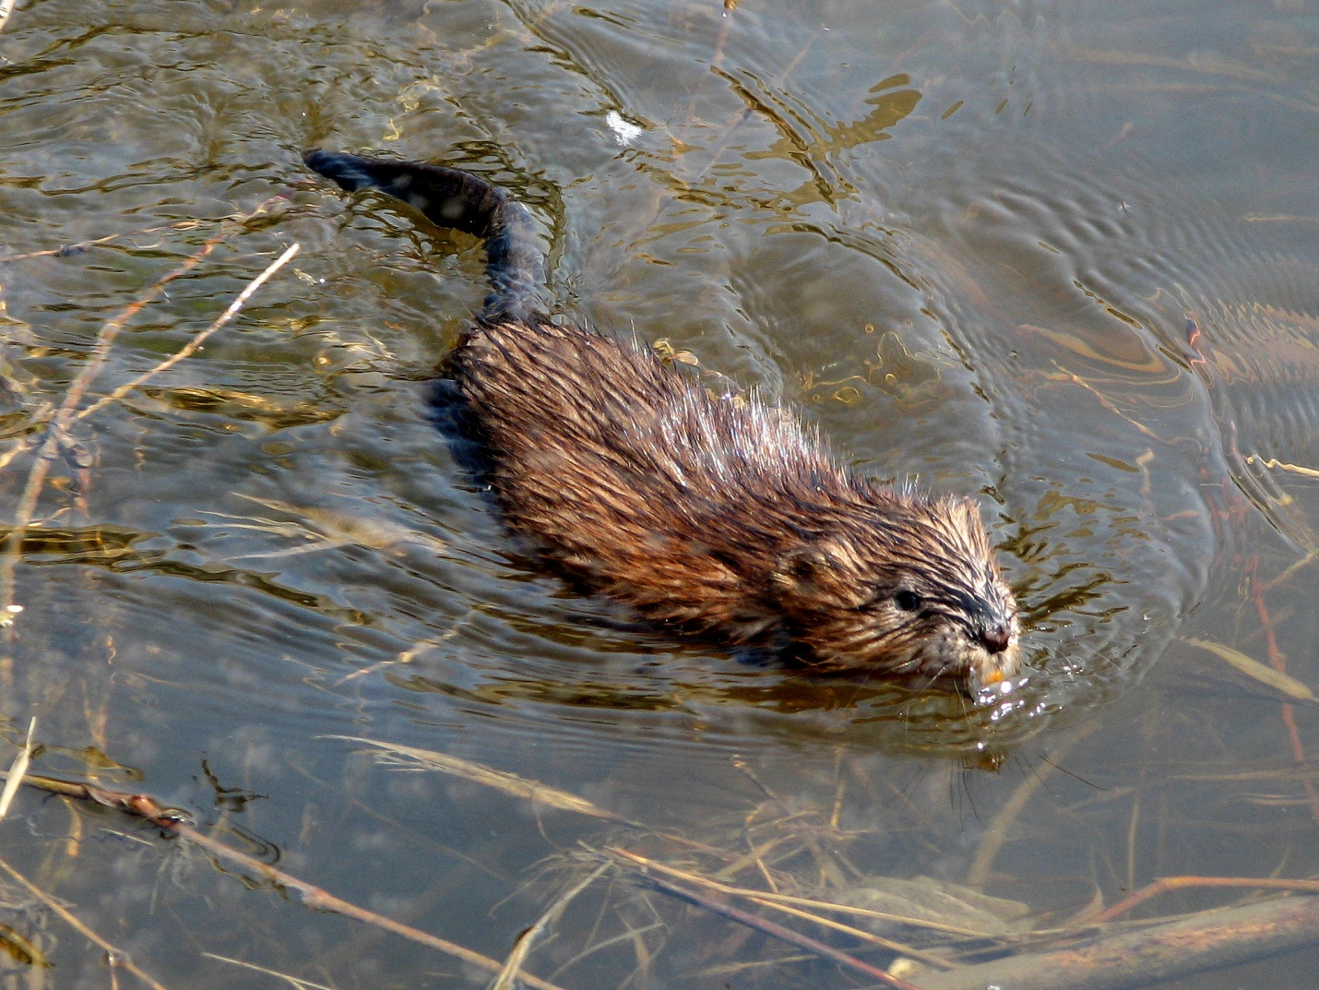
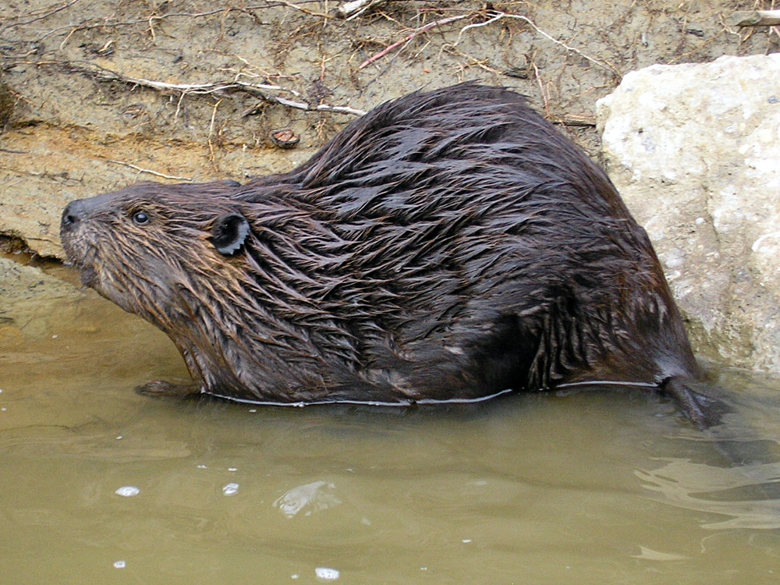
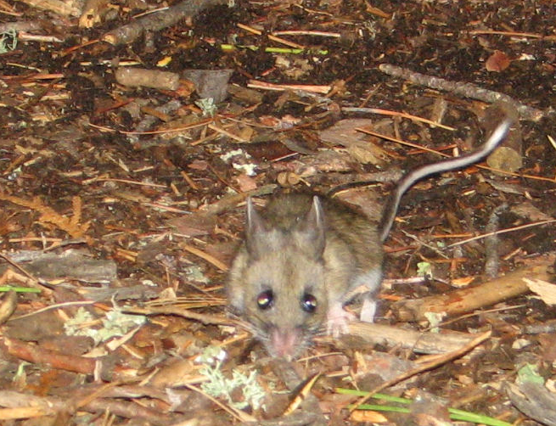
Animals
Mammals
Common muskrats (Ondatra zibethicus) have large heads, bodies that are a foot long, and tails that are flat, scaly and 10 inches long. They also have dense fur, short legs and large feet. *Photo courtesy of the creative commons.
Beavers (Castor canadensis) are nocturnal, semi-aquatic rodents known for making dams. Beavers have large heads, bodies, and tails. They also have large, very sharp teeth which they use to eat tree bark. *Photo courtesy of the creative commons.
White-footed mice (Peromyscus leucopus) have medium-sized bodies that average 7 inches long from nose to tail. They weigh on average 23 grams. White footed mice also have short tails and white colored hair on their feet. *Photo courtesy of the creative commons.
Notes:
Picture credits? Cary definitely has a better white-footed mouse pic.

Slide 8
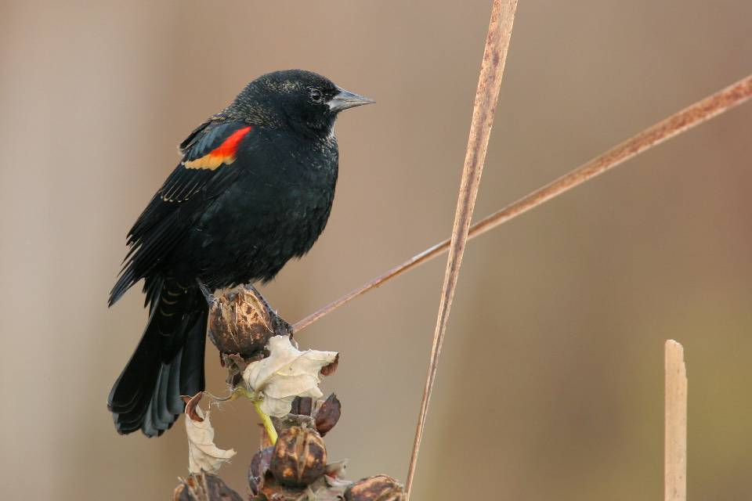
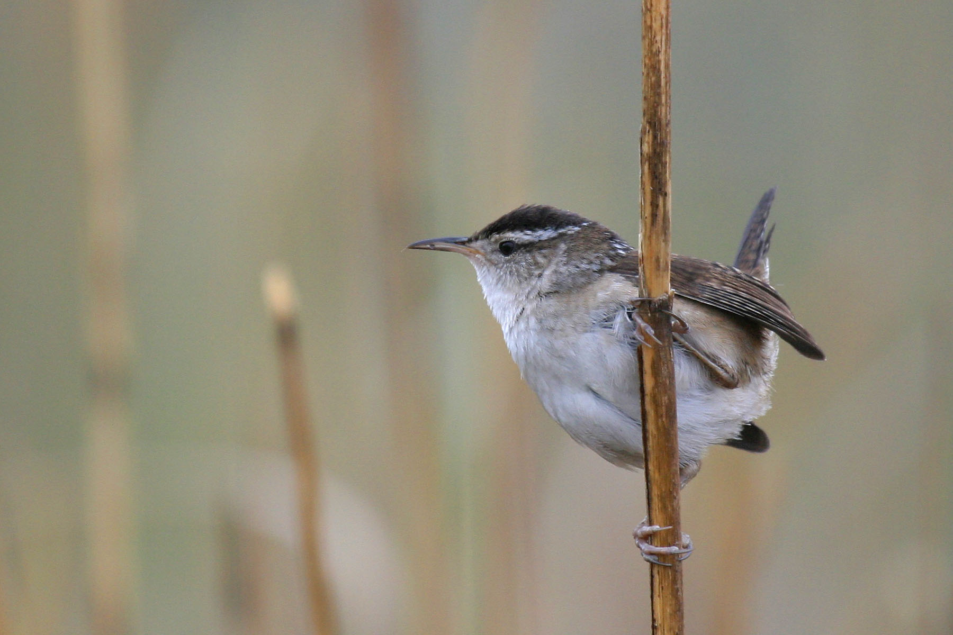
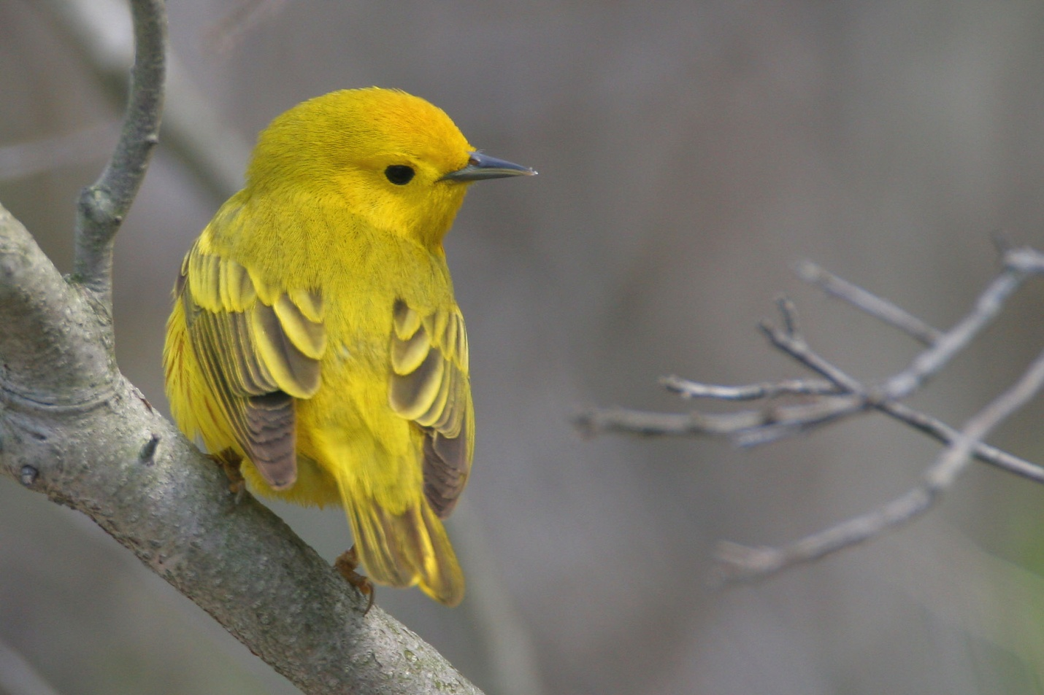
Birds
Red-winged blackbirds (Agelaius phoeniceus) have thick bodies, cone-shaped bills, and a medium-sized tail. They have glossy black feathers, with red and yellow shoulder patches. *Photo courtesy of Alan Wells.
Marsh wrens (Cistothorus palustris) have small bodies and a thin bill. They have brown feathers on their back, whitish bellies, a dark “cap” with a matching ‘eyeline,’ and whitish ‘eyebrow’. *Photo courtesy of Alan Wells.
Yellow Warbler (Setophaga petechia) is a small songbird species with bright yellow feathers, a round head and a thin, black bill. *Photo courtesy of Alan Wells.

Slide 9
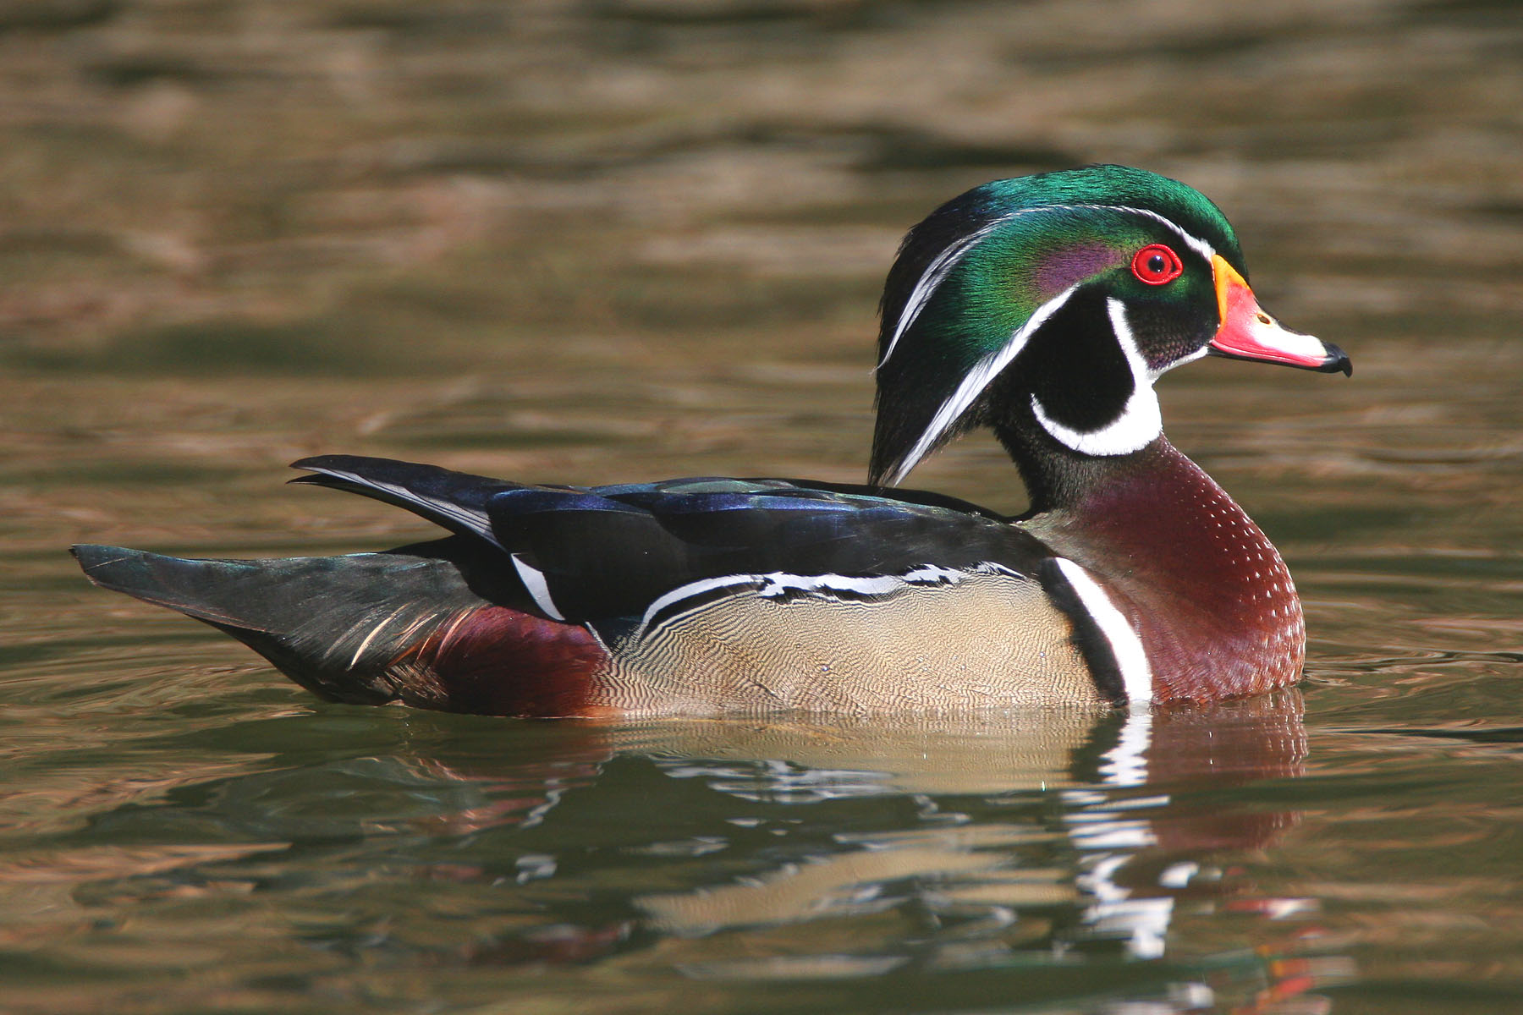
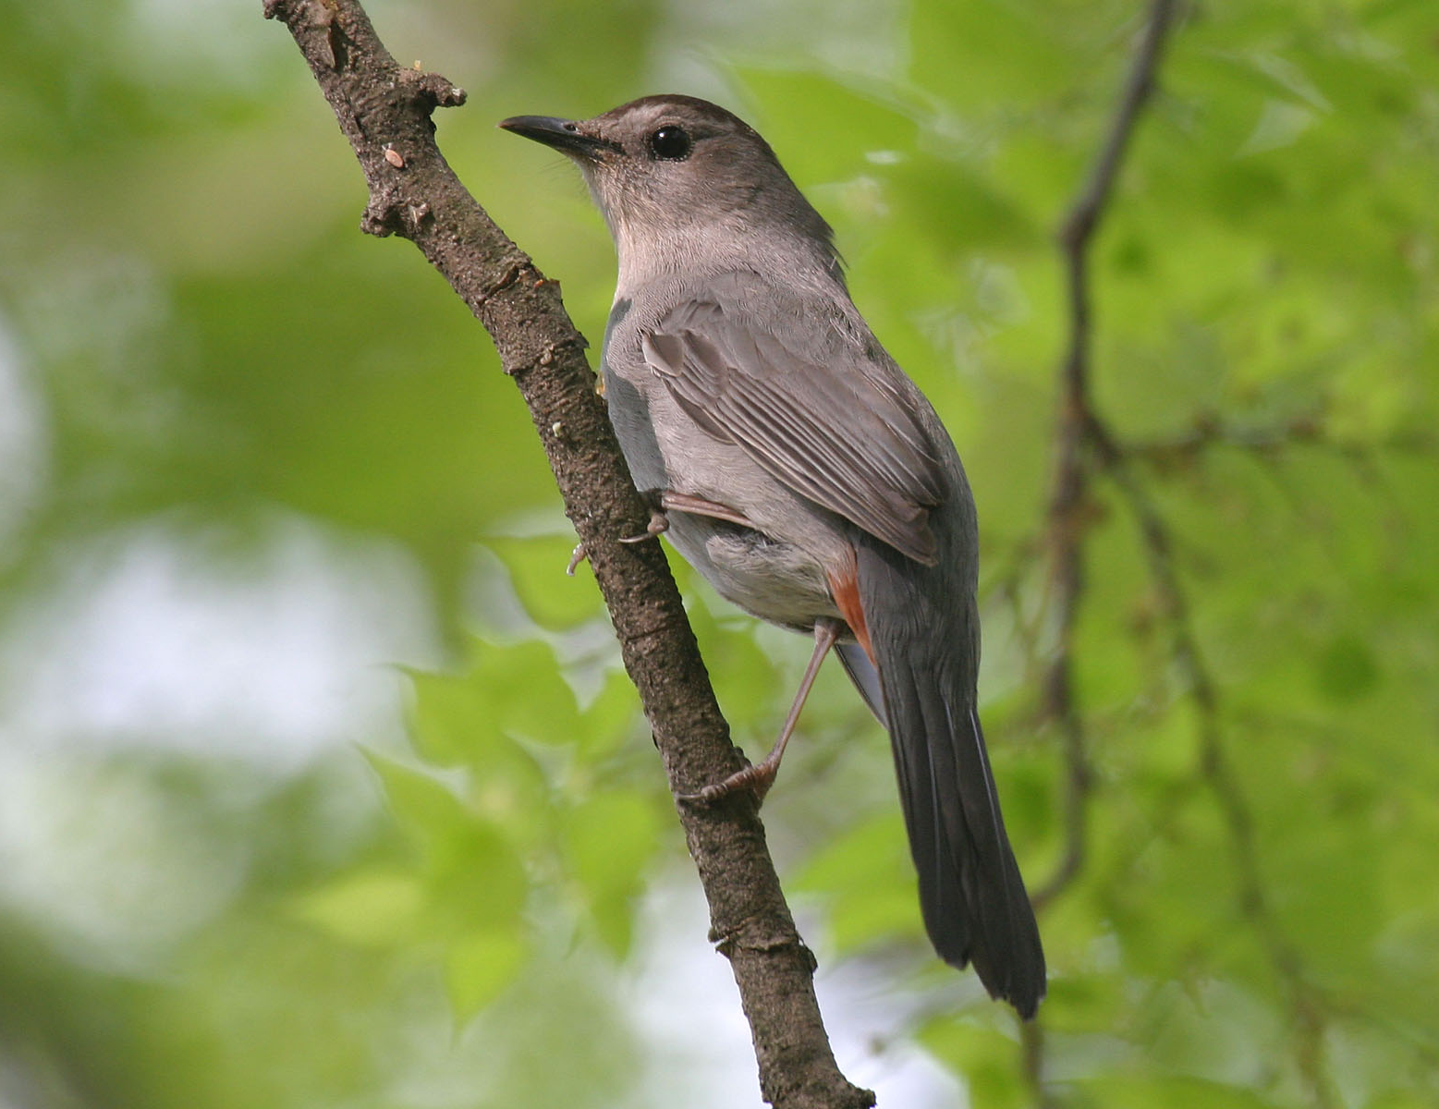
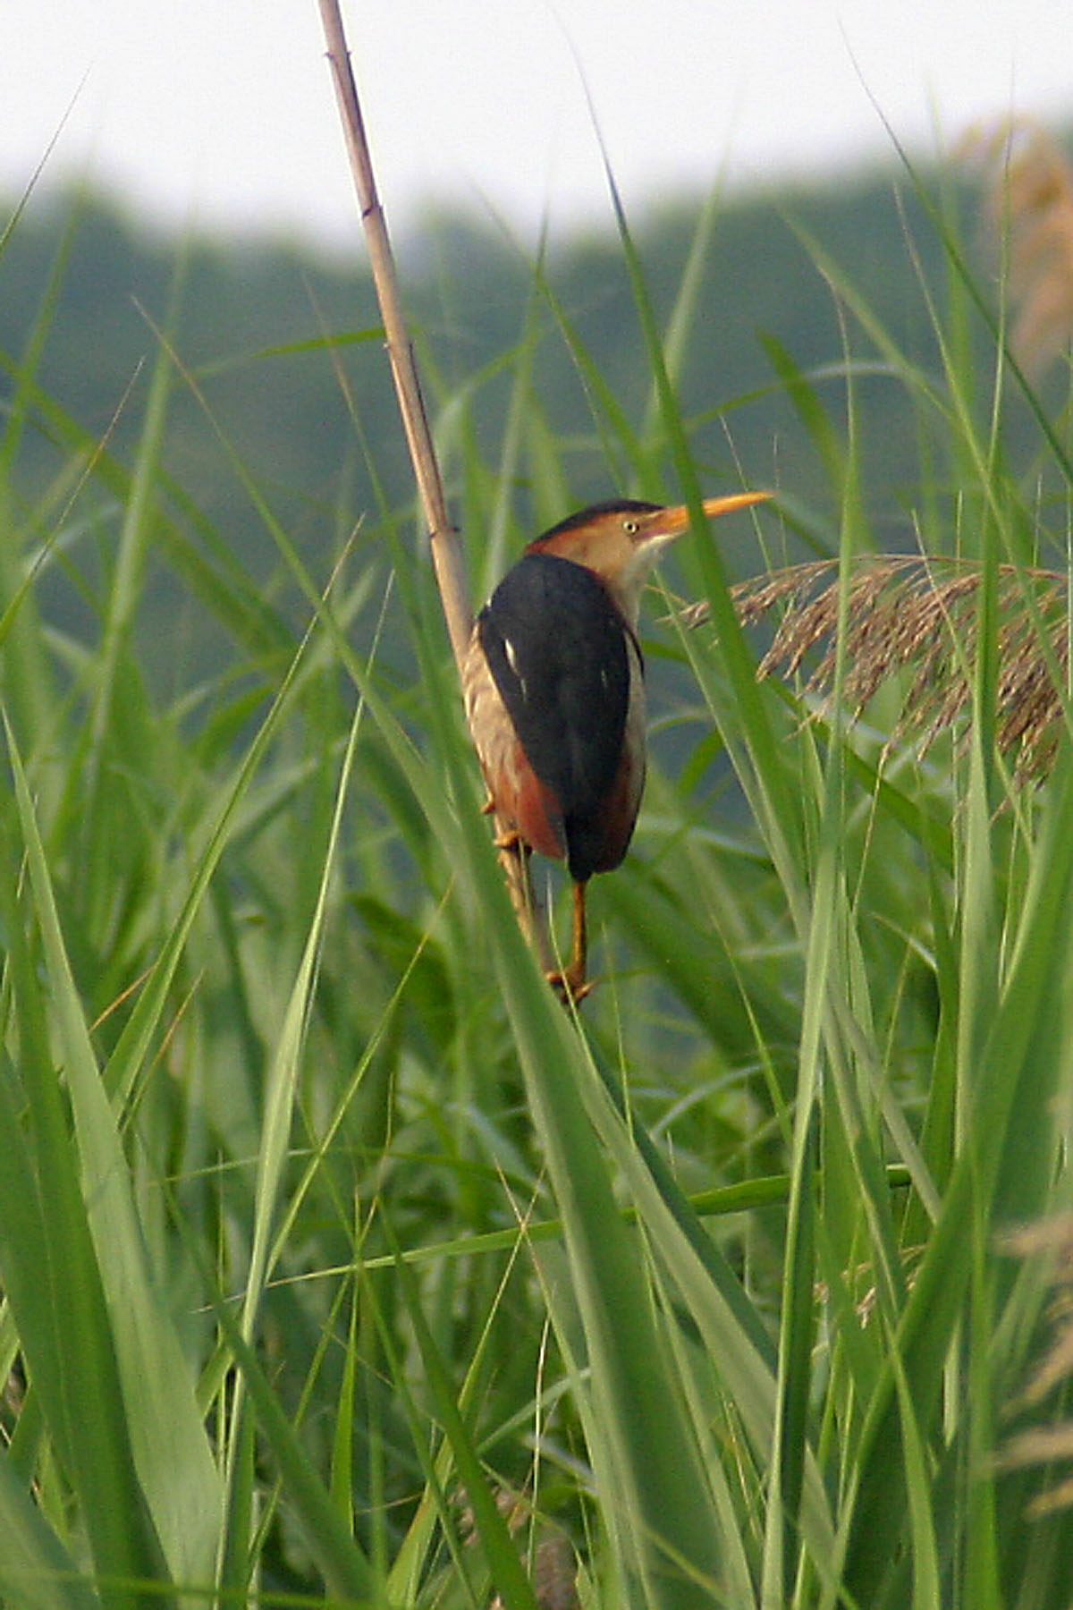
Wood duck (Aix sponsa) are medium-sized, colorful birds with a feathered head crest. Wood duck have a rectangular-shaped tails, white colored stomachs and white stripes on the wings. Males are much more brightly colored than females. *Photo courtesy of Alan Wells.
Gray Catbird (Dumetella carolinensis) is a medium-sized bird with a dark gray body, black cap on its head, and a dark tail with a reddish patch beneath (its ‘undertail coverts’). *Photo courtesy of Alan Wells.
Least Bittern (Ixobrychus exilis) has a long neck and bill. It has black feathers on the back, and orange feathers on the neck. *Photo courtesy of Alan Wells.

Slide 10
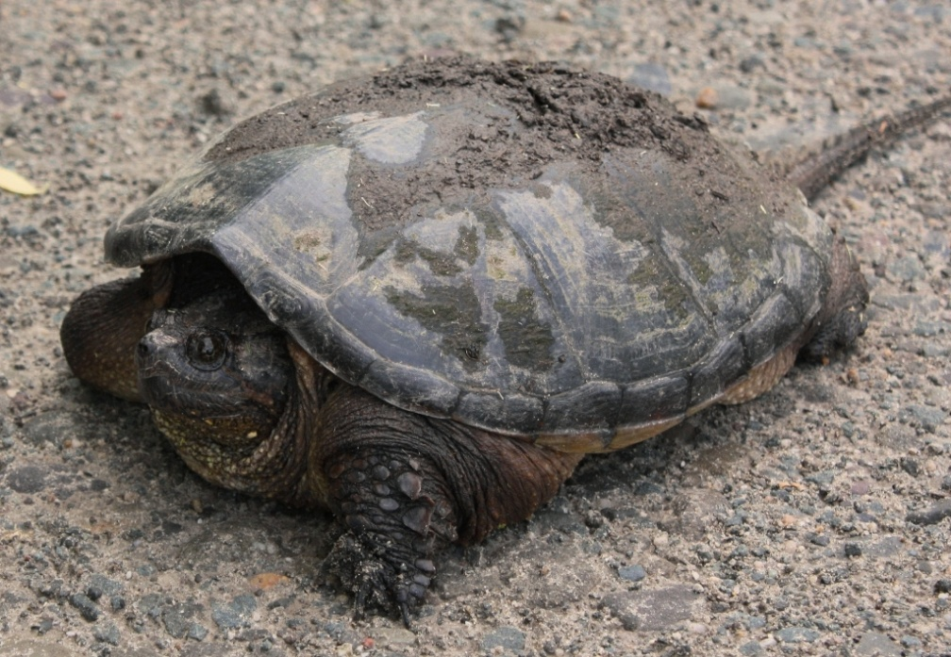
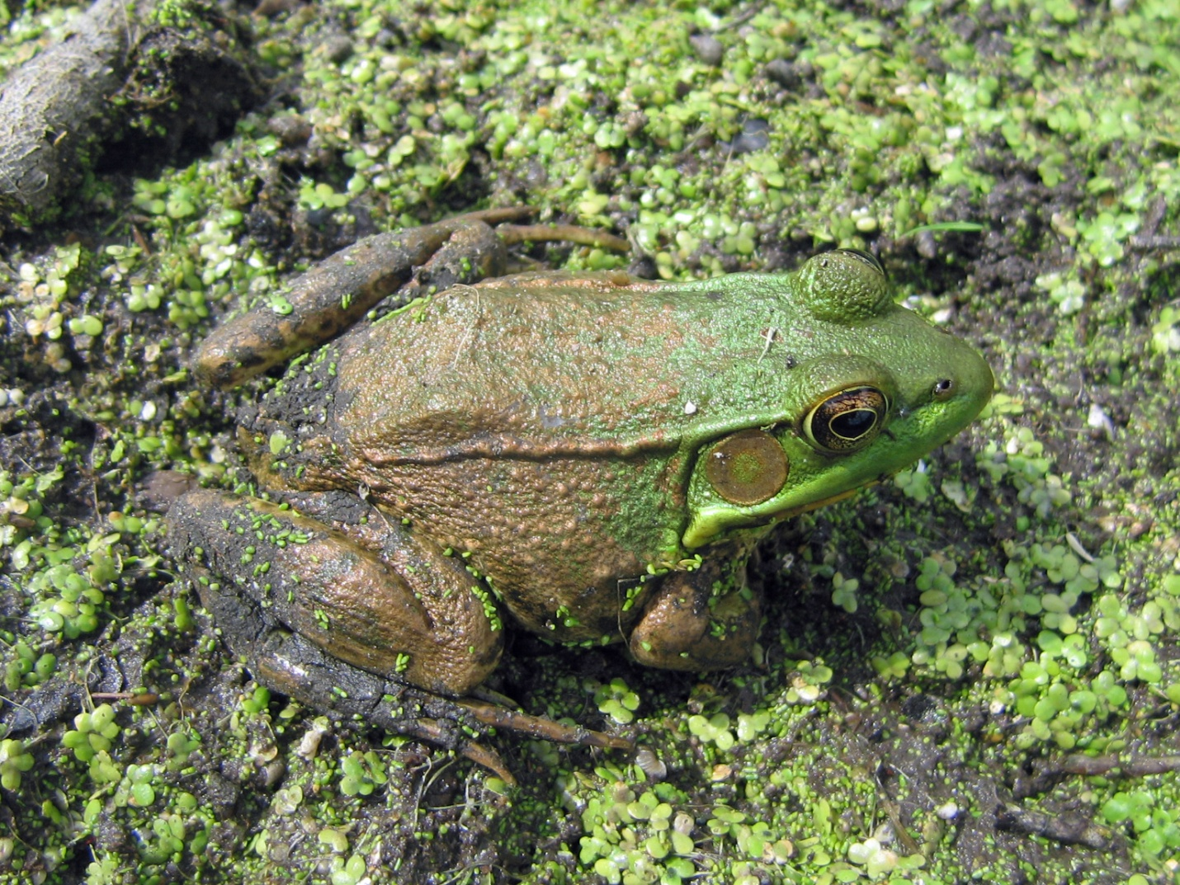
Reptiles & Amphibians
Snapping turtle (Chelydra serpentina) is the most common turtle species found in New York State. An adult Snapping turtle can grow to be very large, having an average weight of around 20 pounds and an average length of around 13 inches. Snapping turtles are named after their large, powerful snapping jaw. *Photo courtesy of Steve Stanne.
Green frog (Rana clamitans) are on average 4 inches in length and have a greenish-brown head and neck area. The head and neck area of the Green frog are much more colorful than the rear part of the animal, which is usually dull and spotted. *Photo courtesy of the creative commons.

Slide 11
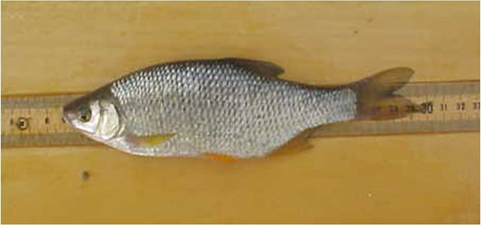
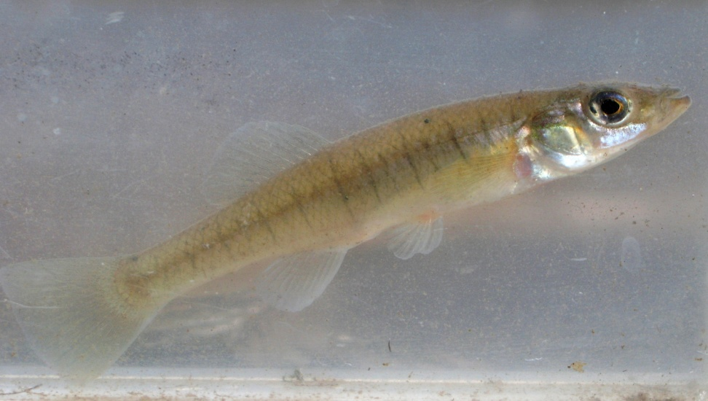
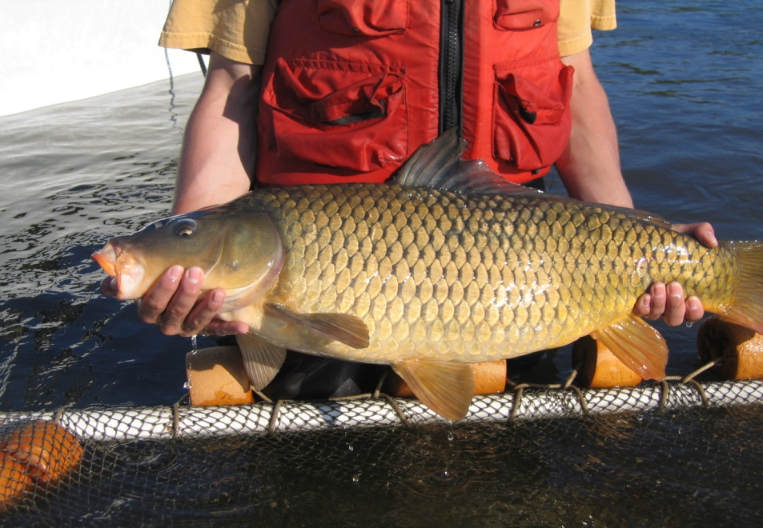
Fish
Golden shiner (Notemigonus crysoleukas) have silvery scales with an olive-colored back and yellowish fins. *Photo courtesy of Steve Stanne.
Banded killifish (Fundulus diaphanus) are thin, with square-shaped tails, and have characteristic vertical dark bands running the length of the body. *Photo courtesy of Steve Stanne.
Common Carp (Cyprinus carpio) are 1-2 ft long and weigh 1 - 9 lbs. They are characterized by their deep body and serrated dorsal spine, and have large scales of varying colors. *Photo courtesy of Steve Stanne.
Notes:
Common carp length and weight -- from Tomelleri and Eberle 1990; Body characteristics -- Nelson 1984.

Slide 12
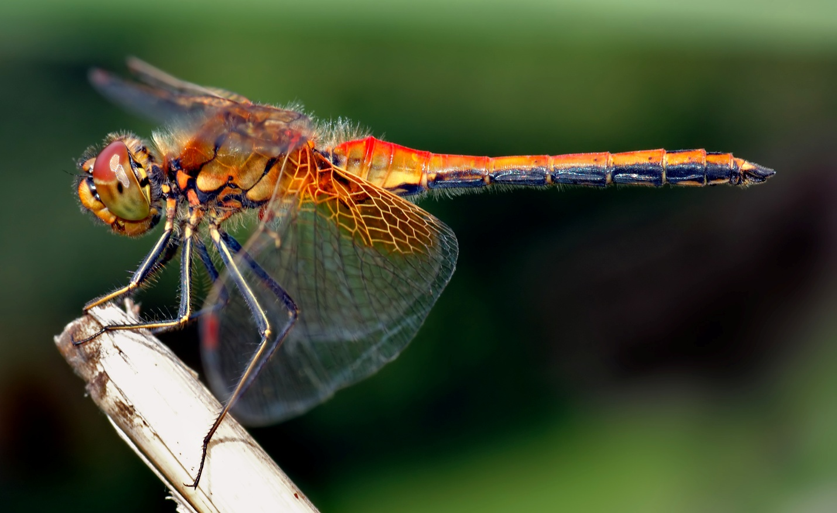
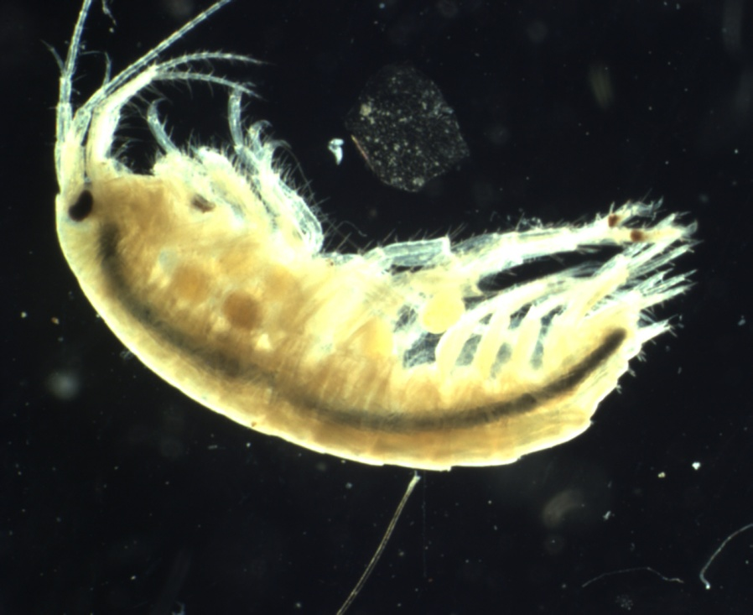
Invertebrates
Dragonflies (Anisoptera) hold their wings horizontally when landed. Adult dragonflies catch prey in flight. There are many different species of dragonfly, each with subtle physical differences. Look closely at their color patterns to help you distinguish among them. *Photo courtesy of the creative commons.
Amphipods (Amphipoda) can grow to be ¾ inches long. They can stretch out or bunch up. Amphipods do not have the hard covering of the thorax that is common in other crustacea. They have seven leg appendages, and two antennae. There are many different species of amphipods, each with subtle physical differences. *Photo courtesy of Steve Stanne.

