Slide 1
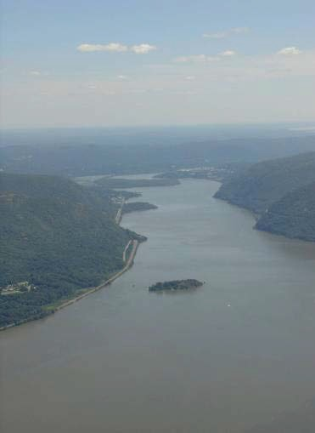
Journey down the Hudson River
Kara Goodwi

Slide 2
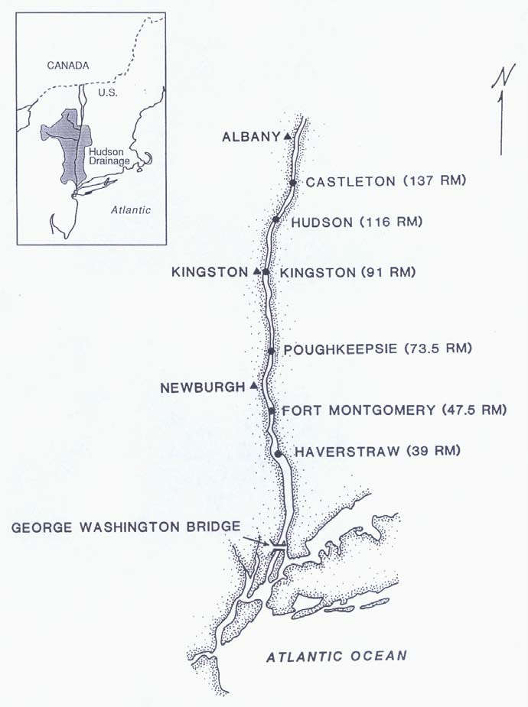
How long is the Hudson River?
Begins at Lake Tear of the Clouds in the Adirondacks
Travels ~ 300 miles (480 km ) to the Atlantic Ocean.
It’s watershed drains much of NY, and parts of CT, VT, MA, & NY.

Slide 3
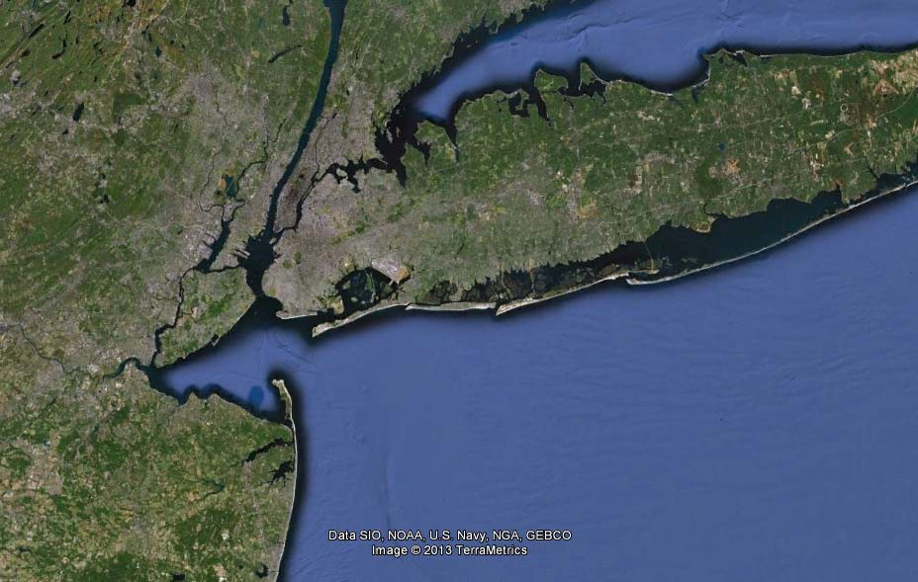
Why is the Hudson an estuary?
Hudson River
Atlantic Ocean

Slide 4
Why is the Hudson an estuary?
Hudson River
Atlantic Ocean
Notes:
Presenter
2013-06-25 11:18:17
--------------------------------------------
An estuary is the word we use to describe the place where salt water meets fresh. The freshwater of the Hudson empties into the salty Atlantic Ocean. Due to the topography of the region and tidal action, the estuarine portion of the river is not limited to the lowest reaches of the river. All of the lower Hudson is considered to be estuarine, with the ‘salt front’ (the leading edge of ocean water entering the estuary) reaching to Beacon or even Poughkeepsie in late summer of dry years.

Slide 5
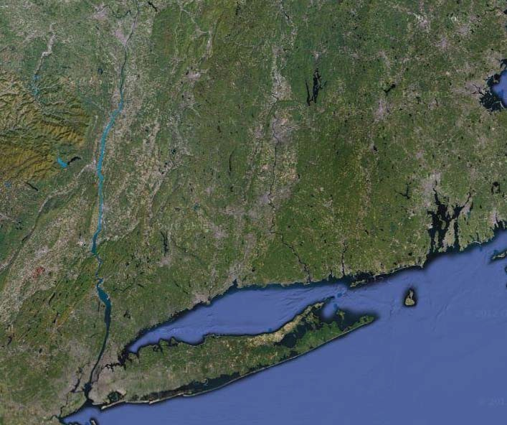
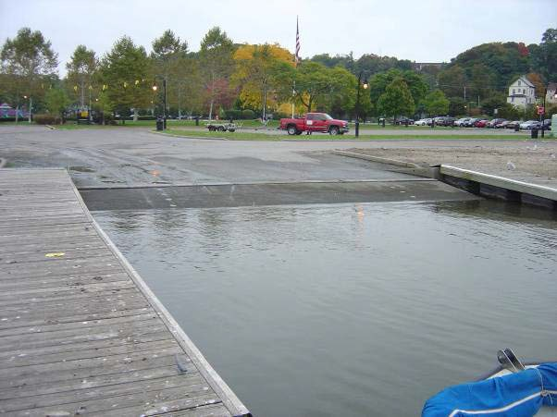
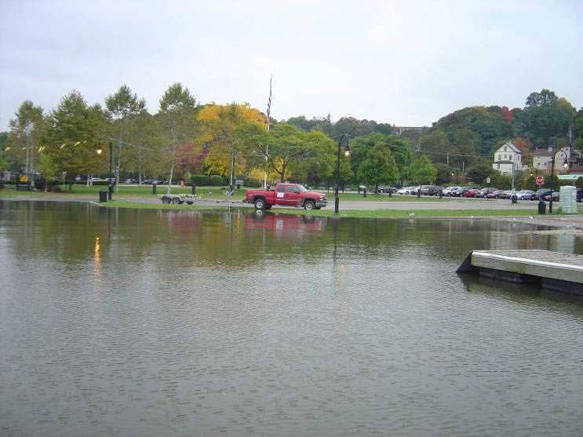
The Hudson River estuary is tidal
Troy
Low tide (Peekskill)
Peekskill
High tide
Notes:
Presenter
2013-06-25 11:18:17
--------------------------------------------
The Hudson is tidal all the way up to the Troy dam. Images: Map (Google Satellite); Peekskill tides (Cary Institute).

Slide 6
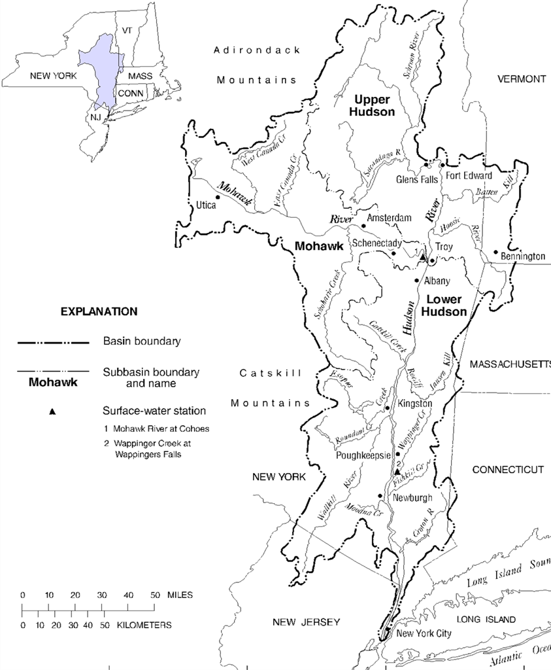
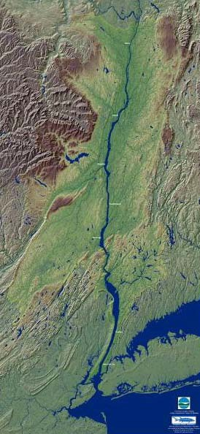
Where do you live in relation to the Hudson?
Notes:
Presenter
2013-06-25 11:18:18
--------------------------------------------
You will often hear people talking about different parts of the River: the upper Hudson, which runs from Mt. Marcy to Troy, the Mohawk, which runs from Rome to Troy, and the lower Hudson, from Troy to New York Bay. These refer to the three main sub-basins of the Hudson River watershed. Ask: In which sub-basin do we live? Or, if you do no live within the watershed, which sub-basin is closest? Have a student point out your location on the inset river map, the watershed map, and the NY State map.
Image from USGS.

Slide 7
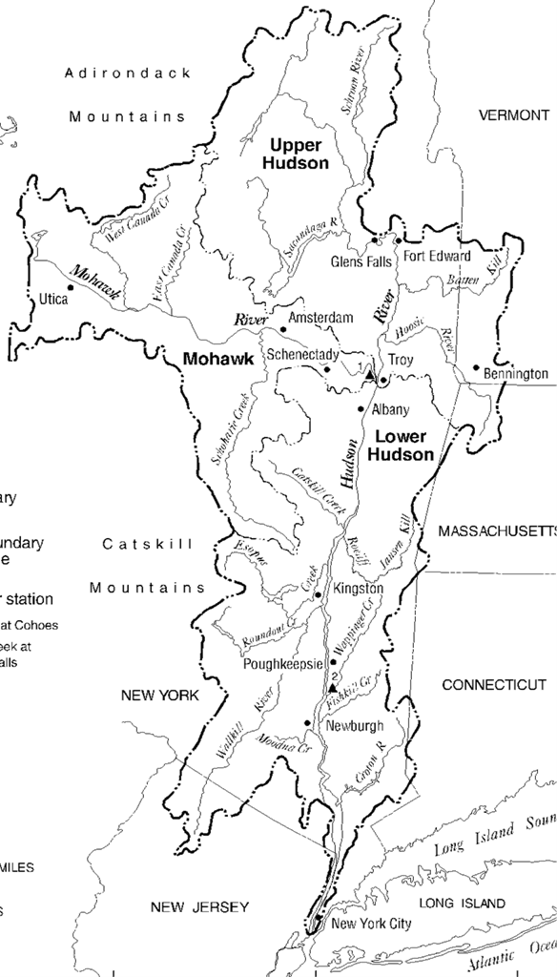
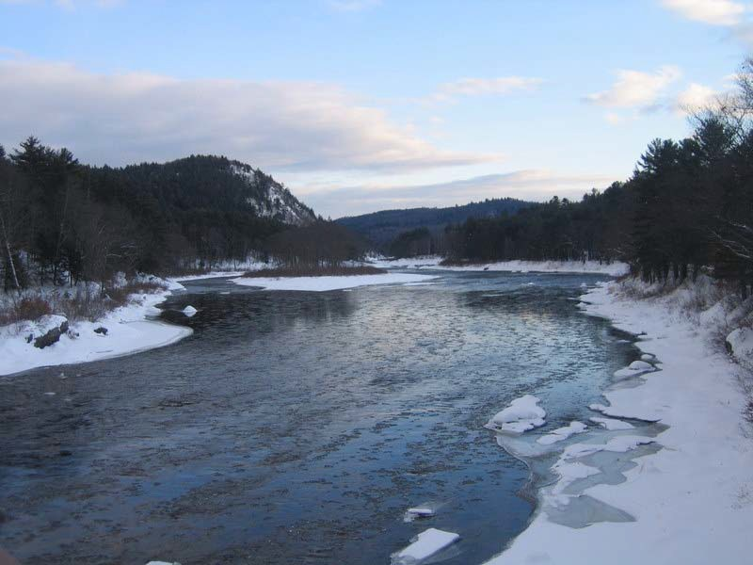
How does the Hudson change along its length?
Adirondacks
Notes:
Presenter
2013-06-25 11:18:18
--------------------------------------------
In the Adirondacks, the river is surrounded by forest and metamorphic rocks, making the water clear and cold.

Slide 8

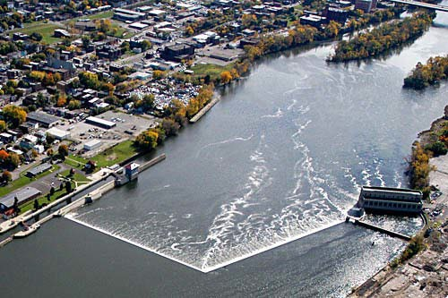
How does the Hudson change along its length?
Adirondacks
Troy Dam
Notes:
Presenter
2013-06-25 11:18:19
--------------------------------------------
The Federal Dam at Troy halts the tidal action of the river. The ‘estuary’ starts here and continues to the harbor in New York City.

Slide 9
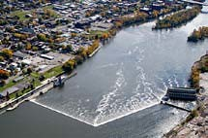
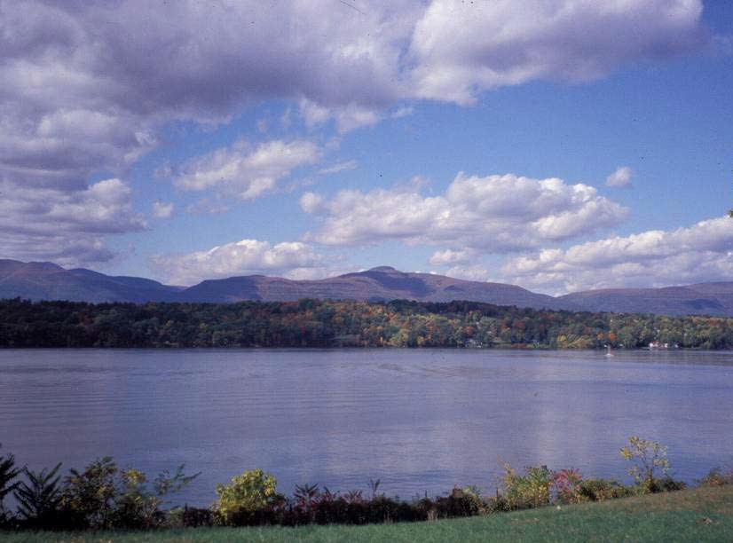
How does the Hudson change along its length?
Adirondacks
Troy Dam
Lower Hudson
Notes:
Presenter
2013-06-25 11:18:19
--------------------------------------------
As you move into the lowlands, the river becomes wider and deeper.

Slide 10
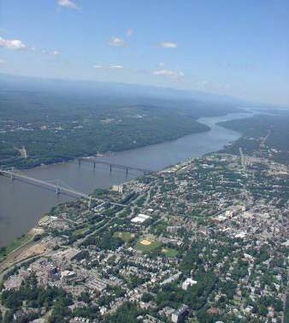

How does the Hudson change along its length?
Adirondacks
Troy Dam
Lower Hudson
Kara Goodwin
Notes:
Presenter
2013-06-25 11:18:20
--------------------------------------------
And as it continues further south, the surroundings become more developed…

Slide 11
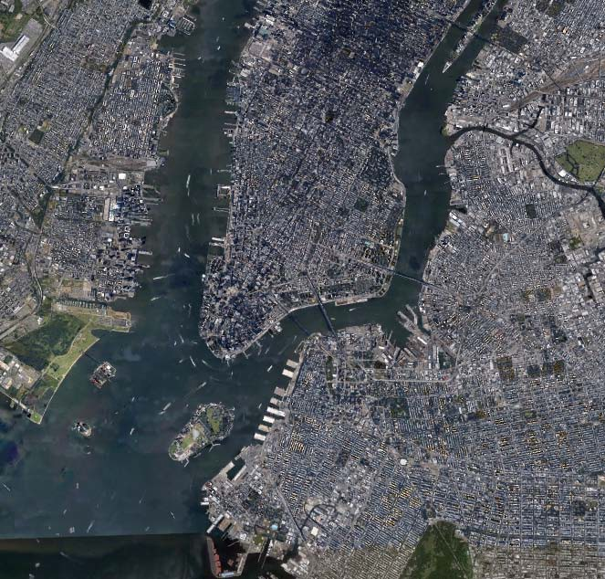
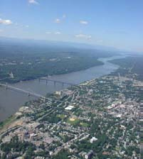
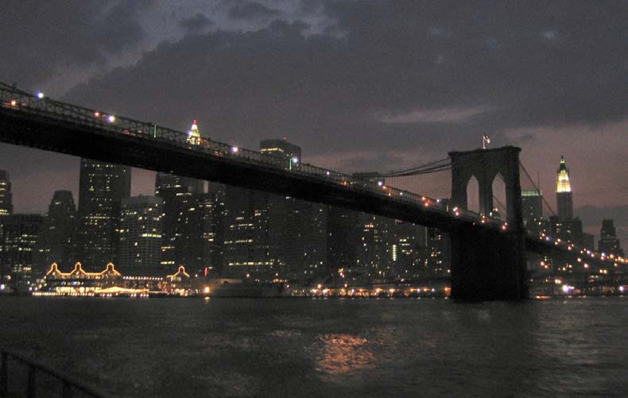
How does the Hudson change along its length?
Adirondacks
Troy Dam
Lower Hudson
Manhattan
Notes:
Presenter
2013-06-25 11:18:21
--------------------------------------------
…until the river reaches its most urban portion and its last stop – the Atlantic Ocean.

Slide 12
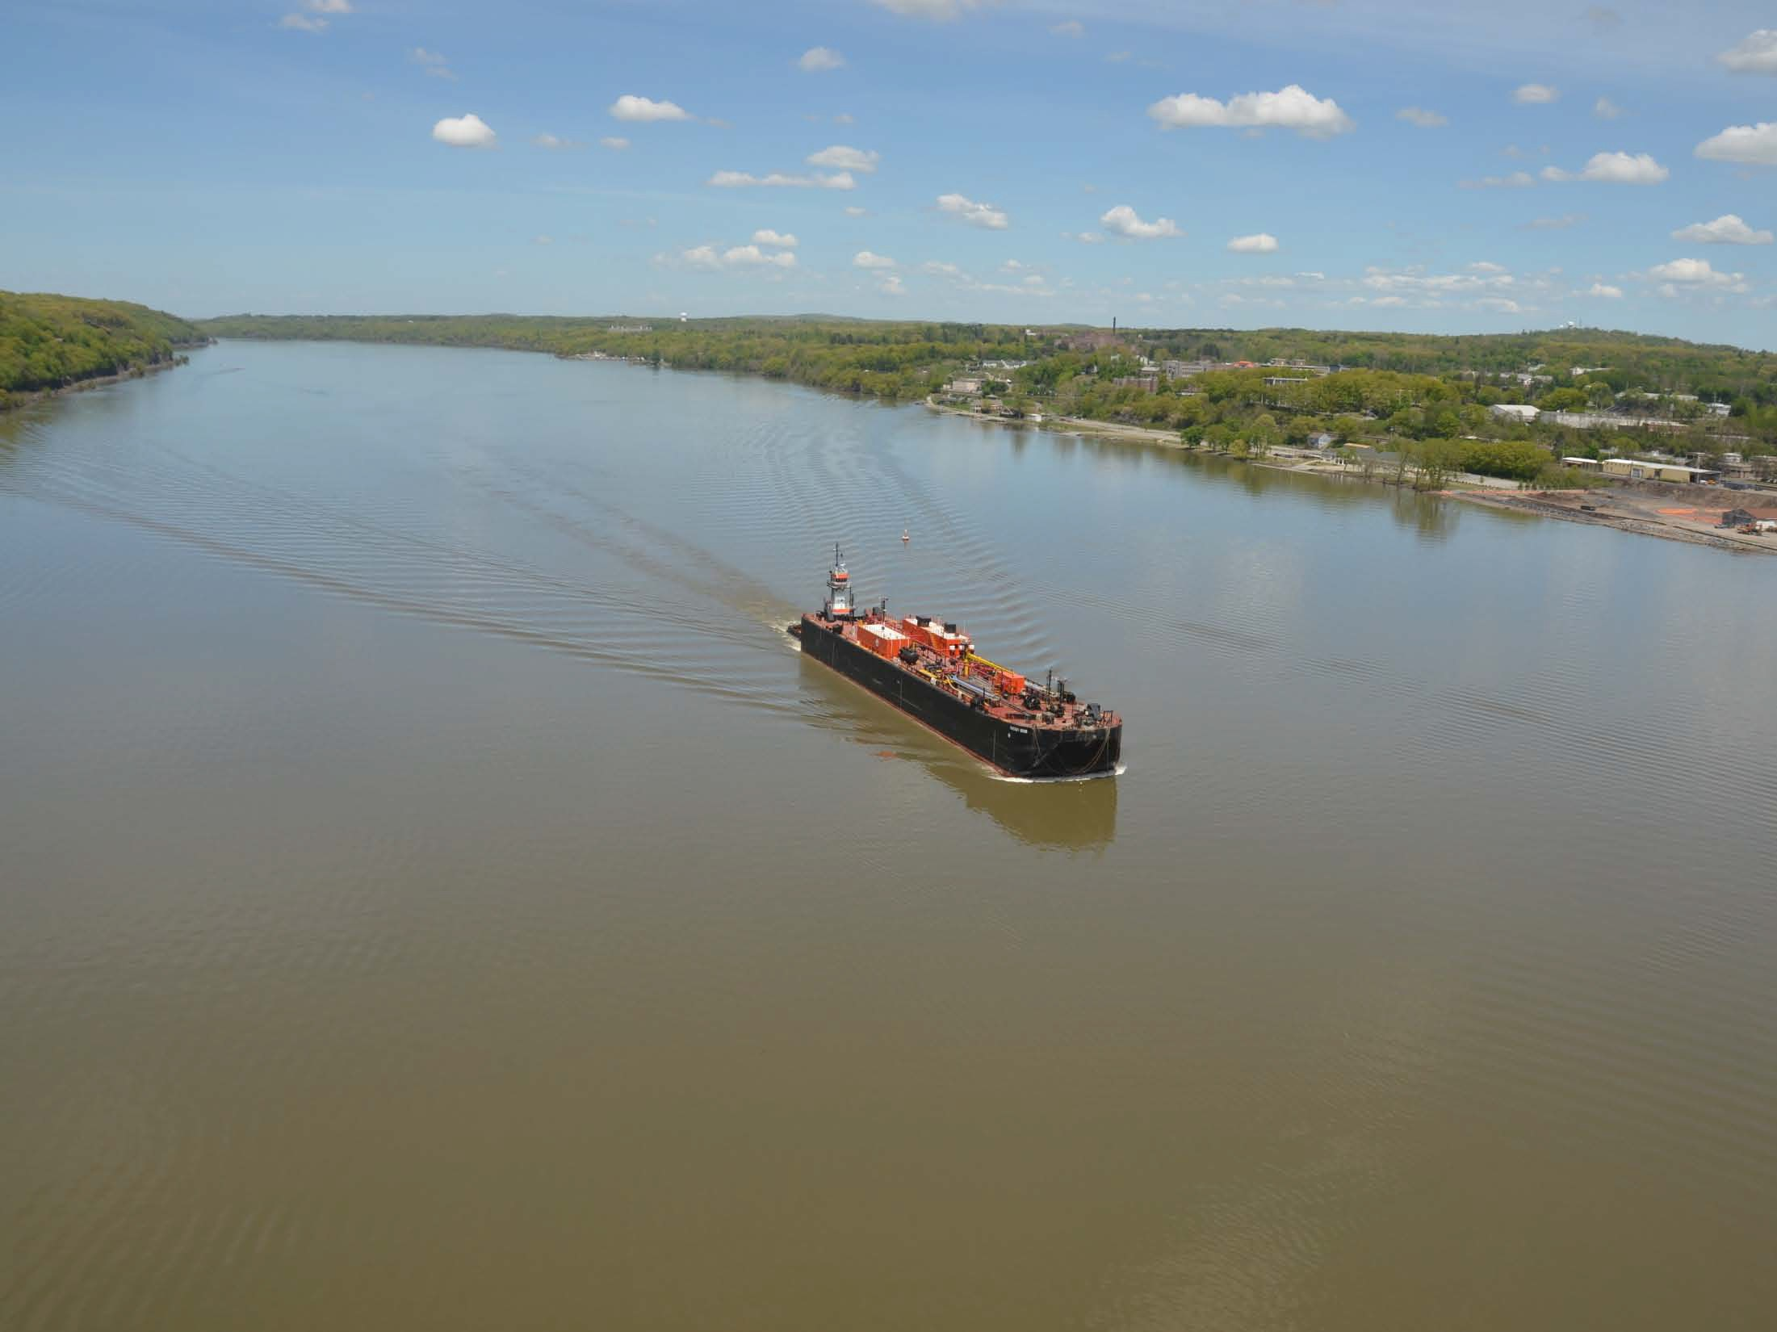
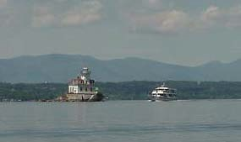
You can find boats, lighthouses, and barges all along the river.
Photo by Jeff Anzevino
Notes:
Presenter
2013-06-25 11:18:21
--------------------------------------------
Background image used with permission from Jeff Anzevino. Inset boat/lighthouse used with permission from Cornelia Harris.

Slide 13
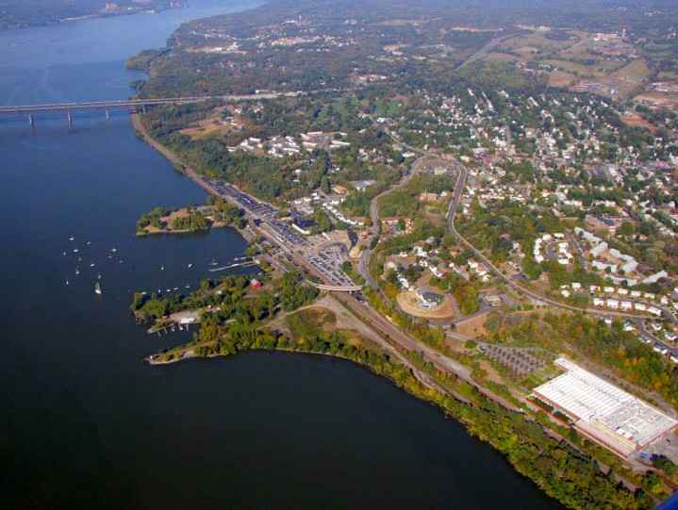
Hudson River communities use the river for many different things
Travel
Business
Recreation
Food
Scenic views
Photo by Jeff Anzevino
Clean Water
Wildlife habitat
Notes:
Presenter
2013-06-25 11:18:22
--------------------------------------------
Image owned by and used with permission from Scenic Hudson.

Slide 14
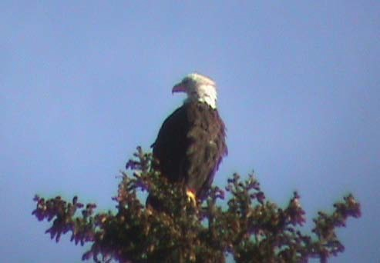
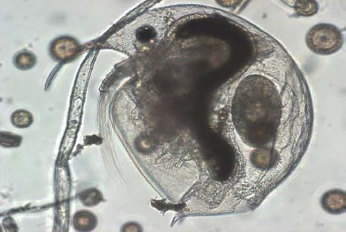
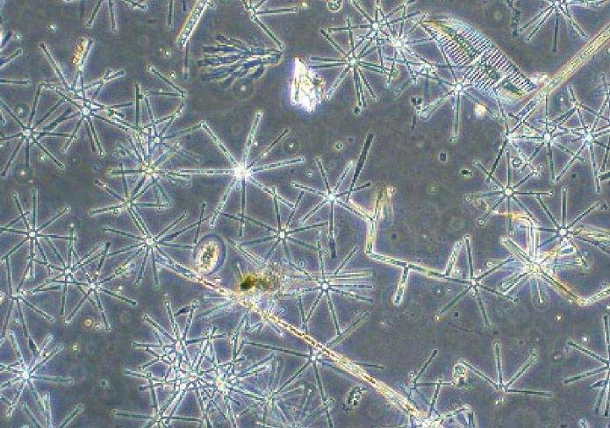
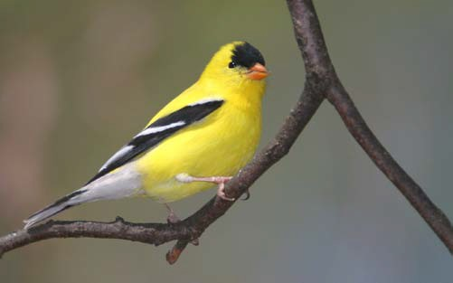
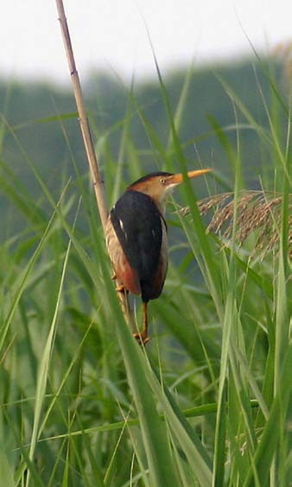
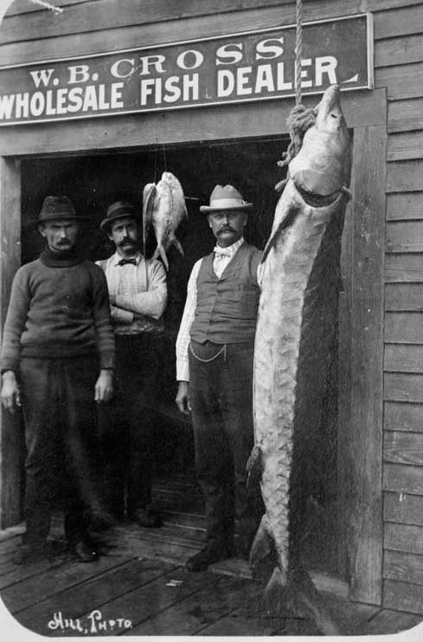
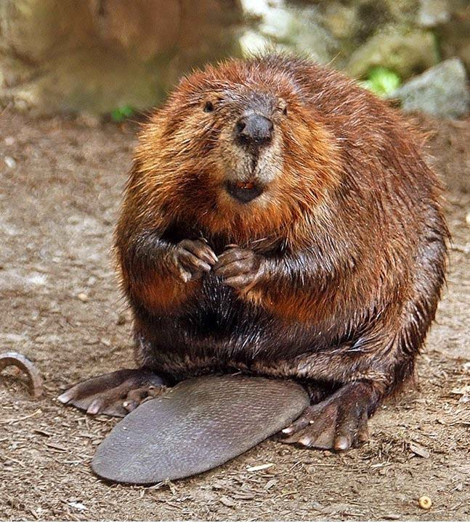
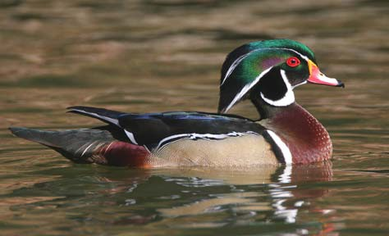
Many animals, large and small, live in & along the Hudson
Bald eagle Phytoplankton
Bosmina
Least Bittern
American Goldfinch
Beaver
Wood duck (male)
Atlantic sturgeon
Photo by Steve Hersey
Notes:
Presenter
2013-06-25 11:18:23
--------------------------------------------
Image credits: Bald eagle (Cornelia Harris); American goldfinch, wood duck, least bittern (Alan W. Wells); Bosmina, phytoplankton (Stuart Findlay); Beaver (Steve Hersey, Flickr CC); Atlantic sturgeon (unknown; public domain)

Slide 15
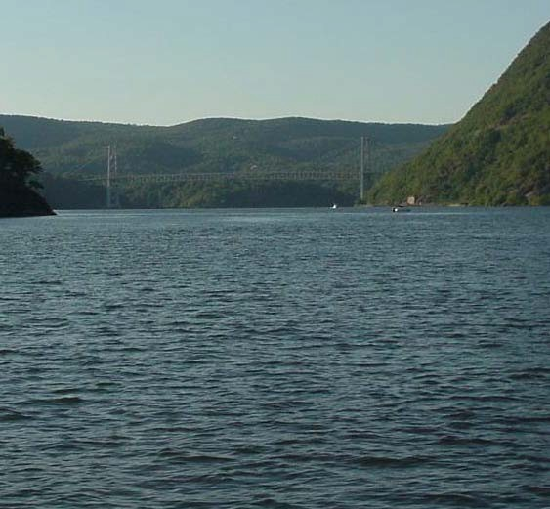
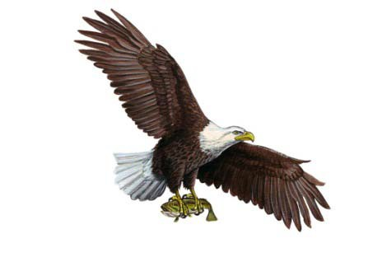
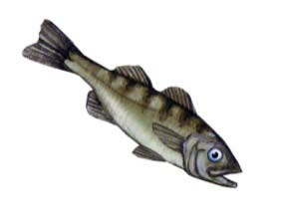
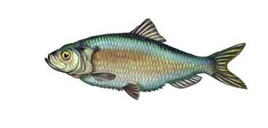
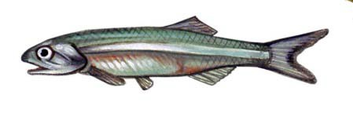
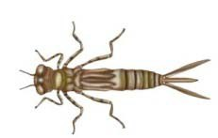
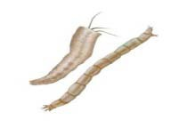
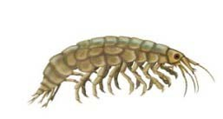
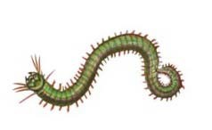
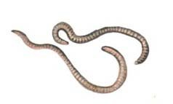
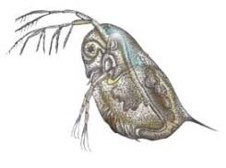
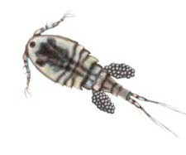
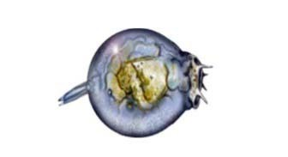

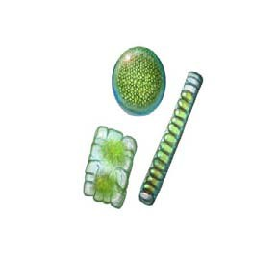
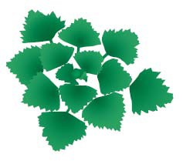
Example Hudson River food pyramid
3° consumer
2 ° consumer
1 ° consumer
Producers
Notes:
Presenter
2013-06-25 11:18:23
--------------------------------------------
Remind students that the real world works as a food web, but a pyramid can be a helpful when beginning to think about what eats what and why. Images from Cary Institute (Background, invertebrates & producers) & the NYSDEC (vertebrates).

Slide 16

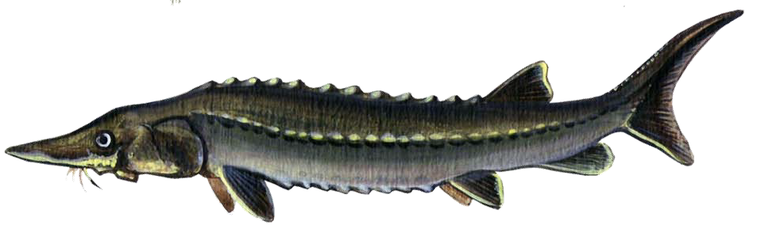
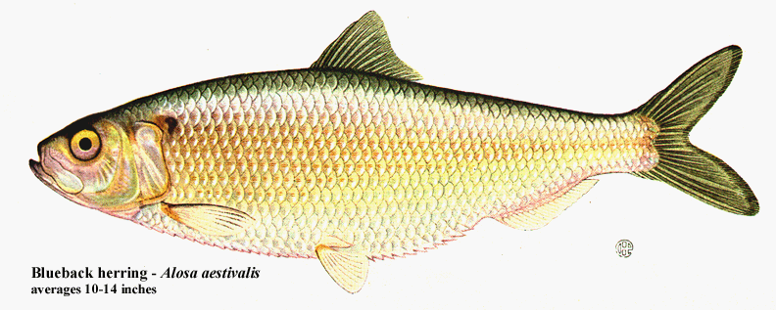
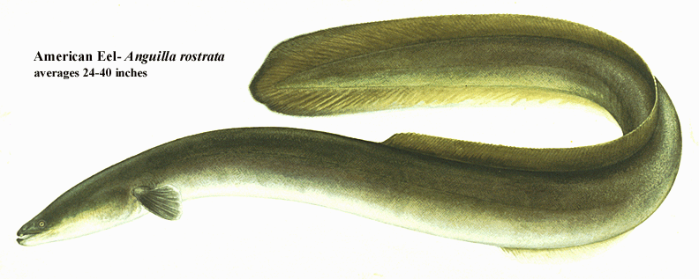
Diadromous fishes
Atlantic Sturgeon
Blueback herring
American Eel
Notes:
Presenter
2013-06-25 11:18:23
--------------------------------------------
The Hudson River is important habitat for diadromous (di= two, dromous= direction) fish, which migrate between fresh and marine waters. Anadromous fish, like Atlantic sturgeon and blueback herring, spend most of their lives in salt water and come back to freshwater to spawn. Catadromous fish, like the American eel, spawn in salt water, then spend most of their lives growing up in fresh water. Images by NYSDEC.

Slide 17
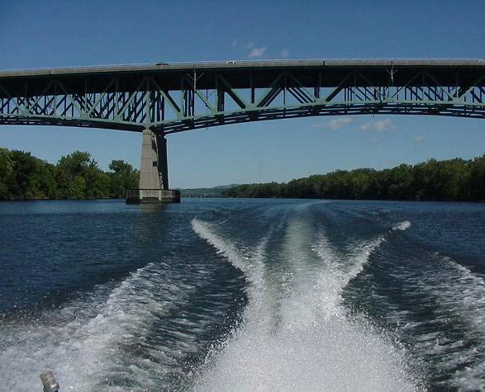
Beautiful, dynamic, & full of life
— a great place to visit!

Slide 18
We hope you enjoyed your journey!

