Slide 1

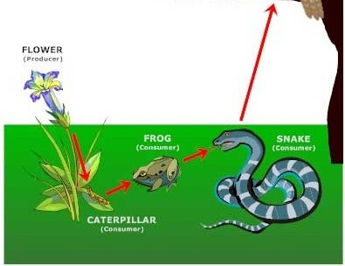
Hudson as an Ecosystem: Focus on Food Webs
neurobusiness.wordpress.com

Slide 2
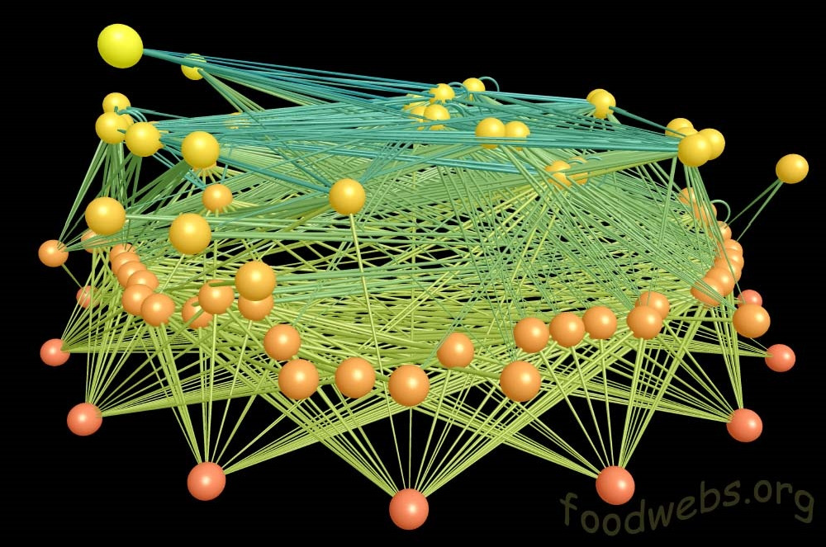
East River Valley - Colorado

Slide 3
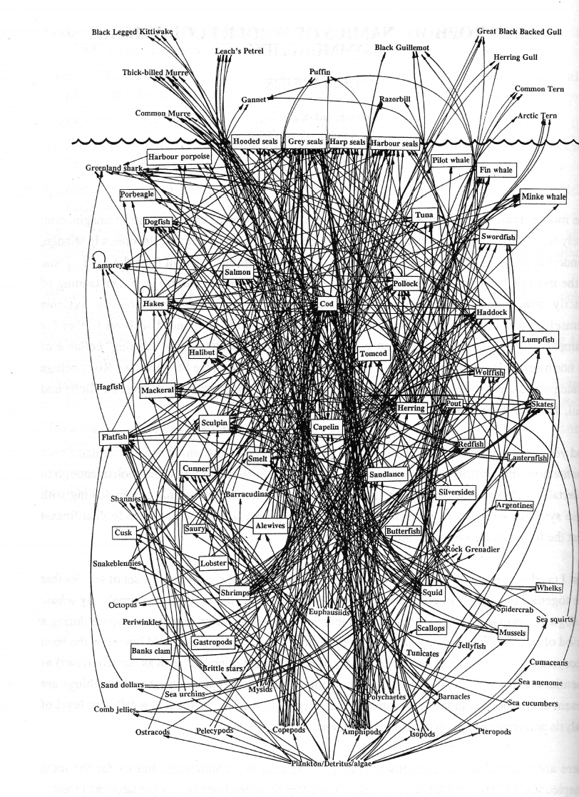
Northwest Atlantic cod food web
http://www.fisherycrisis.com/coral7.html

Slide 4

Everything is connected
www.kidsplanet.org

Slide 5
Everything is connected…sort of
www.kidsplanet.org

Slide 6
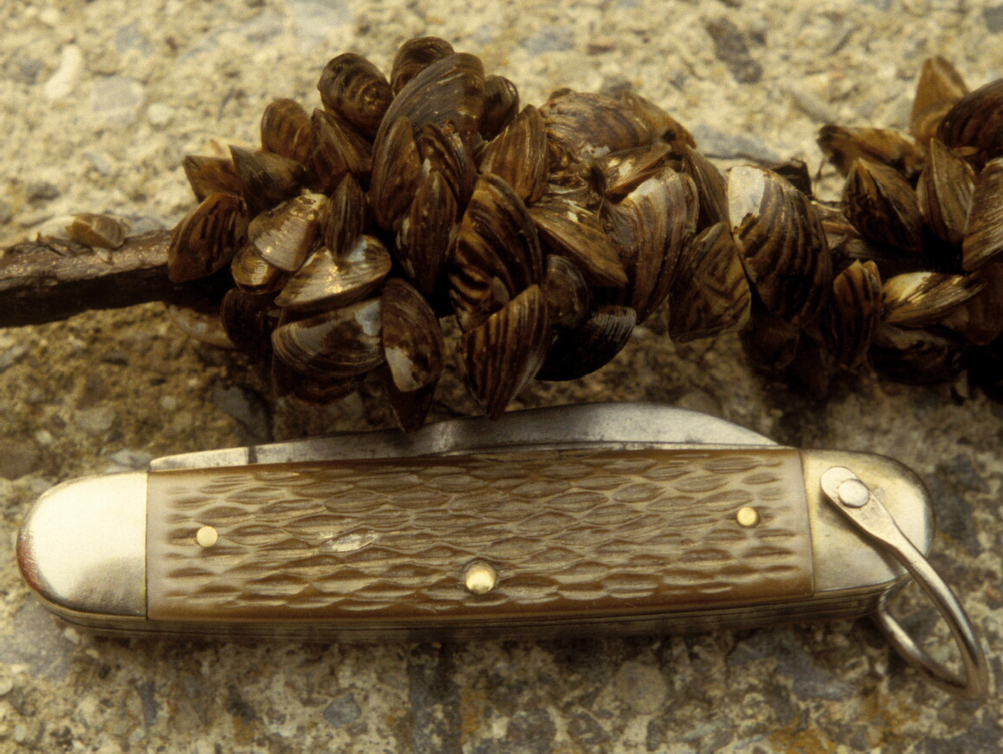
Interaction Webs: A Case Study from the Hudson River

Slide 7
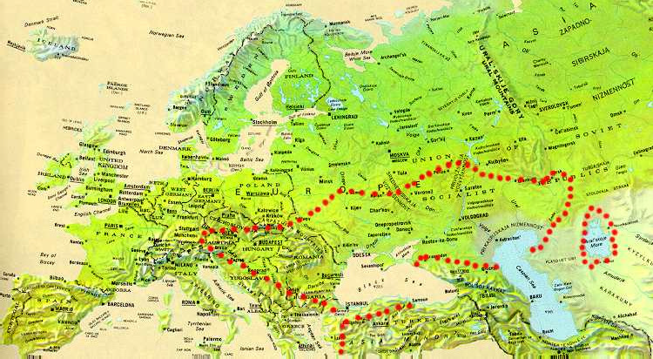
Native range of zebra mussels
Eastern Europe

Slide 8
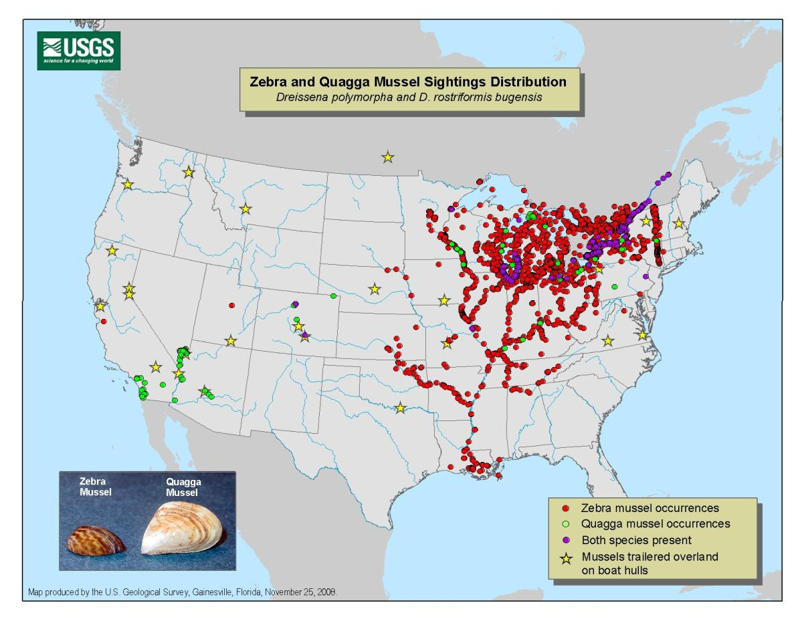
Zebra mussel range 2009
First detected in the Hudson Valley in 1991

Slide 9
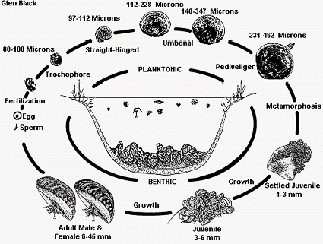
Zebra Mussel Life Cycle

Slide 10
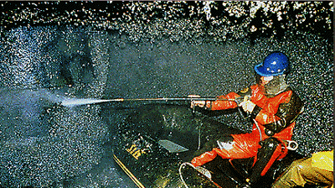
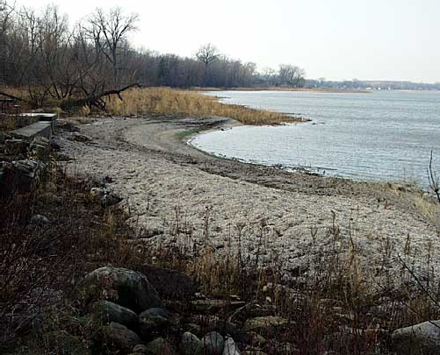

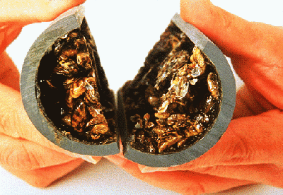
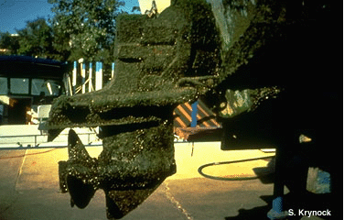
Zebra mussels cause economic damages

Slide 11
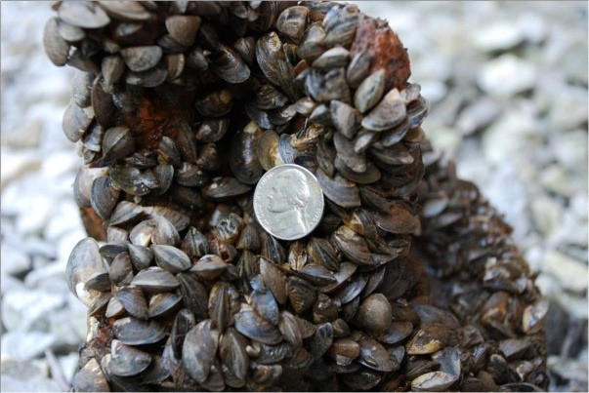


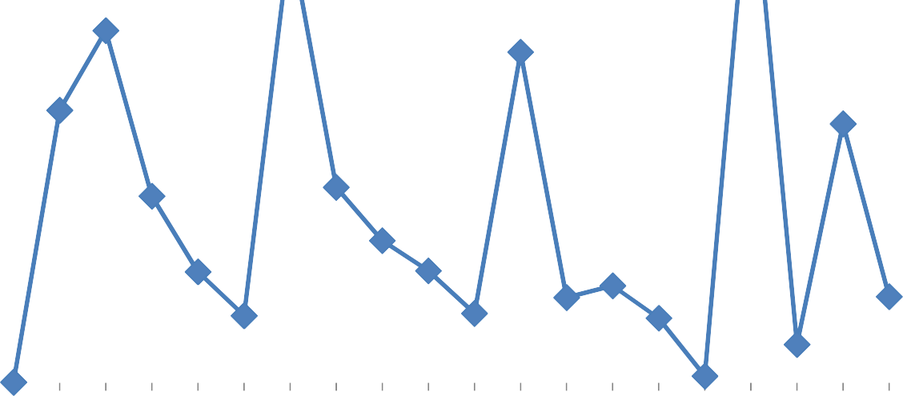
How many zebra mussels fit inside one square meter?
Zebra Mussel, number per square meter
4000
3500
3000
2500
2000
1500
1000
500
0
zebra mussels, (#/m2)
Year

Slide 12

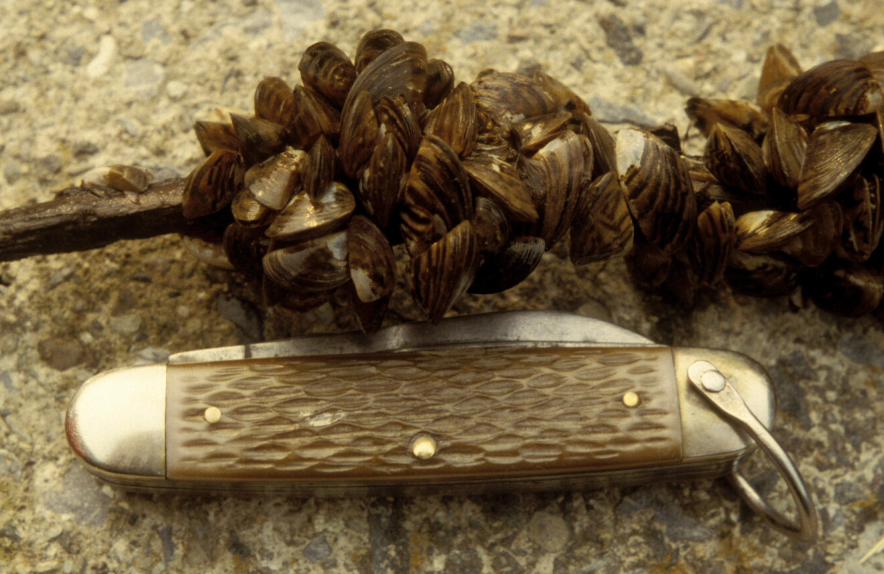

How much water do zebra mussels filter?
Zebra mussels filter all the water in the Hudson River basin every 1-4 days.
Zebra mussels filter water to capture their food – phytoplankton and small zooplankton.

Slide 13

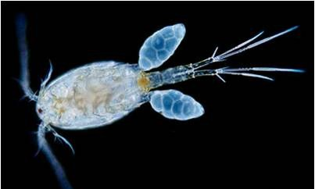
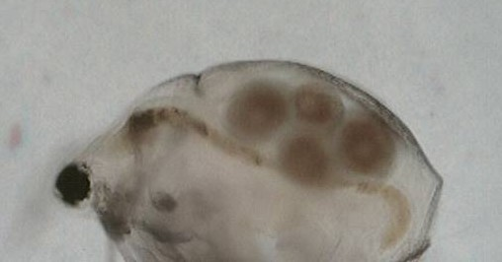
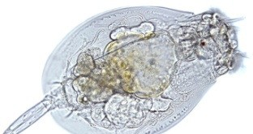



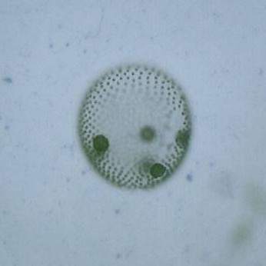
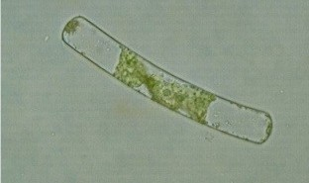
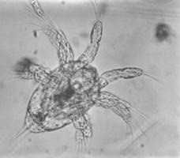
Zebra Mussels arrived in the Hudson River in 1992.
How do you think this affected other organisms? Why do you think they affected other organisms?
copepod
rotifer
Cladoceran (daphnia)
Nauplius (immature copepod)
Phytoplankton (algae)
Find out in Part 2: Invasion of the Zebra Mussels
-- Population Changes

Slide 14
Zebra mussels ate the phytoplankton
(and zooplankton)
Filtration rate (% of water-column/day)
100
35
Phytoplankton biomass (μg chl-a/L)
30
80
25
60
20
40
15
10
20
5
0
0
1988 1990 1992 1994 1996 1998 2000 2002 2004

Slide 15
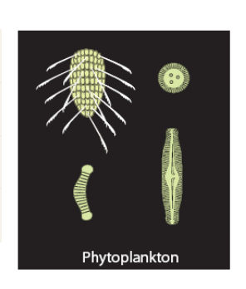



Phytoplankton (algae & protists)
photosynthesize and produce chlorophyll
Chlorophyll a, micrograms per liter, 1987-2009
35
30
25
20
15
10
5
0
Chlorophyll a, µg/l
Year
Phytoplankton
eaten by bivalves and zooplankton

Slide 16













Micro-zooplankton
nauplii (immature copepods), rotifers, and tintinnids
Nauplii, number per liter, 1987-2009
120
100
80
60
40
20
0
Nauplii #/l
Year
Rotifers, number per liter, 1987-2009
1400
1200
1000
800
600
400
200
0
Rotifers #/l
Year
Algae & bacteria
eaten by micro-zooplankton
eaten by mussels & meso-zooplankton

Slide 17
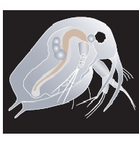












Meso-zooplankton:
copepods and cladocerans
Copepods, number per liter, 1987-2009
10
8
6
4
2
0
Copepods, #/l
year
Cladocerans, number per liter, 1987-2009
50
40
30
20
10
0
Cladocerans (#/L)
Year
Algae & bacteria
eaten by meso-zooplankton
eaten by larger plankton & fish larvae

Slide 18
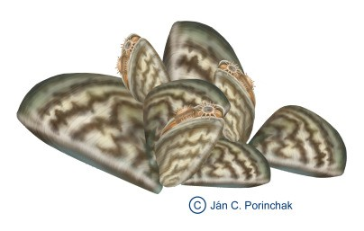
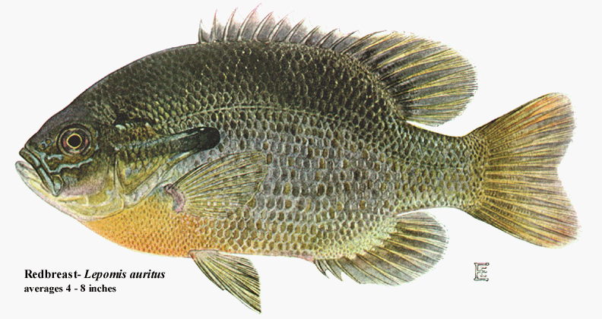
Part 3:
What about abiotic factors and other organisms in the Hudson River?
Look at the chart in Part 3 of your worksheet packet.
What abiotic factors are included in the chart?
First you will learn about how these abiotic factors and other organisms responded during the early invasion years.
Predict: How do you think these were affected by zebra mussels?

Slide 19
Zebra Mussels caused many changes to the Hudson River ecosystem in the early invasion years . . .

Slide 20
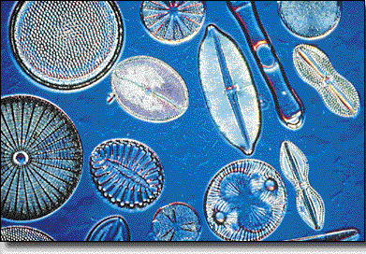
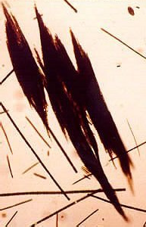
Zebra mussels
Phytoplankton was reduced by 80% during the early invasion years.
Phyto-
plankton
-80%

Slide 21
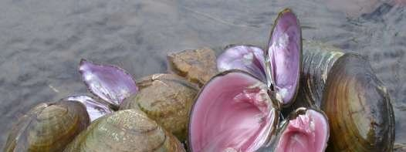
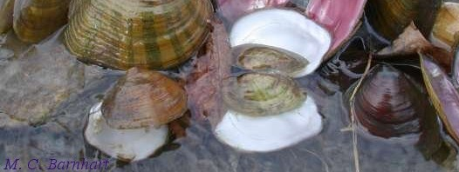
What do you think happened to the native pearly mussel population when the zebra mussels invaded?

Slide 22
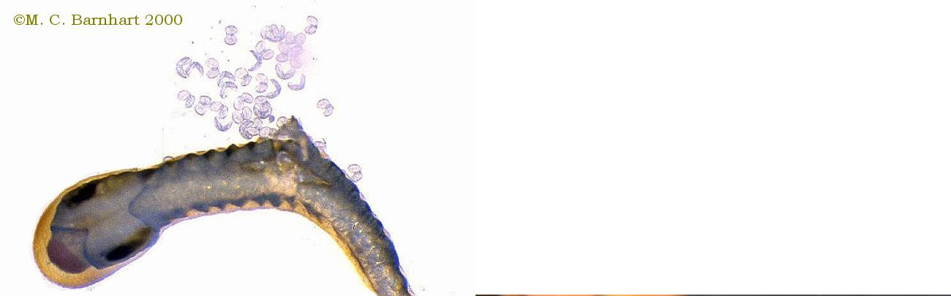
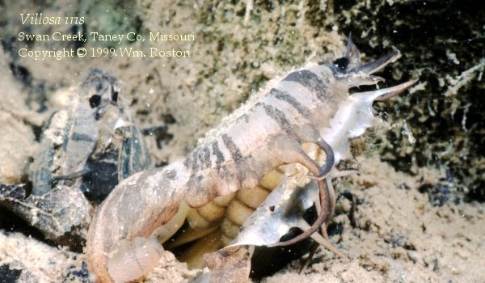
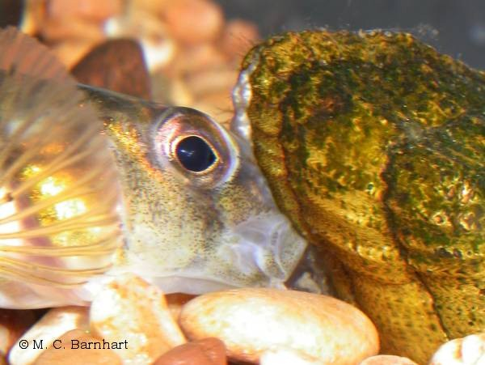
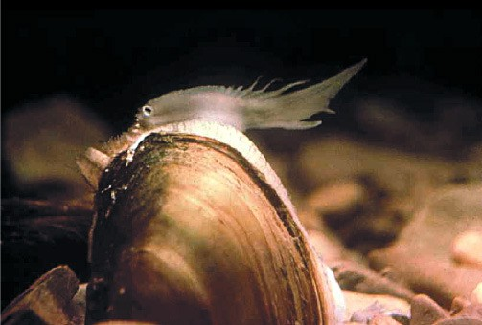
Pearly Mussels Lure Fish then release their larvae (glochidia) which attach to the gills of the fish!

Slide 23
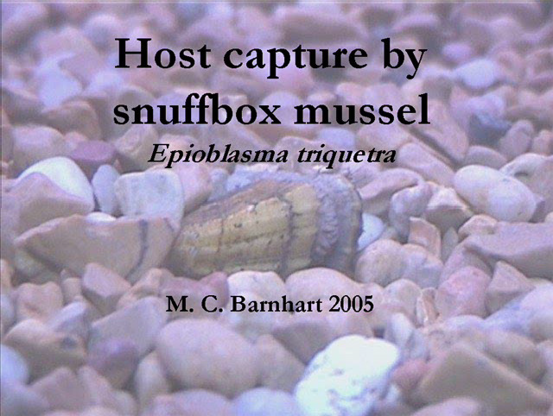

Slide 24
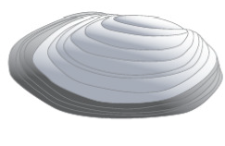


Pearly Mussels, Other Mussels, and Clams
Native Bivalves
Pearly mussel, number per square meter
10
8
6
4
2
0
Pearly mussel, (#/m2)
Year
Plankton eaten by mussels and clams eaten by pelagic (deepwater) fish
Predict: What do you think will happen to pearly mussels and other native bivalves now that there are very few adult zebra mussels?

Slide 25
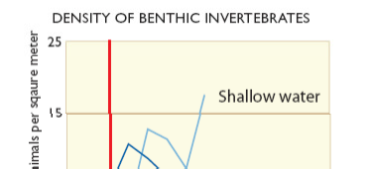
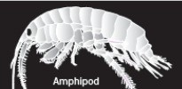
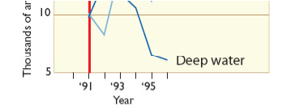
Benthic (bottom dwelling) Invertebrates
Algae & bacteria
eaten by benthic invertebrates
eaten by both pelagic and littoral fish
Predict: How will pelagic (deepwater) fish and littoral (shallow water) fish be affected by the changes in benthic invertebrate numbers?

Slide 26
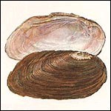
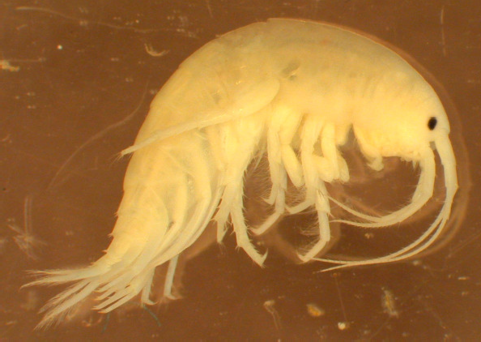
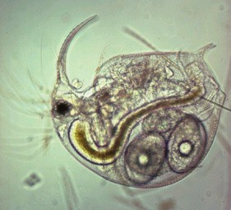
Zebra mussels
Early Invasion Years, 1993-2004
Native bivalves
-72%
Deepwater zoobenthos
-40%
Phyto-
plankton
-80%
Zooplankton
-71%

Slide 27
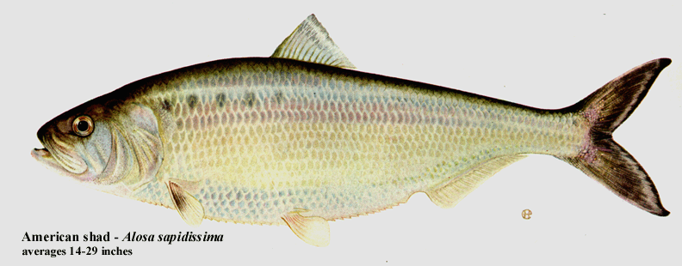

Zebra mussels
Early Invasion Years, 1993-2004
Native bivalves
-72%
Deepwater zoobenthos
-40%
Phyto-
plankton
-80%
Pelagic fish
-28%
Zooplankton
-71%
Pelagic bacteria
+45%

Slide 28

Zebra mussels
Early Invasion Years, 1993-2004
Dissolved oxygen
-12%
Native bivalves
-72%
Deepwater zoobenthos
-40%
Phyto-
plankton
-80%
Pelagic fish
-28%
Zooplankton
-71%
Pelagic bacteria
+45%

Slide 29

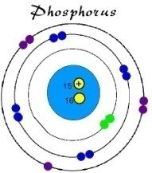
Zebra mussels
Early Invasion Years, 1993-2004
Dissolved oxygen
-12%
Native bivalves
-72%
Deepwater zoobenthos
-40%
Transparency
+45%
Phyto-
plankton
-80%
Pelagic fish
-28%
Zooplankton
-71%
Pelagic bacteria
+45%
Soluble P
+125%

Slide 30
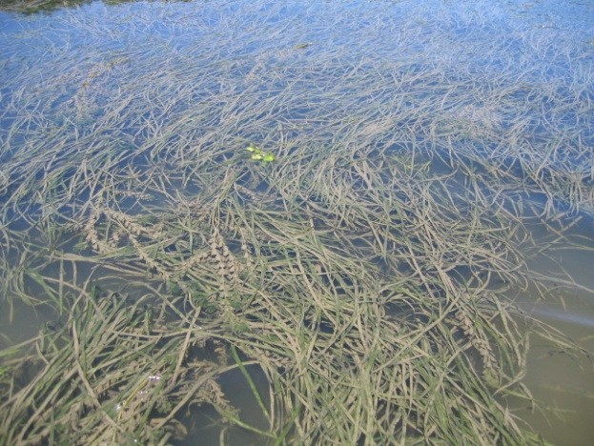
Zebra mussels
Early Invasion Years, 1993-2004
Dissolved oxygen
-12%
Native bivalves
-72%
Deepwater zoobenthos
-40%
Transparency
+45%
Submersed plants
+38%
Phyto-
plankton
-80%
Pelagic fish
-28%
Zooplankton
-71%
Pelagic bacteria
+45%
Soluble P
+125%

Slide 31
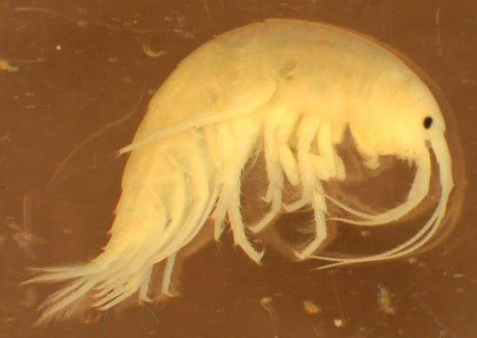
Zebra mussels
Early Invasion Years, 1993-2004
Dissolved oxygen
-12%
Littoral zoobenthos
+20%
Native bivalves
-72%
Deepwater zoobenthos
-40%
Transparency
+45%
Submersed plants
+38%
Phyto-
plankton
-80%
Pelagic fish
-28%
Zooplankton
-71%
Pelagic bacteria
+45%
Soluble P
+125%

Slide 32
Zebra mussels
Early Invasion Years, 1993-2004
Dissolved oxygen
-12%
Littoral zoobenthos
+20%
Native bivalves
-72%
Deepwater zoobenthos
-40%
Transparency
+45%
Submersed plants
+38%
Phyto-
plankton
-80%
Pelagic fish
-28%
Zooplankton
-71%
Littoral fish
+97%
Pelagic bacteria
+45%
Soluble P
+125%

Slide 33
Zebra mussels
Early Invasion Years, 1993-2004
Dissolved oxygen
-12%
Littoral zoobenthos
+20%
Native bivalves
-72%
Deepwater zoobenthos
-40%
Transparency
+45%
Submersed plants
+38%
Phyto-
plankton
-80%
Pelagic fish
-28%
Zooplankton
-71%
Littoral fish
+97%
Pelagic bacteria
+45%
Soluble P
+125%
Food web in the open water
Food web in the shallows

Slide 34
Zebra Mussel Size Classes: The Later Invasion Years
Watch the video clip, “Going Further” from the American Museum of Natural History

Slide 35
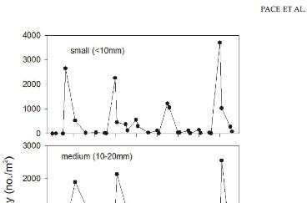
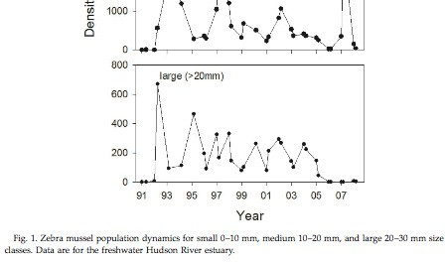
Zebra Mussels
Zebra Mussel Population Dynamics: Size Classes
Small
Medium
Large
Scientists noticed a change in the numbers of different size classes beginning about 2005.
What do you notice?
Think about the food web: What do zebra mussels eat?
Do different size classes eat different organisms?

Slide 36
What organisms recovered when there were fewer zebra mussel adults?
Phytoplankton are not recovering.
Why do you think that might be?

Slide 37












Zebra mussels
Later Invasion Years, 2005-2009
increasing
Dissolved oxygen
-12%
Still low
stable
Littoral zoobenthos
+20%
Native bivalves
-72%
Deepwater zoobenthos
-40%
Submersed plants
+38%
Phyto- plankton
-80%
Transparenc
+45%
y
Pelagic fish
-28%
Zooplankton
-71%
Littoral fish
+97%
Pelagic bacteria
+45%
Soluble P
+125%
Food web in the open water
Food web in the shallows

Slide 38
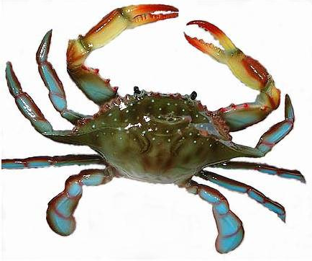
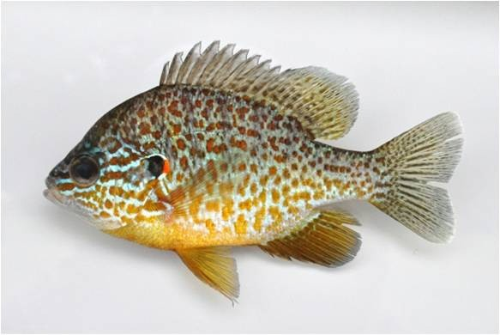
What was eating the large zebra mussels?
Blue crabs and
pumpkin seed fish

Slide 39

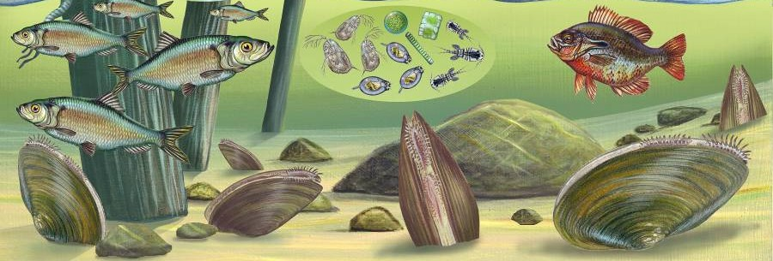
Pre-zebra mussel

Slide 40

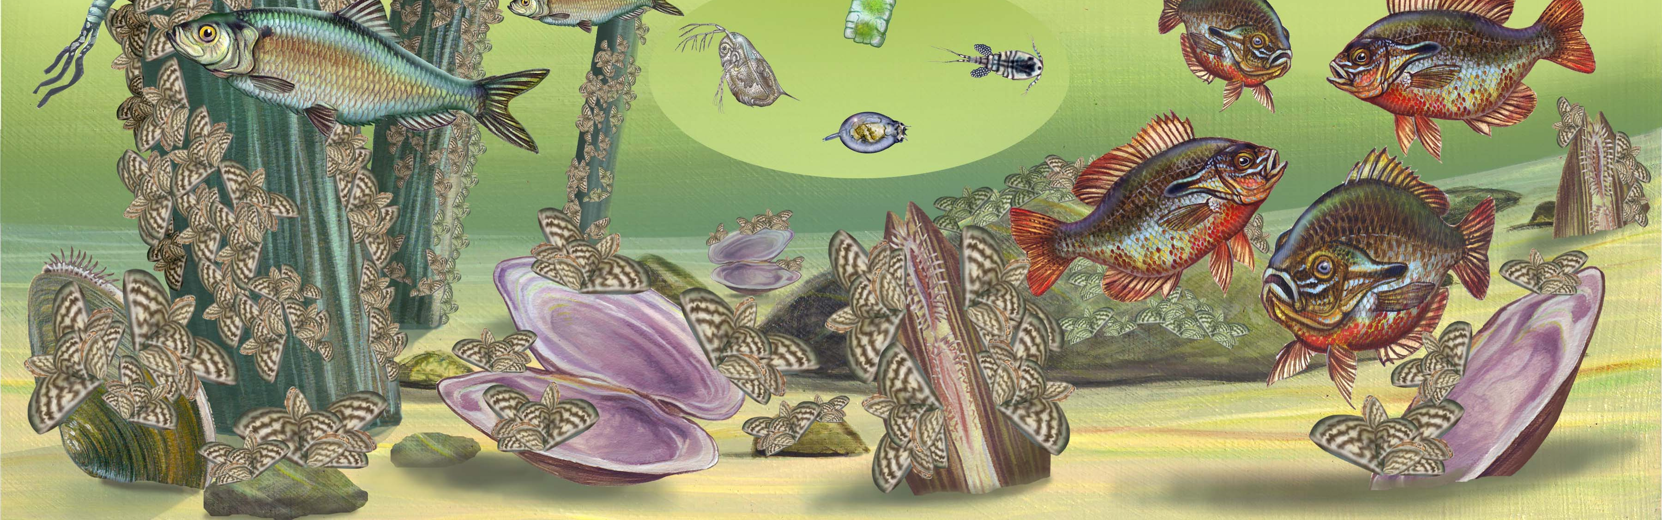
Early invasion of zebra mussel

Slide 41
Late invasion of zebra mussels:
Zooplankton populations are recovering
Deepwater benthic invertebrates are starting to recover
Native pearly mussels are recovering
River water is still clearer
Phytoplankton populations are still low
What will happen in the future?

Slide 42





