Slide 1
Climate Change and Sea Level Rise

Slide 2
Learning Goals
Students will graph Hudson River sea level data from 1970-2015.
Students will compare scatter plots to line graphs.
Students will identify data trends.
Students will use graphs to make predictions.
Students will identify possible consequences of the data trends.

Slide 3
Turn and Talk
What are some effects of climate change?

Slide 4

Day 1: Sea Level Changes
NOAA (National Ocean and
Atmospheric Administration)
Is part of the US Department
Of Commerce, which is designed
to promote economic growth.

Slide 5

Turn and Talk: Why would the DOC be involved with oceans and atmosphere?

Slide 6
NOAA Sea Level Data
Today, you will be a climate scientist analyzing NOAA’s sea level data. Yay! I simplified the data a little for you.
What do the negative numbers mean?
What do the positive numbers mean?

Slide 7
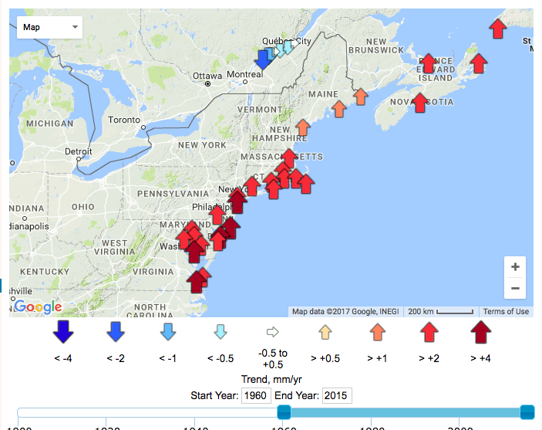
Relative Sea
Level Rise
Where has sea level risen?
Where has sea level dropped?
Why do you think that is?
Notes:
Source: http://www.psmsl.org/products/trends/

Slide 8
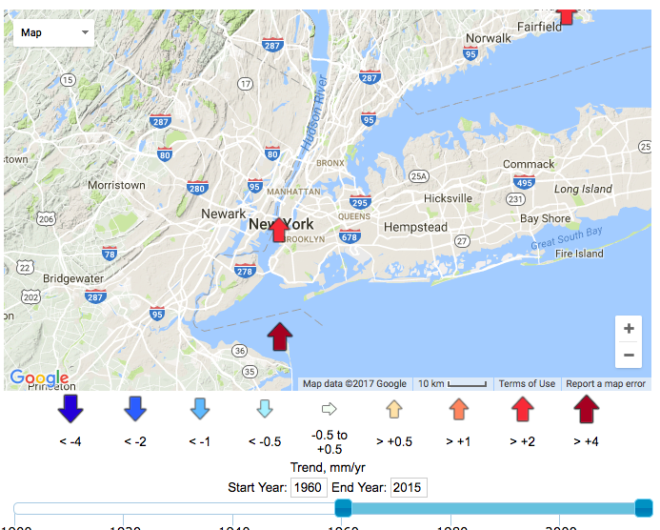
Relative Sea
Level Rise
NYC
Which neighborhood is most
at risk for sea level rise? Is
this surprising? Why or why not?

Slide 9
Graph Time
You will create a series of graphs to visualize the data in front of you. What do graphs do that data tables don’t?

Slide 10
Modeling and Work Time

Slide 11
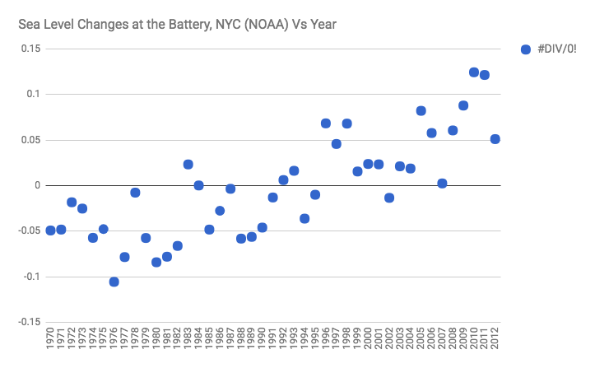
Scatterplot

Slide 12
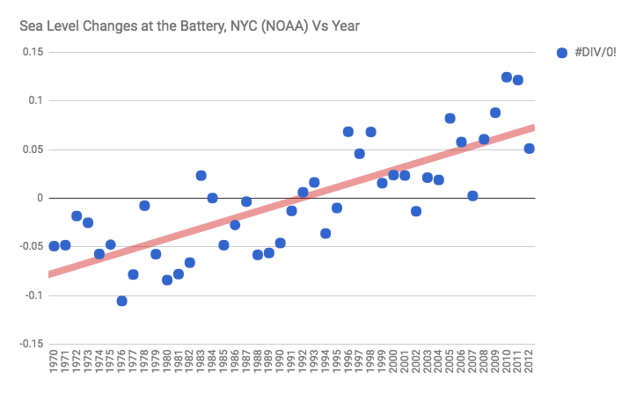
Scatterplot with Trendline

Slide 13
Turn and Talk
What information does a trendline provide? When would you use it? When might you not use it?

Slide 14
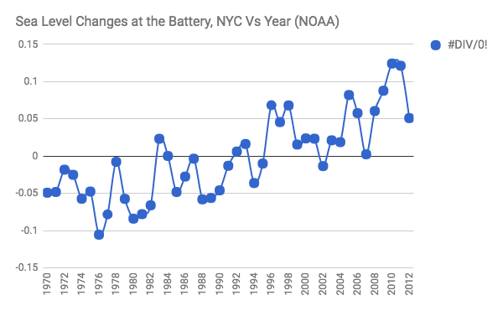
Line graph

Slide 15
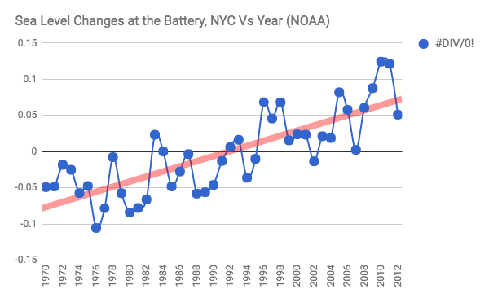
Line Graph with Trendline

Slide 16
Discussion (due at EOC)
What trends do you notice in your line graph?
What trends do you notice in your scatterplot?
Is one graph better than the other at communicating information? Why or why not?
What information does the trendline provide?
If we continued gathering data for the next data, what do you predict to see?
If we looked 10 years into the past, what do you predict to see?
Come up with three possible consequences for sea level rise along the Hudson River.
Notes:
FEEDBACK: What question are we answering with a scatterplot? What question are we answering with a line graph?

Slide 18
Day 2
Water Temperature

Slide 19
Do Now
What happens to water as it freezes into ice?
What do you imagine happens to water as it heats up? What evidence do you have? Hint: Think of phase changes.

Slide 20
HRECOS
The Hudson River Environmental Conditions Observing System (HRECOS) is a network of near-real-time water quality and weather monitoring stations in the Hudson River Watershed.

Slide 21
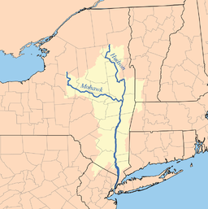


Slide 22
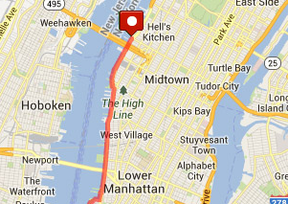
NYC

Slide 23
Turn and Talk
We are comparing data from 2009 to 2010, 2011, 2012, 2013, 2014, 2015 and 2016. With a partner, come up with 3 pitfalls to today’s experiment.

Slide 24
Caveats

Slide 25
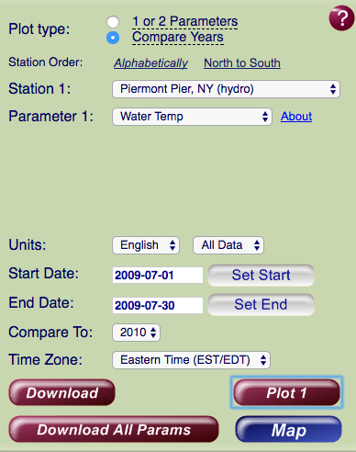
Modeling
Comparing
Data

Slide 26
Discussion
What trends did you notice about water temperature between 2010 and 2016?
Were there any exceptions?
Make three predictions about why water temperature is increasing.
EVALUATE: Looking back at yesterday’s activity on sea level rise in the Hudson, and knowing that the Hudson has had greater sea level rise than the global average, come up with three possible explanations for why this may be the case.

Slide 27
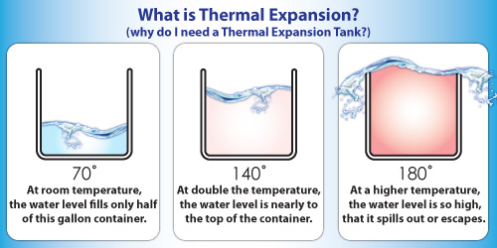
Thermal Expansion

Slide 28
Discuss: What does thermal expansion mean for sea level rise?

Slide 29
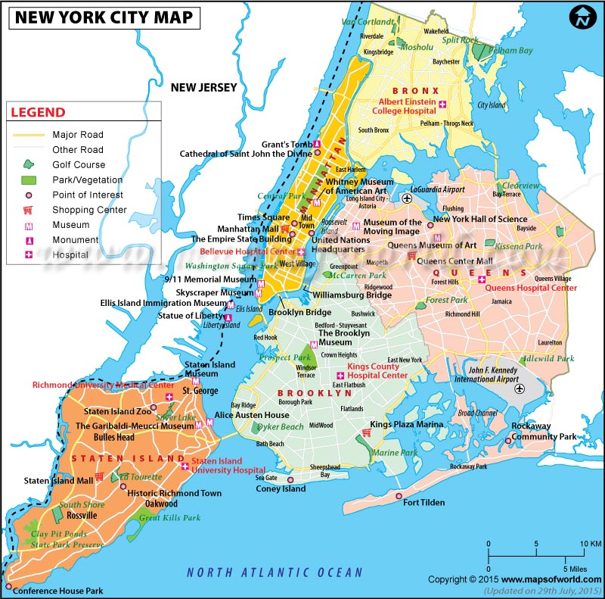
Prediction/Exit Ticket
Tomorrow, we will look at projections for sea level rise in NYC. Please complete your exit ticket and predict what you will see.

Slide 31
Day 3
The Future of the Hudson and NYC

Slide 32
Hurricane Irene and Sandy
Has your house, or the house of someone you know, ever flooded? If so, how long did it take to recover?

Slide 33
Climate Change
What are all the climate change factors that can impact sea level?

Slide 34
Yesterday’s Exit Ticket
Take out your predicted flood areas from yesterday. Today, we will see if you were correct!

Slide 35
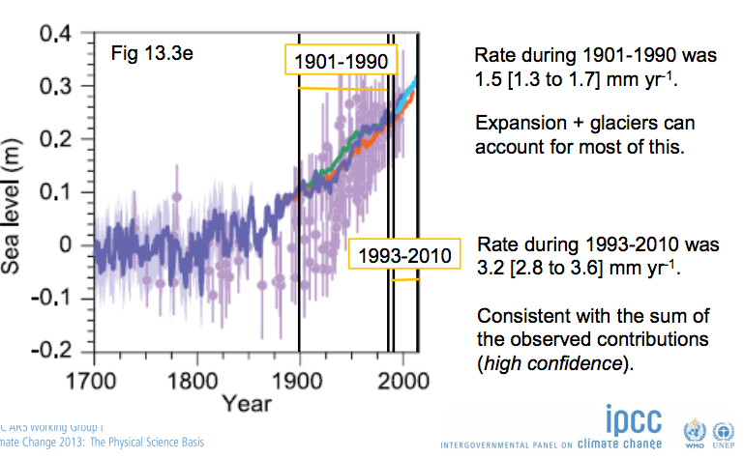
Notes:
Source: https://www.ipcc.ch/pdf/unfccc/cop19/3_gregory13sbsta.pdf

Slide 36
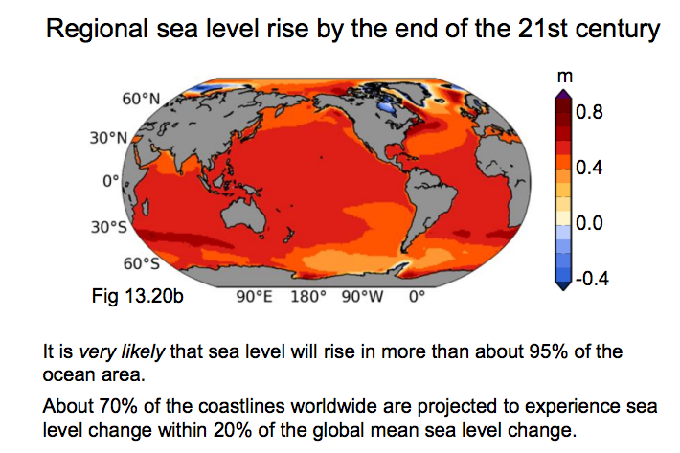

Slide 37
Turn and Talk
As sea levels rise, what are some impacts humans will encounter?

Slide 38
The IPCC projects sea levels will rise over 98cm/38.5 inches by 2100.

Slide 39
NOAA Sea Level Projections
Look at Fulton Street
Look at Coney Island
Look at West Babylon

Slide 40
NPCC Climate Projections 2015
Look at “Climate Observations & Trends”
Look at “Climate Projections”
Look at “Coastal Flooding”
Look at “Key Recommendations and City Actions”

Slide 41
Evaluate:
How do NYC’s Climate Observations, Trends, and Projections compare to the sea level and water temperature data you analyzed?
Based on the NOAA Sea Level Projections, how effective are NYC’s Key Recommendations and City Actions?

