Slide 1
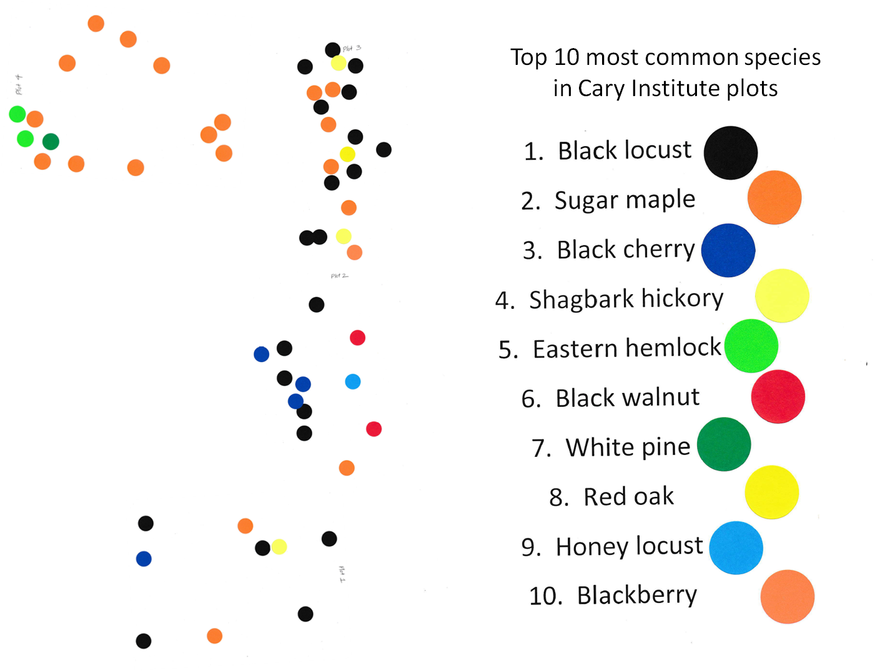
Plot 4
Plot 3
Plot 2
Plot 1

