Slide 1
Who did it?
Photos from the Cary Institute of Ecosystem Studies, unless otherwise specified

Slide 2
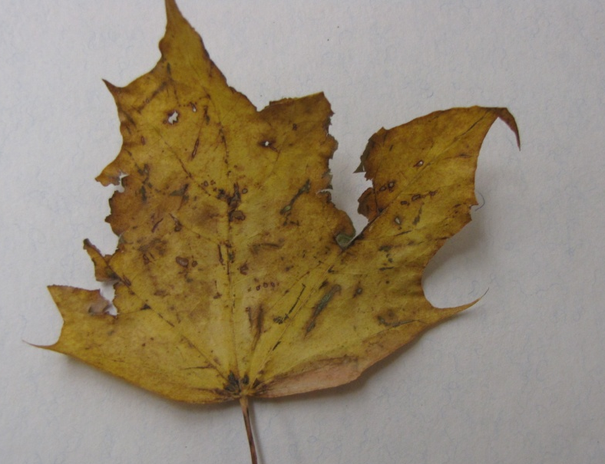
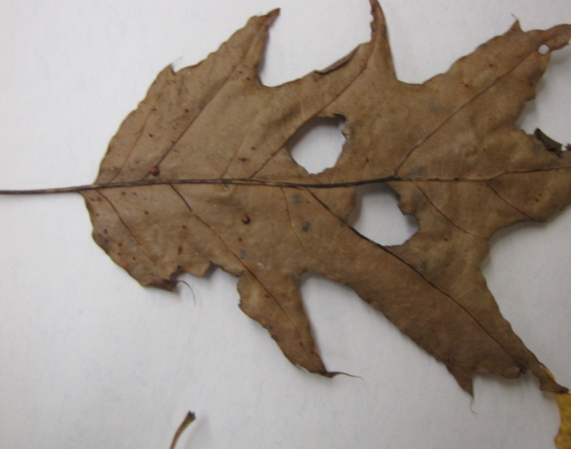
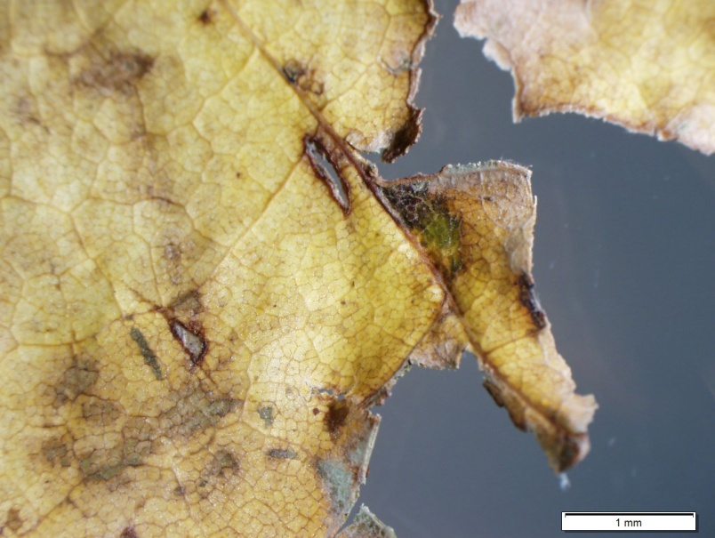
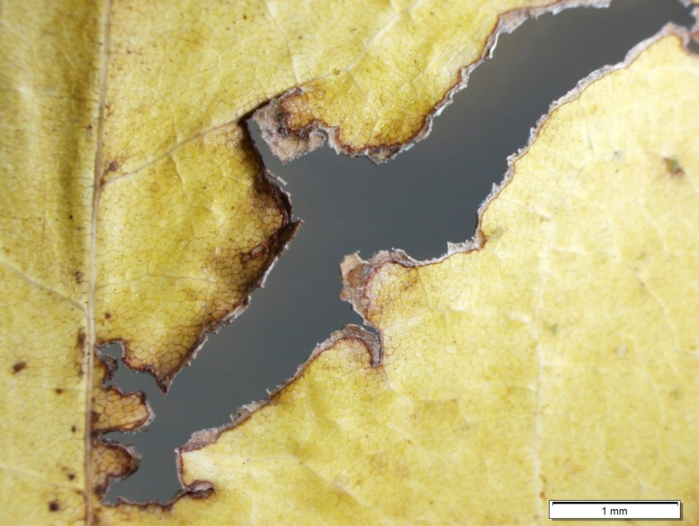
Chewed
Edge Interior

Slide 3
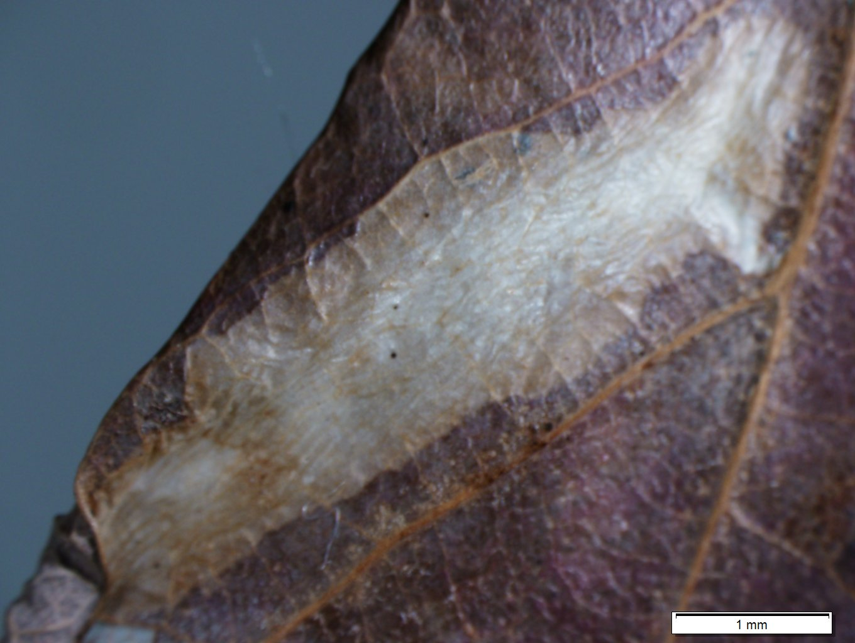
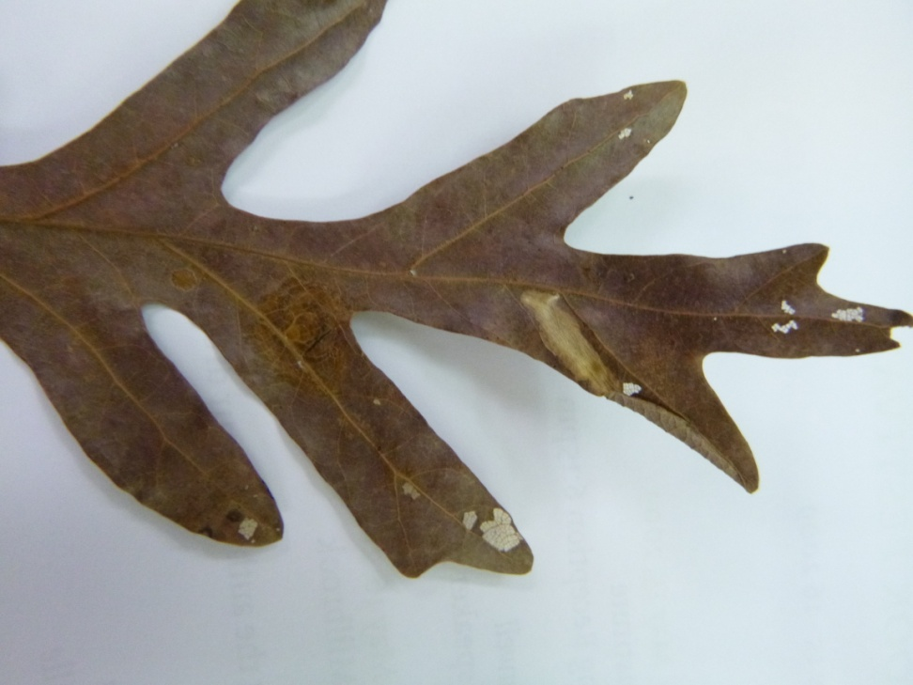
Mined
Notes:
Bottom and top of leaf surface are intact, but what is in between has been eaten out

Slide 4
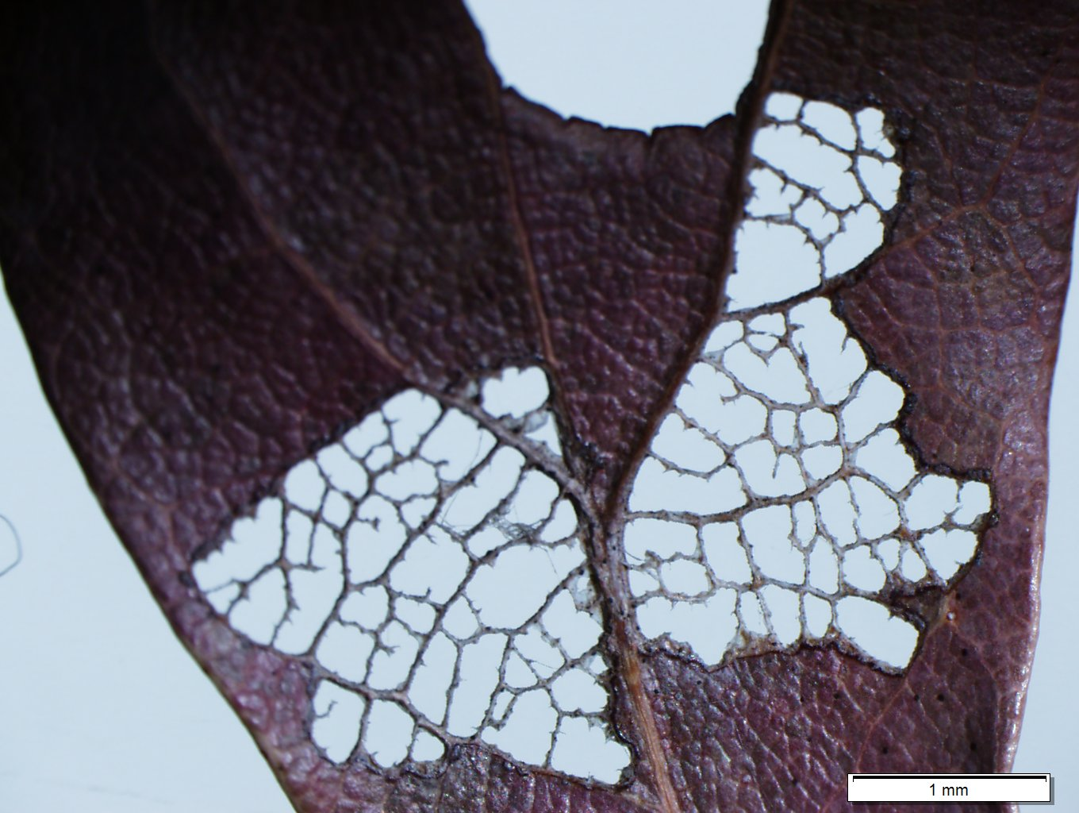
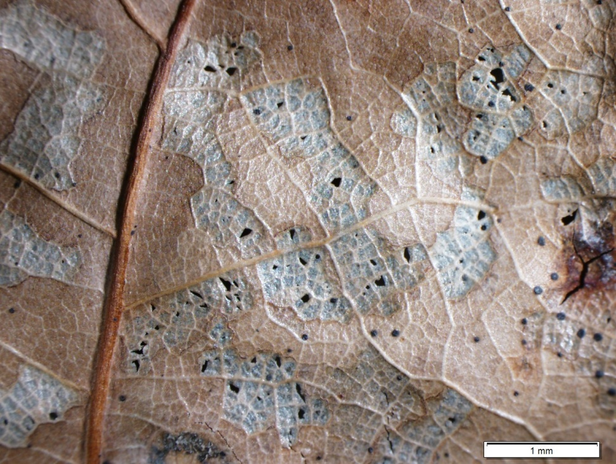
Skeletonized
Notes:
Herbivore consumes the non-vein tissues – very small insects only!

Slide 5
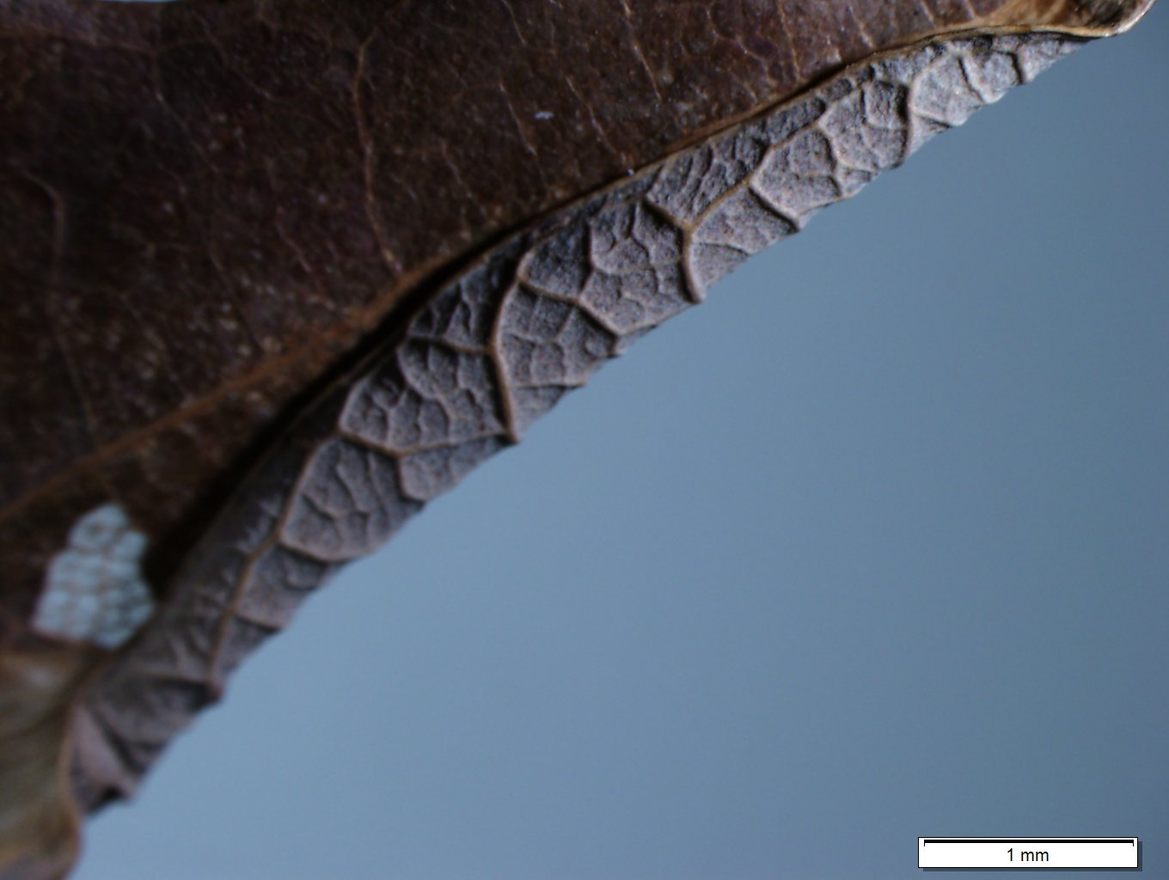
Rolled
Notes:
Lots of insects roll fresh leaves – also some insects “tie” leaves with silk (mostly lepidoptera). Rolling is a complex process – sometimes it is caused by biting into veins and the pressure causes the leaf to roll, sometimes it is tied together with threads, which may or may not be visible in the dead leaf. A change in the physical leaf that is caused by hydrostatic pressure.

Slide 6
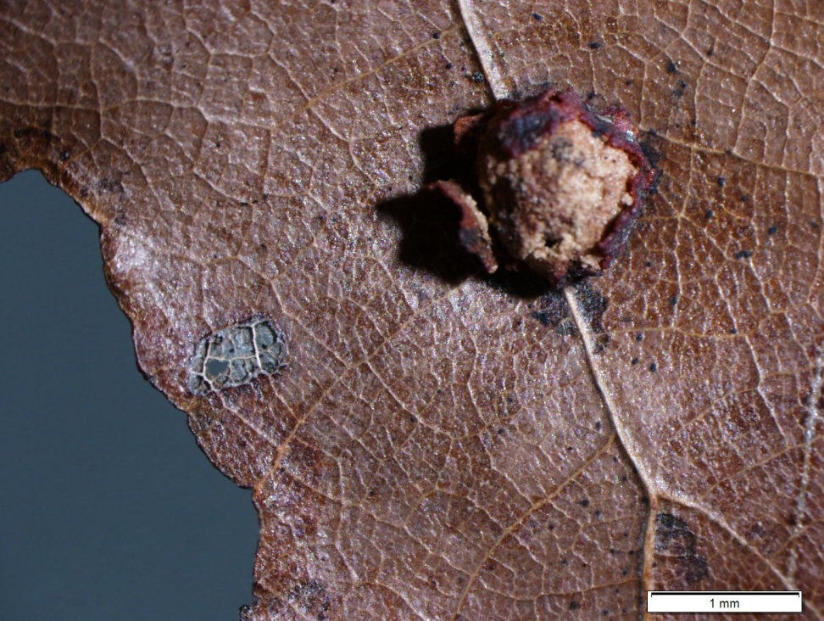
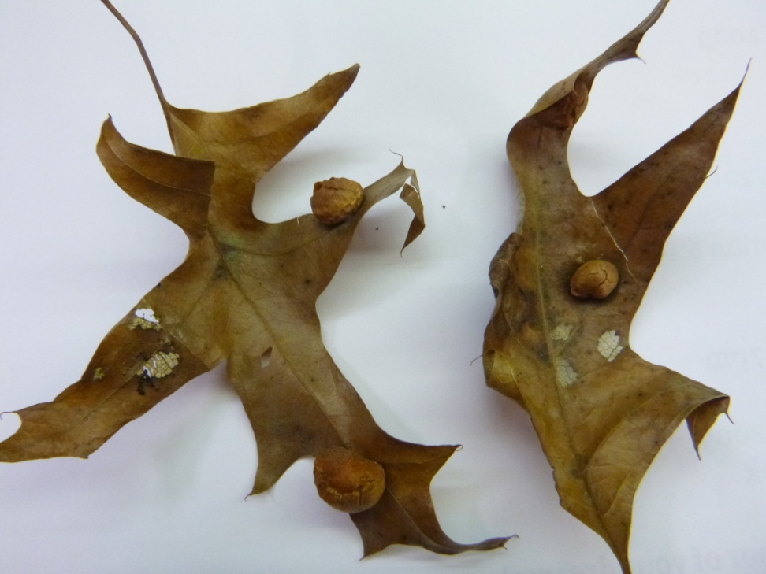
Galled
Notes:
There are fungi and insects that gall…The best way to see is to cut them in half.

Slide 7
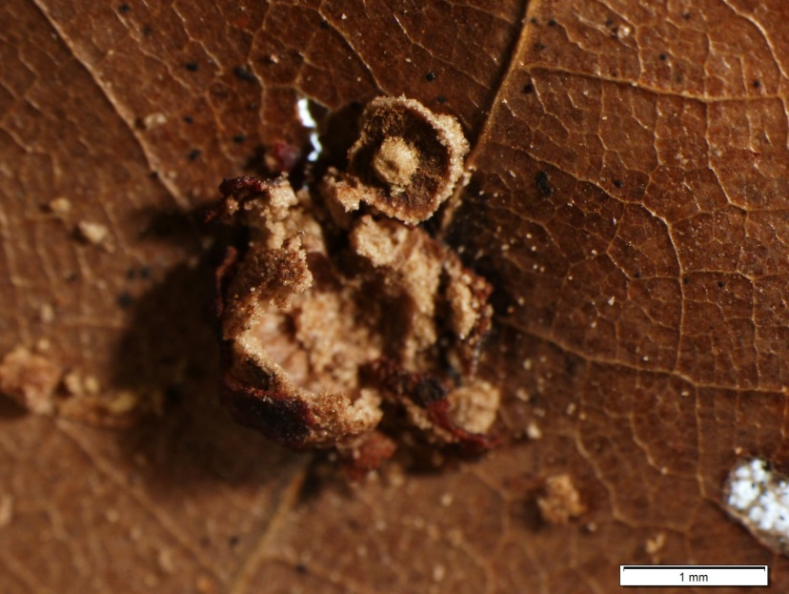
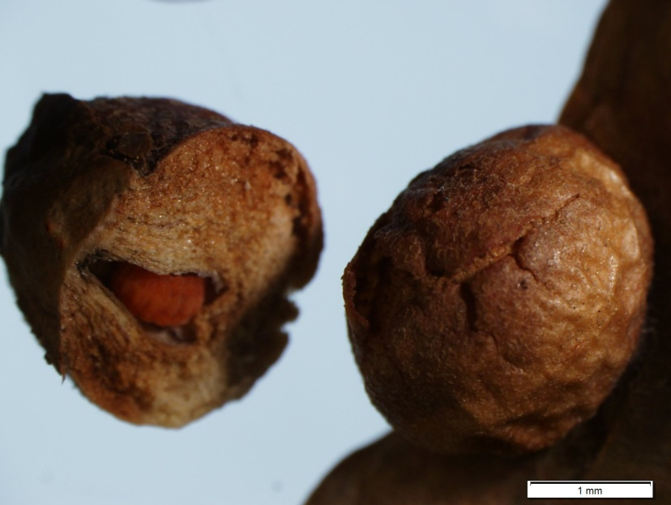
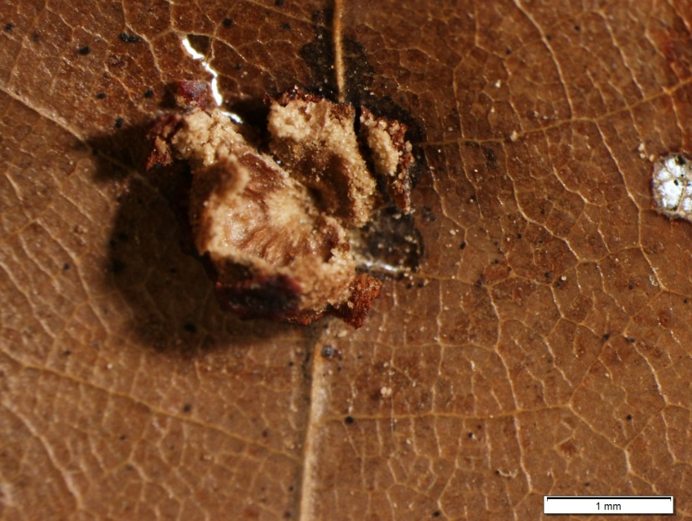
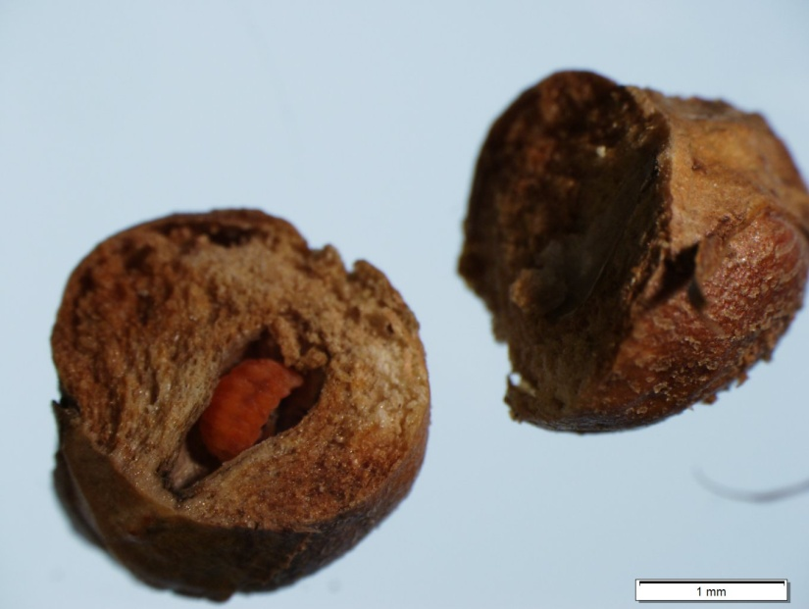
Fungal vs Insect Galls
Cut the gall open and look for larvae; fungal galls will not have larvae nor a clear space for one

Slide 8
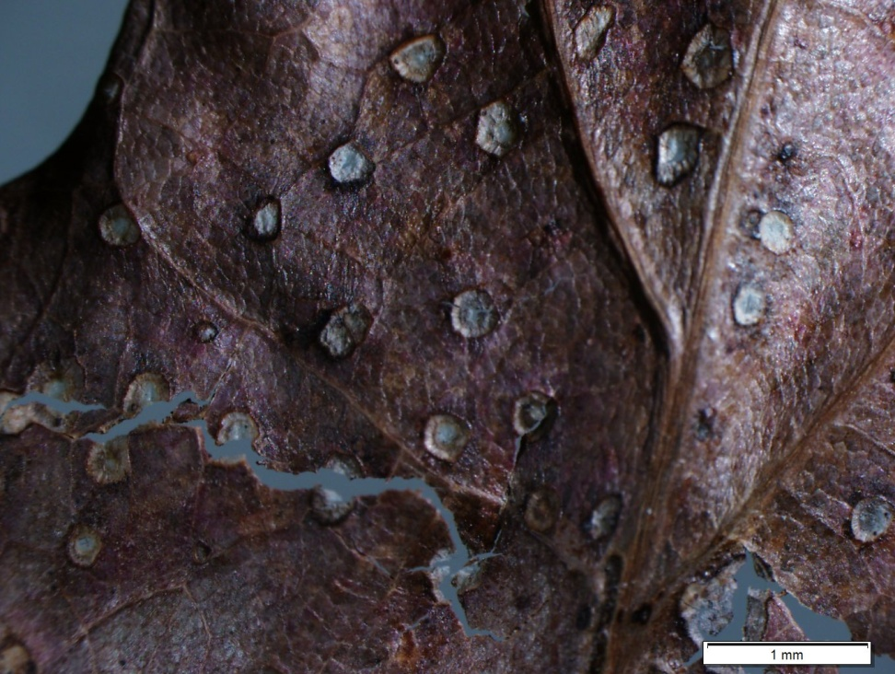
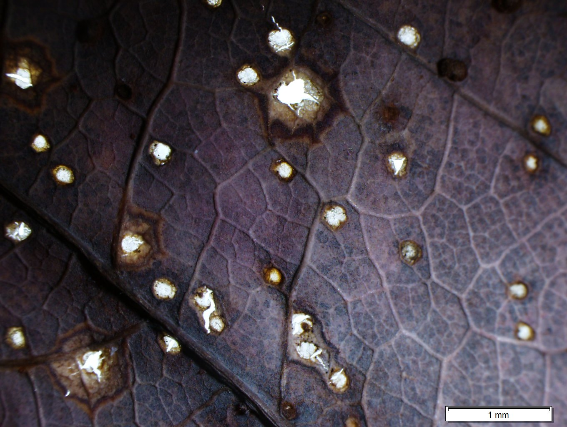
Fungal or Bacterial Consumption
Notes:
Necrotic fungal damage – you can get this kind of damage with insect too, but it is a best guess. It creates lesions and then the plant material falls out.

Slide 9
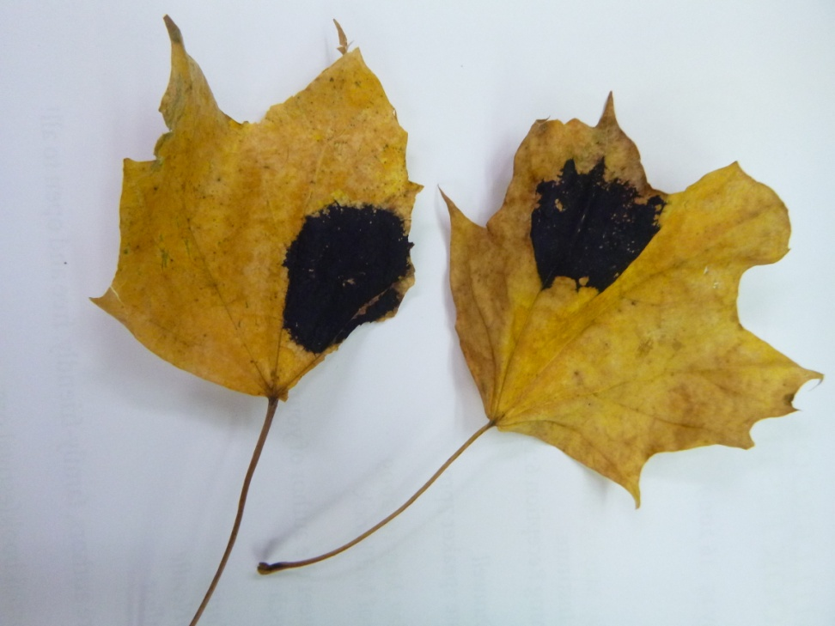
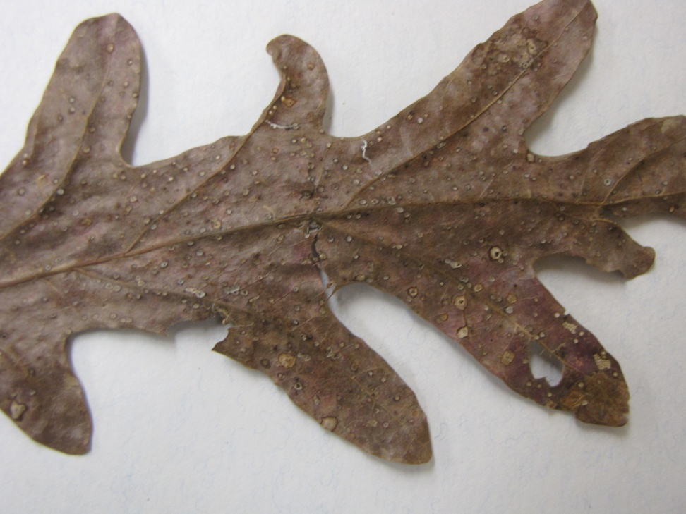
Fungal or Bacterial
Notes:
Leaf spot fungus – necrotic response of the leaf. 90% of terrestrial vegetation goes to decomposition.
Little insects – communuters – the things that make leaves into small bits (collembola – protozoa) work on dead leaves and condition them and make them easier for bacteria and fungi to decompose. In terrestrial ecosystems, that is the fate of most organic material: most plant material decomposes, because it is hard to make a living off of leaves, since the food quality isn’t that great. In aquatic ecosystems, herbivory can be over 100% of primary production. In aquatic systems you don’t have all this investment in physical structure, like algae, so the stuff is much more consumable. In aquatic systems a large percentage of primary production is consumed while the organisms are alive. Because terrestrial plants need to invest in structures to stay alive, that stuff is much more difficult to process – it is harder for organisms to eat leaves and the other structures. In aquatic environments the plant material goes straight into the organisms.
Maples are better food than oaks but you will see more damage on oaks than maples. There are a tremendous number of species that feed on oaks because they are evolutionarily old; more species have evolved to make a living from eating oak. Why do they decompose more slowly – they are poorer quality food – and yet they have more consumption during their lives? This is crappy food – the explanation doesn’t have to do with food quality but with adaptation to poor food quality over time.

Slide 10
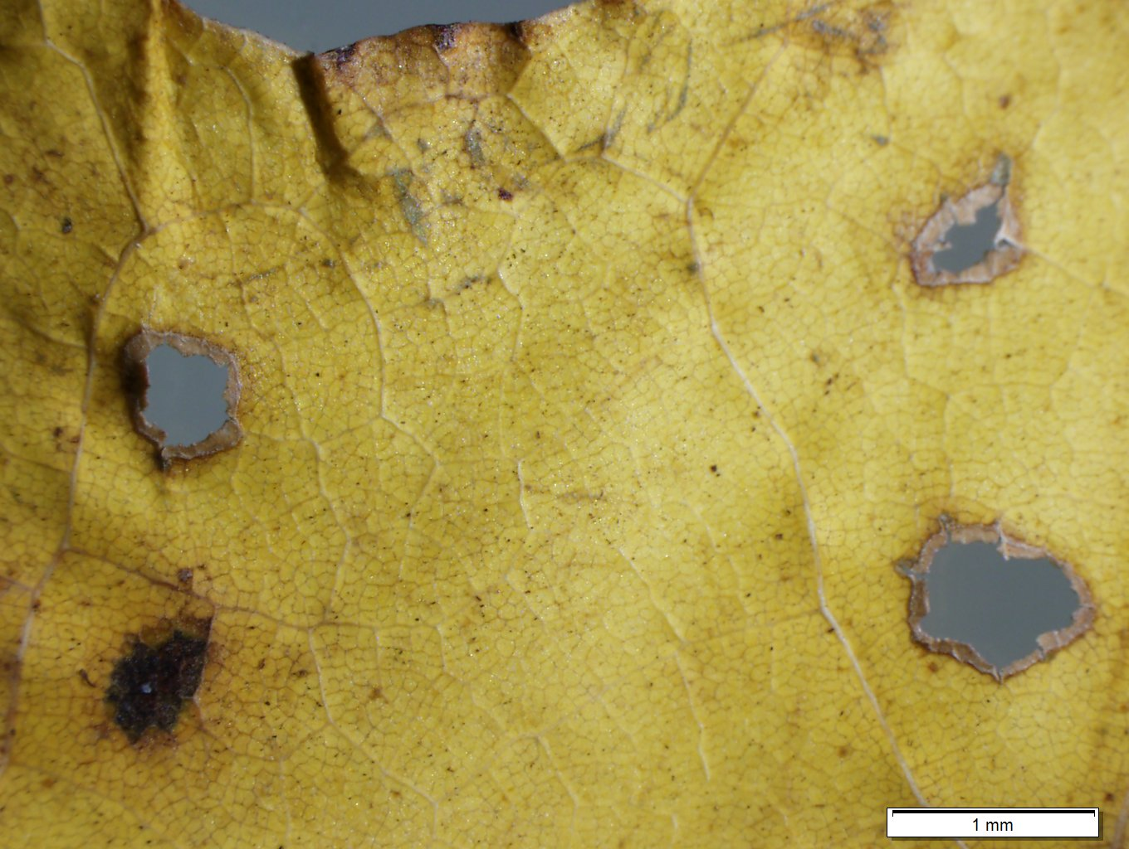
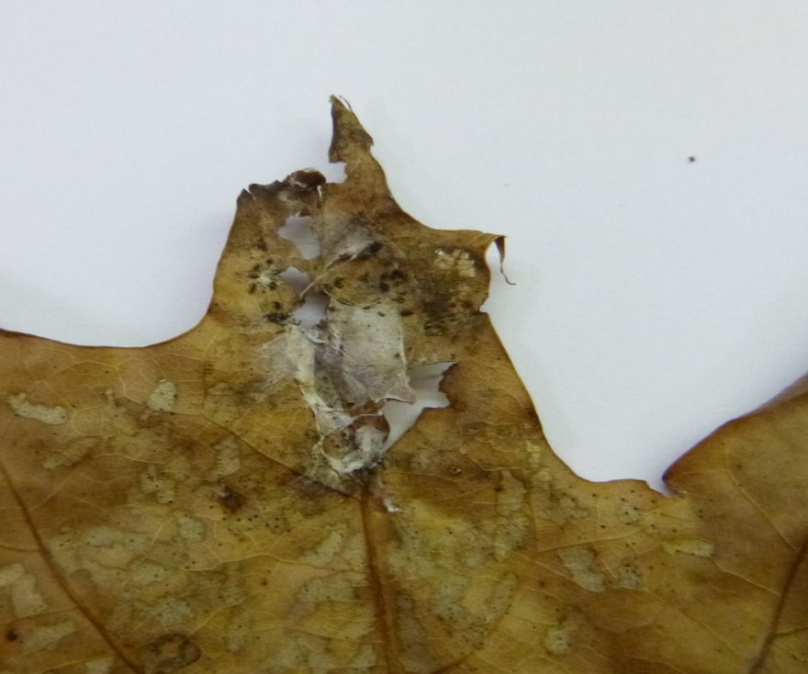
Other
Notes:
Some organisms build a web to protect themselves as they feed – it could be a roll of sorts – silk that has been used to cover that area – it might have been a leaf roller and the threads held the leaf together and lived underneath.

Slide 11
What do some of these organisms look like?
Keep in mind these are just examples, as there are tens of thousands of potential “suspects”!

Slide 12
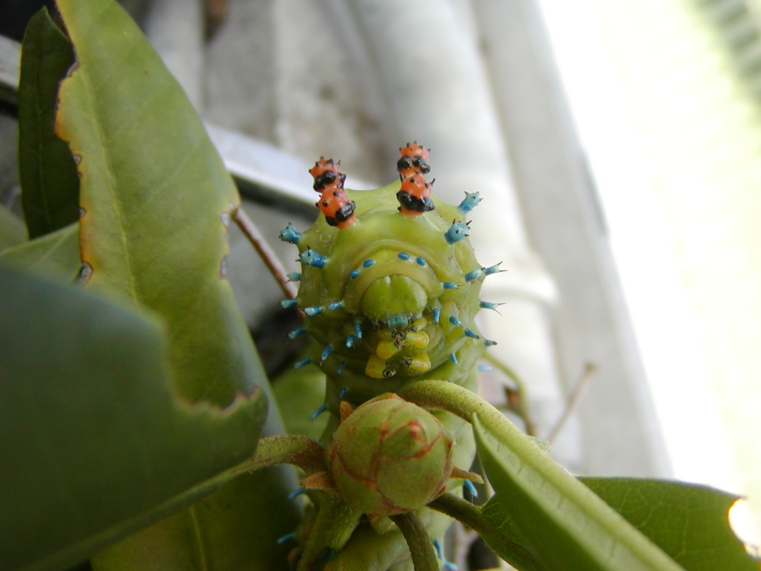
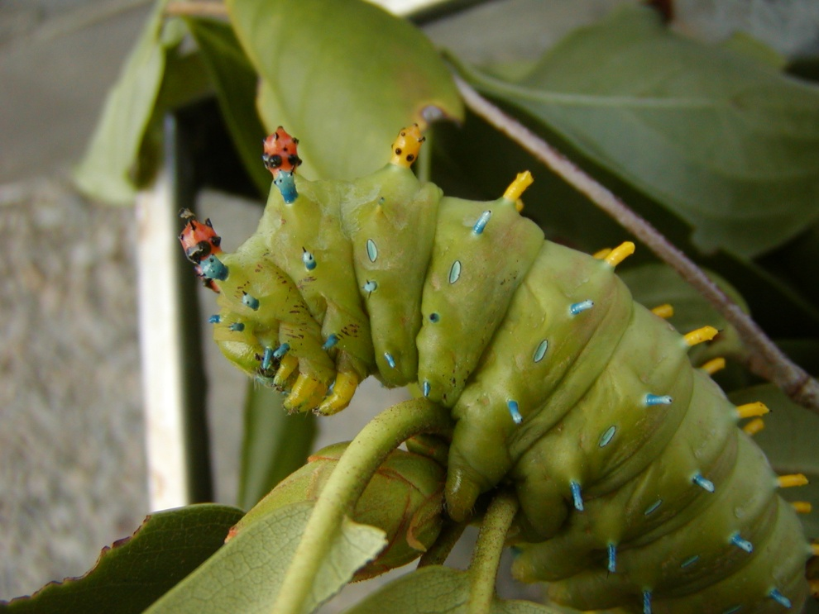
Chewers
Cecropia moth caterpillar

Slide 13
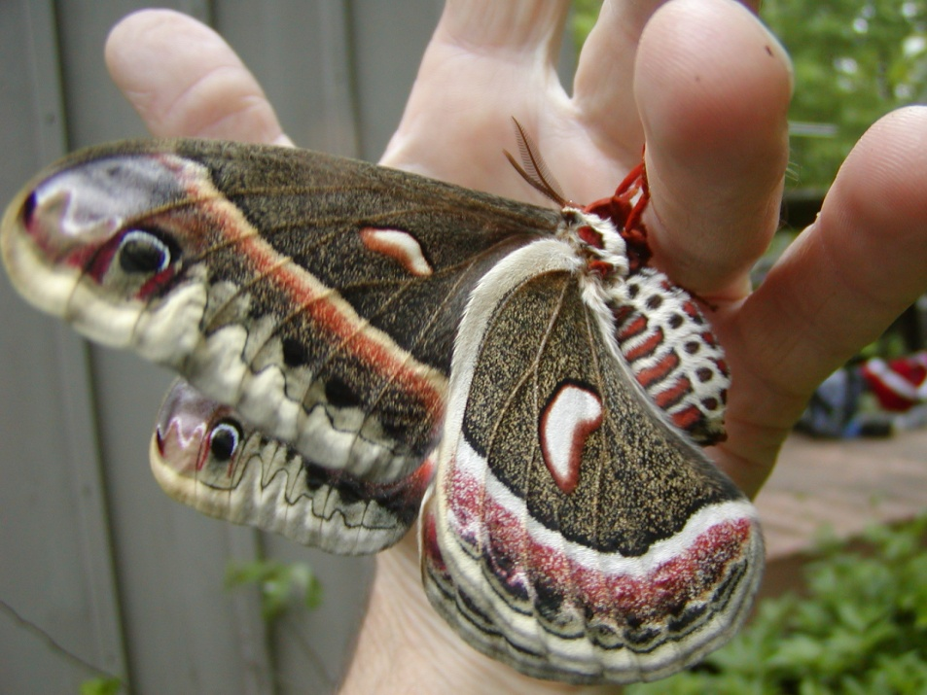
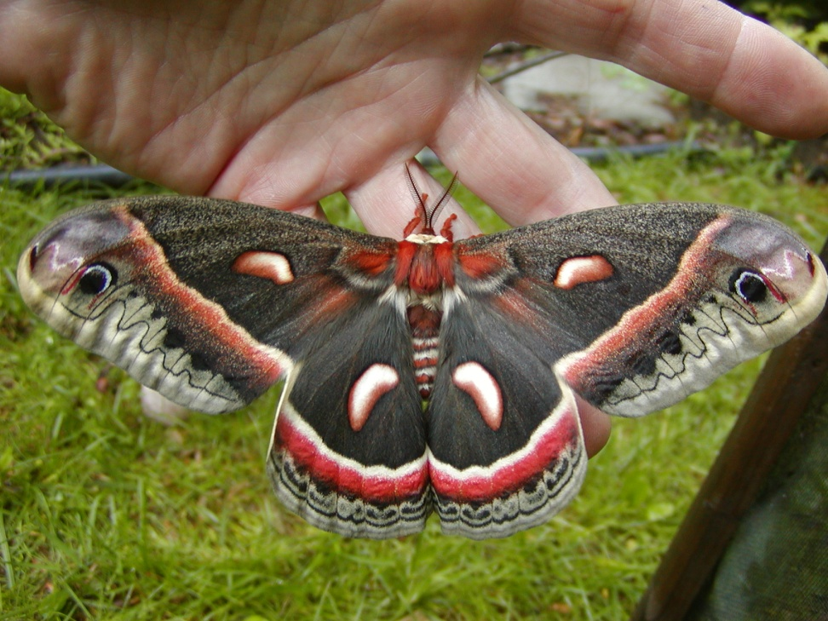
Chewers
Adult cecropia moth

Slide 14
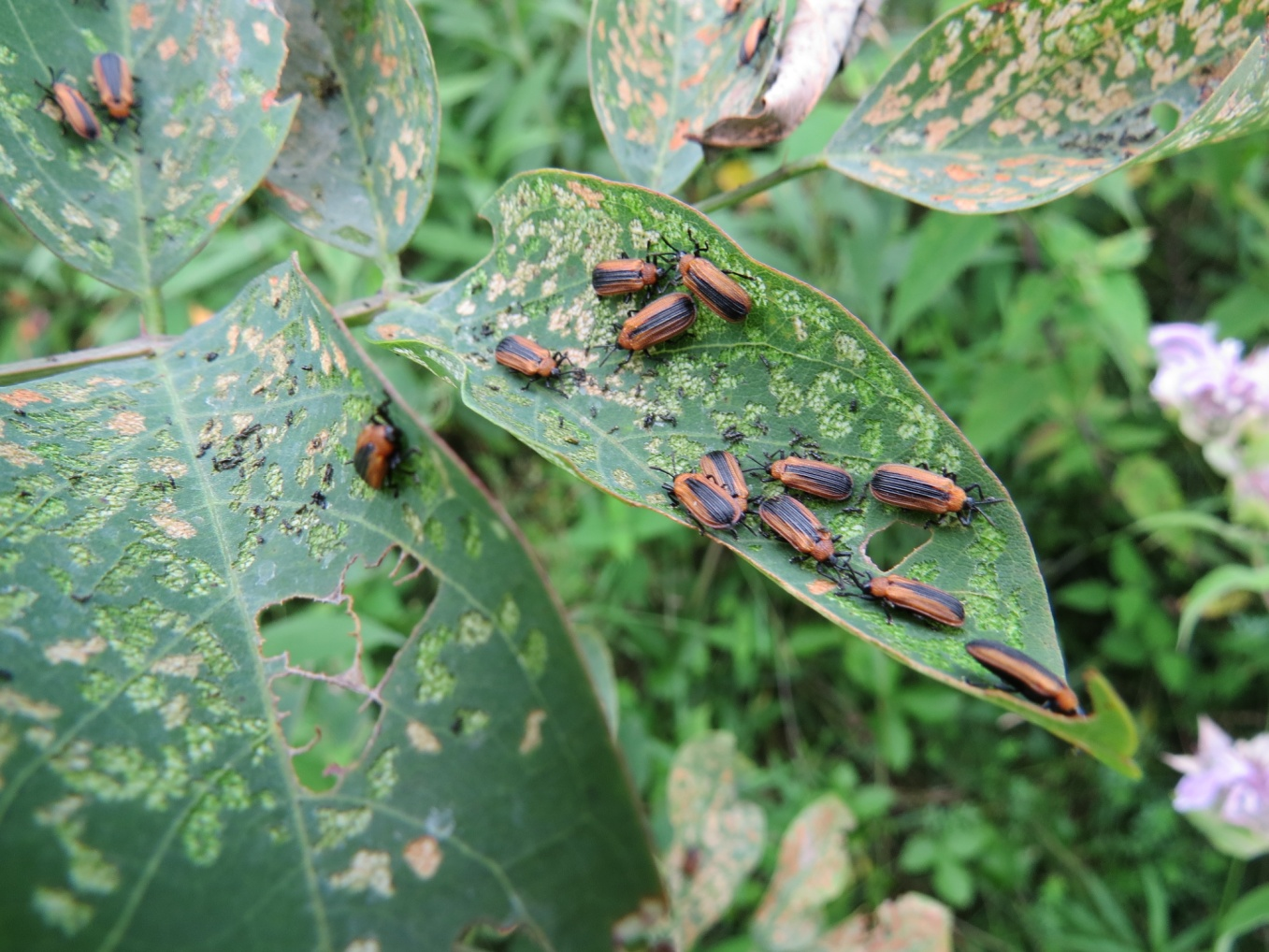
Miners
Locust leaf miner beetle

Slide 15
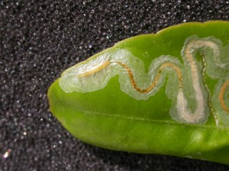
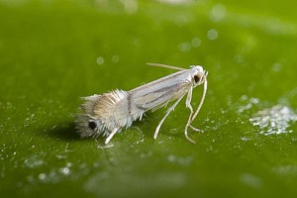
Miners
Citrus leafminer larvae
Citrus leafminer adult
Photos from http://gruett.com/citrus-leafminer/

Slide 16
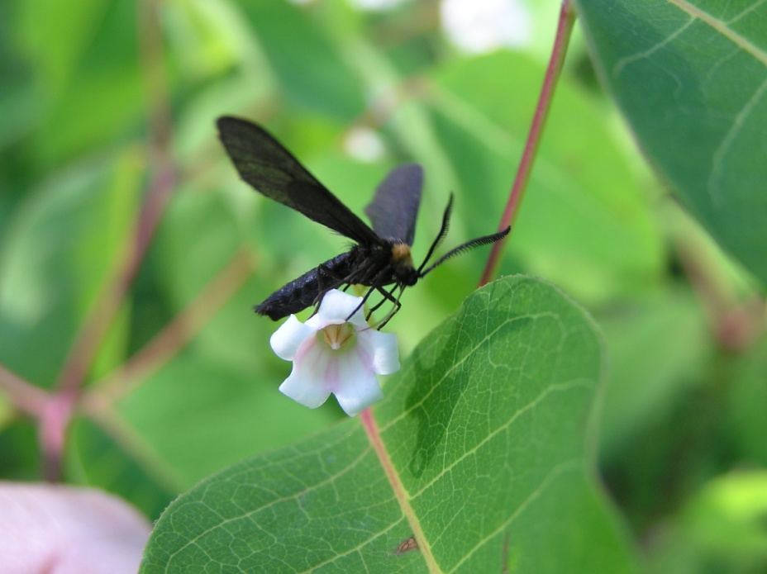
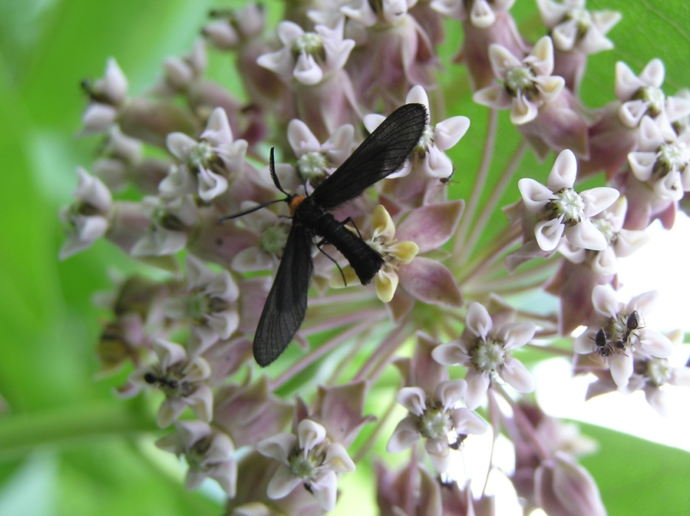
Skeletonizers
Grapeleaf skeletonizer adult

Slide 17
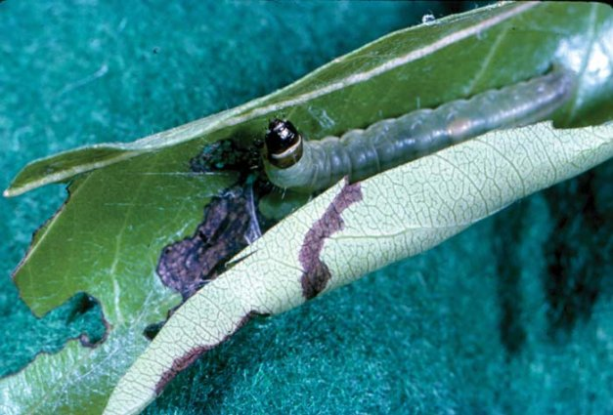
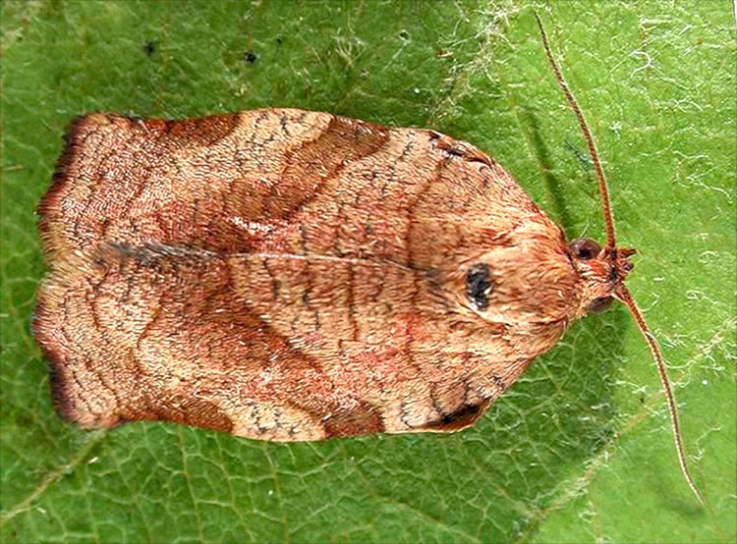
Rollers
Obliquebanded leafroller larvae
Photo from Washington State University
Obliquebanded leafroller adult
Photo from http://invasives.wsu.edu/defoliators/galleries/gallery_live.html

Slide 18
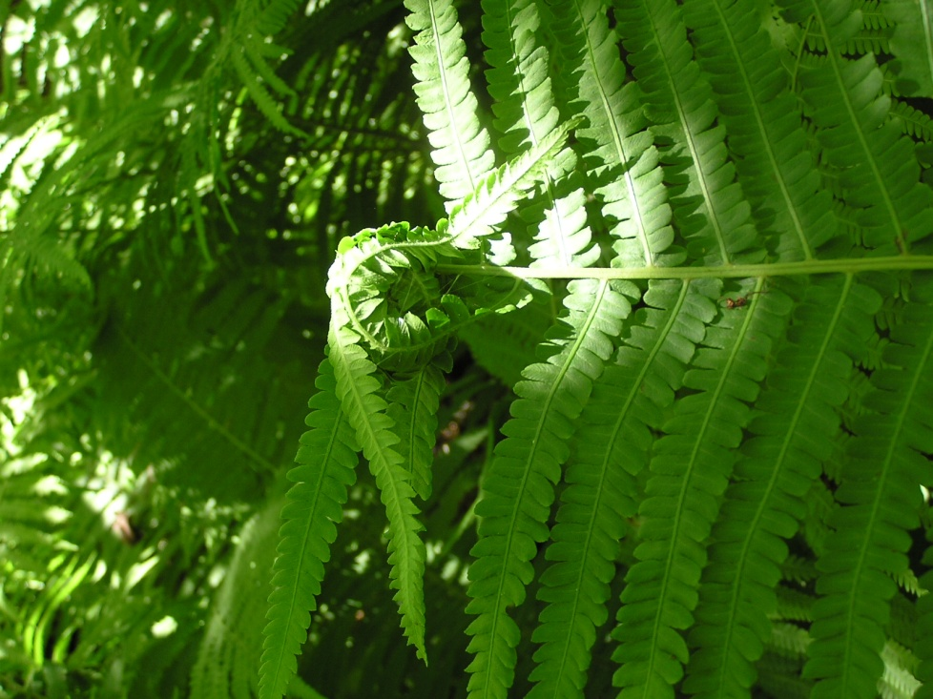
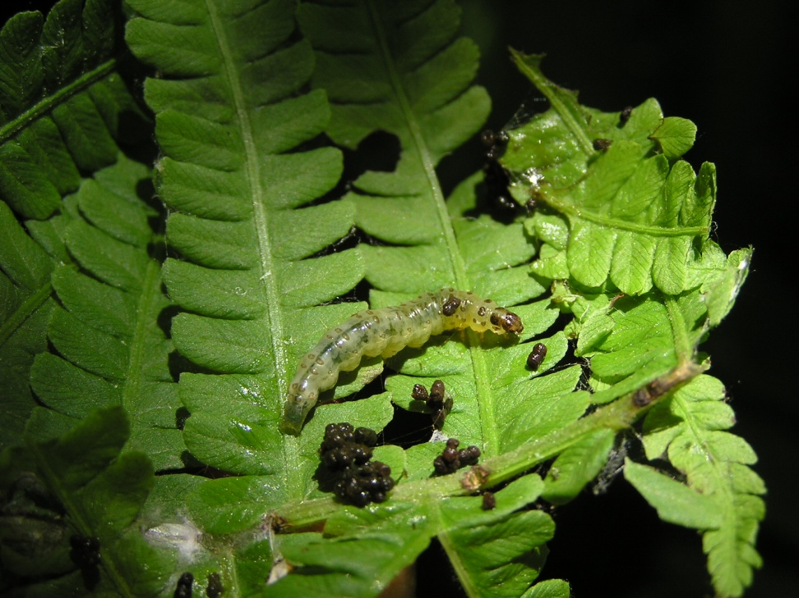
Rollers
Ostrich Fern leaf roller (what it looks like on the left, what the roller looks like inside)

Slide 19
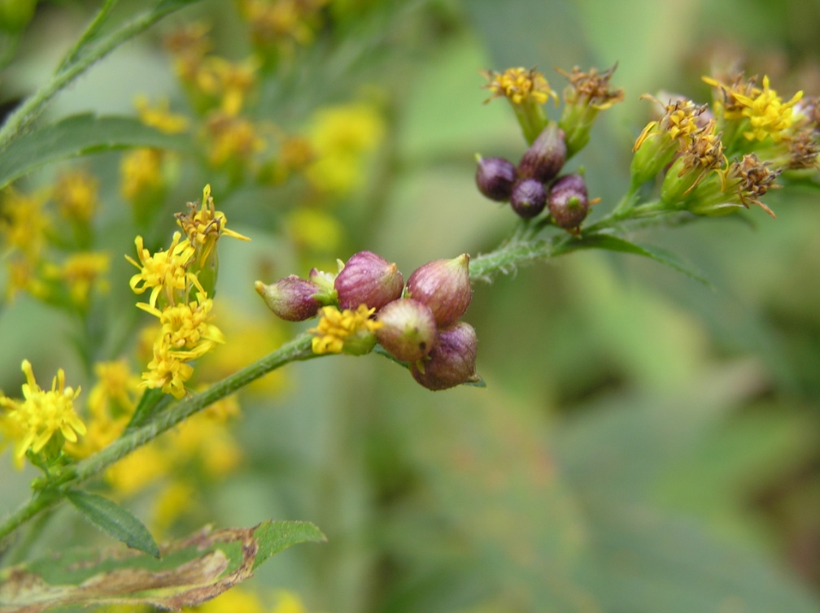
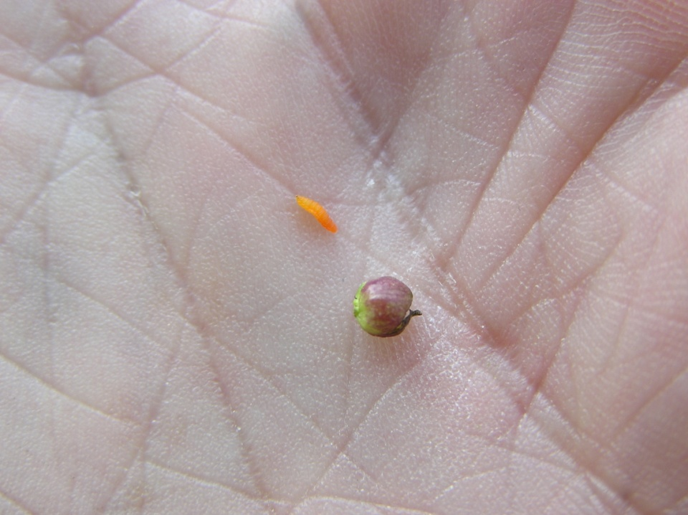
Galls
Goldenrod gall midge (on right); gall on left

