Slide 1
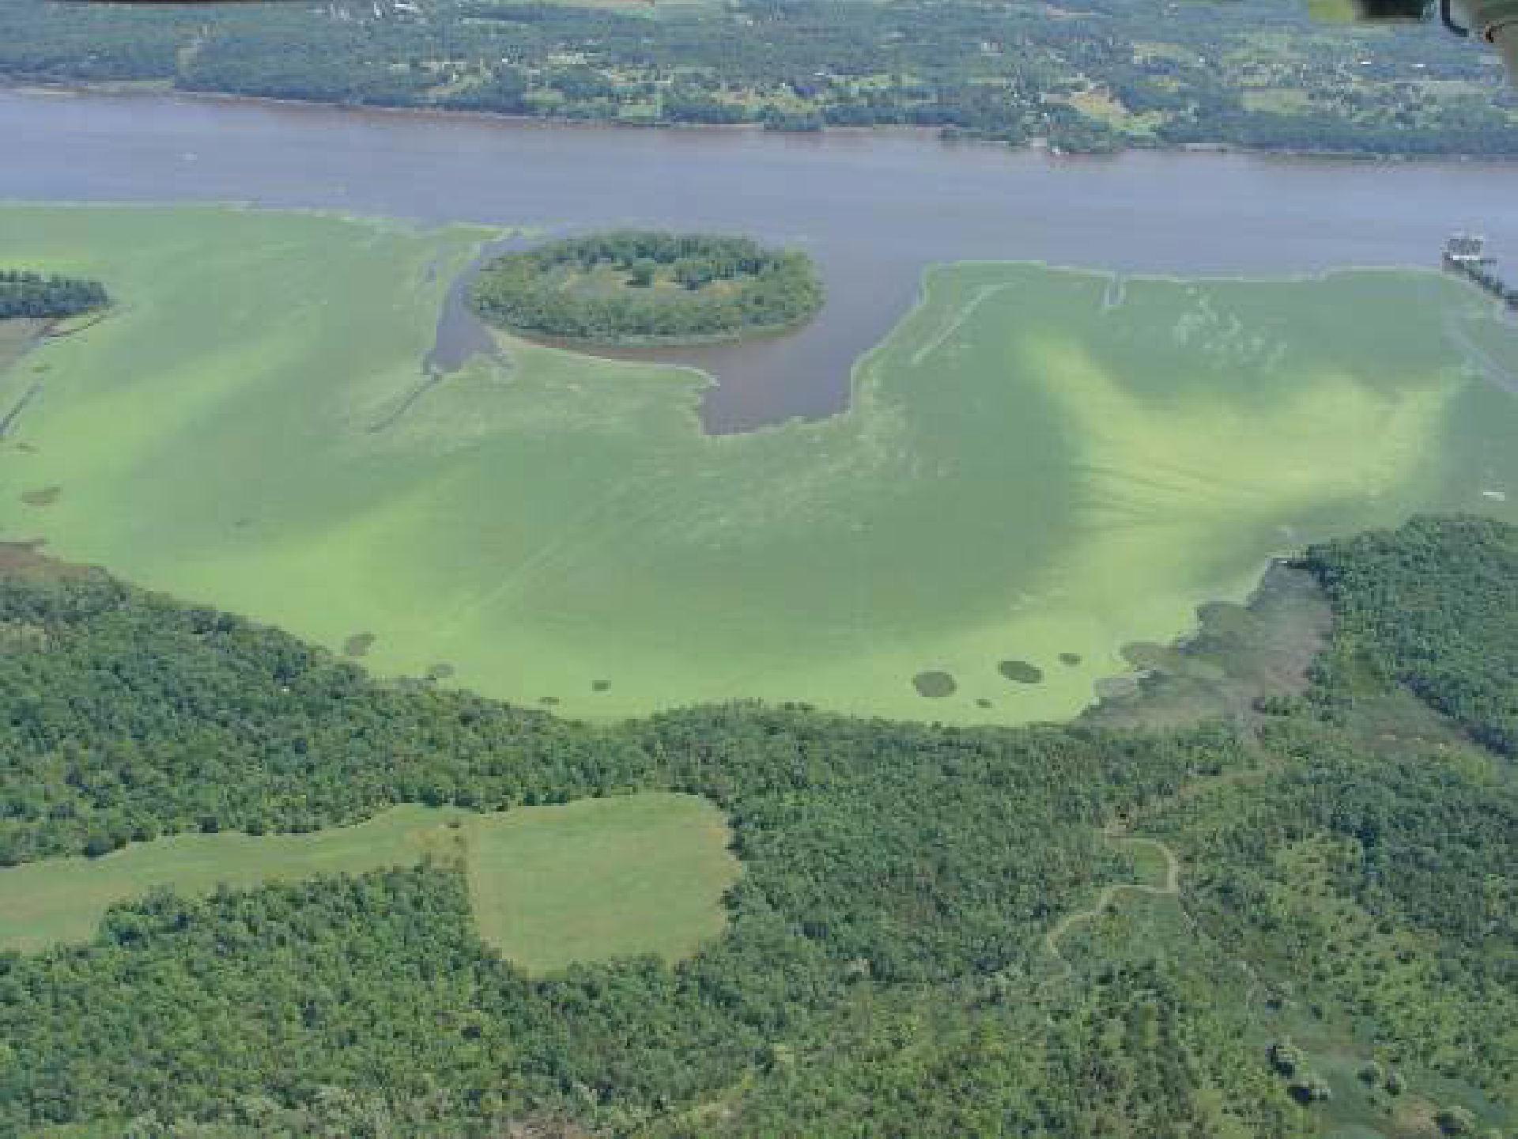
Invasive Species
Photo by Kara Goodwin
Changing Hudson Project
Cary Institute of Ecosystem Studies

Slide 2
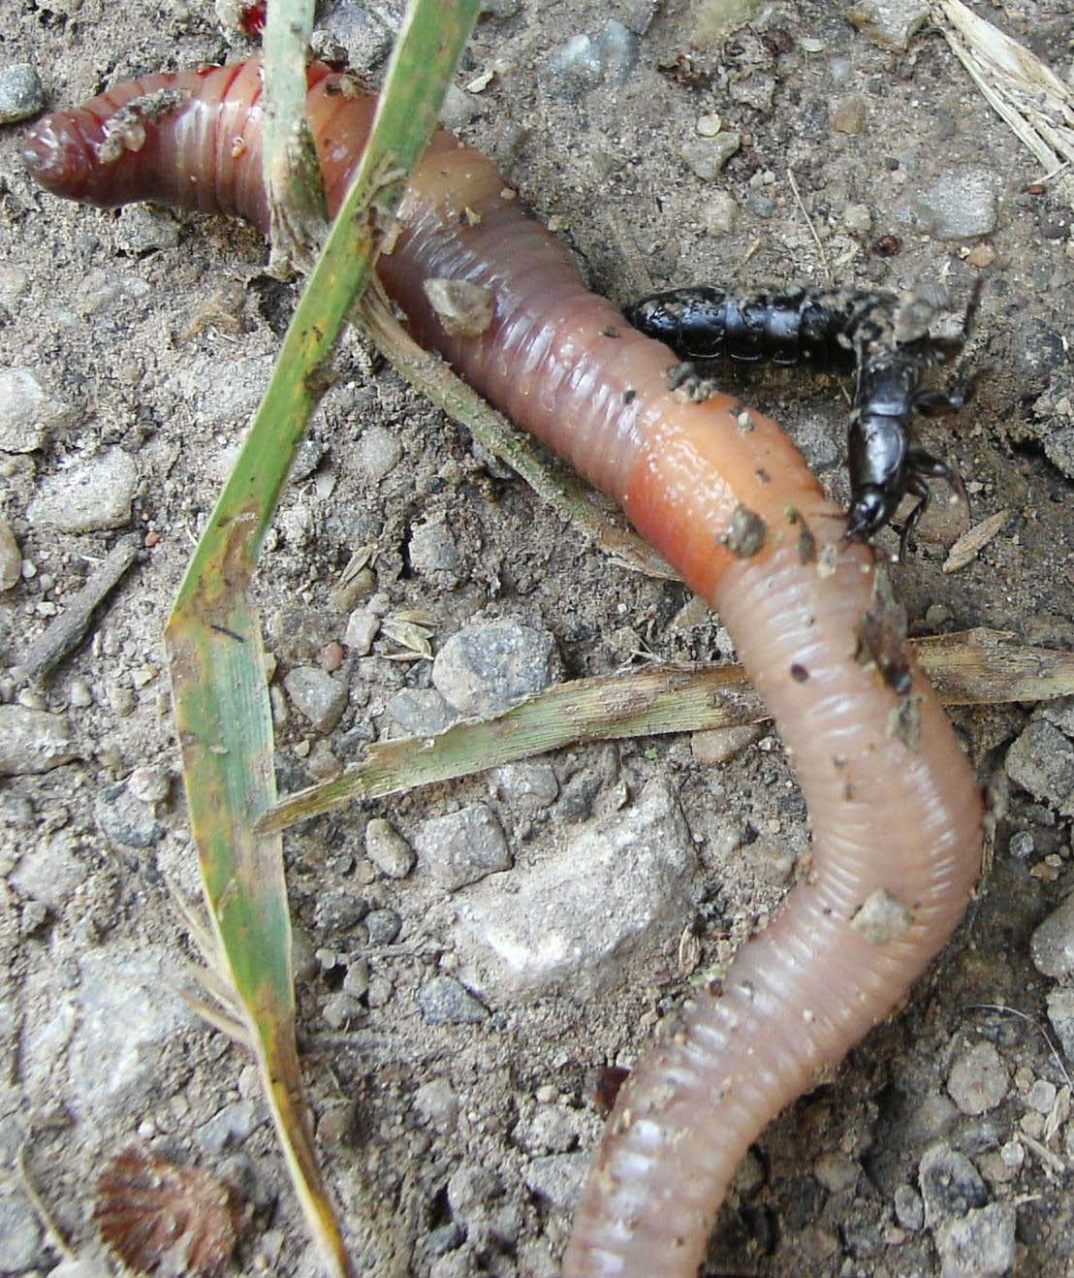
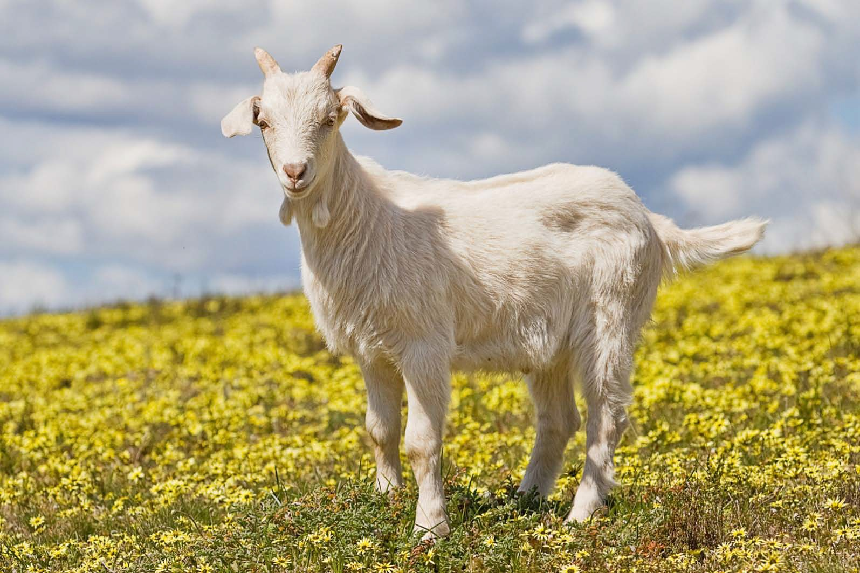
Are these animals invasive?
Photo by sarefo
Fir0002/Flagstaffotos

Slide 3
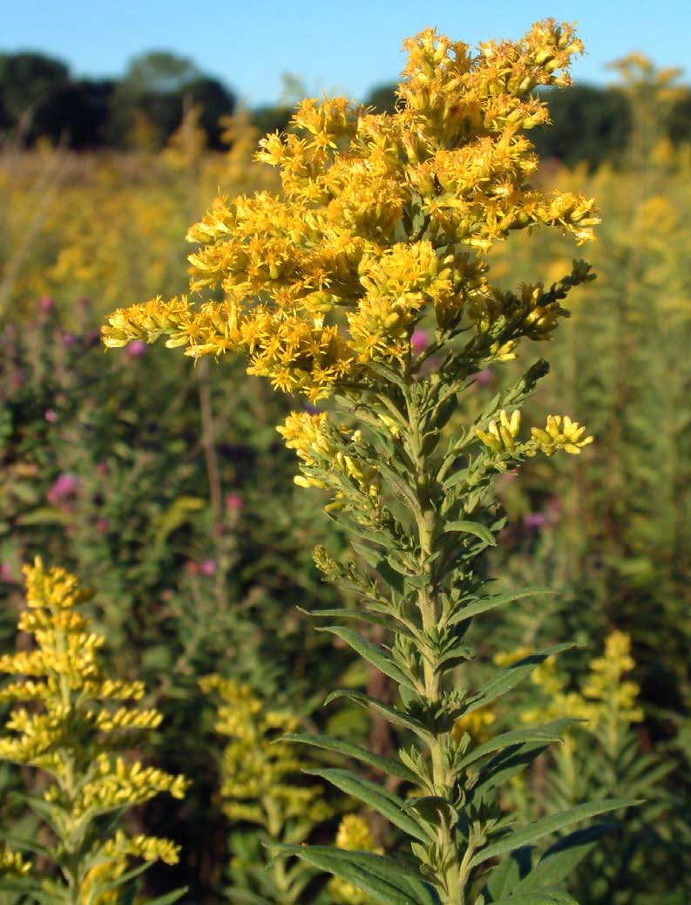
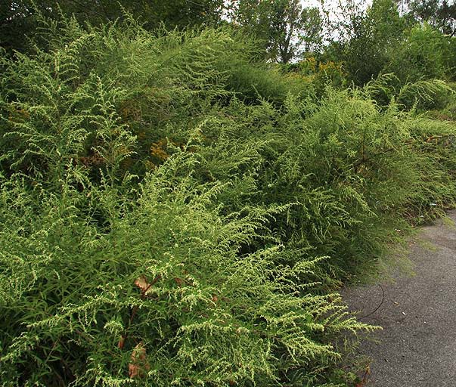
Are these plants invasive?
Photo by Andrew Nelson
Photo by Huw Williams

Slide 4
Game time!

Slide 5
Definitions
Non-native: Alien, outside its native range
  Exotic, introduced, weedy, non-indigenous
  Not normally part of ecosystem
  Established, self-sustaining population
‘10% rule’
~10% survive
~10% of these become invasive
Human activities involved
What is an invasive species? –one that is aggressive and threatens local biodiversity.
Notes:
Presenter
2013-03-14 16:53:09
--------------------------------------------
Non-native species are organisms that originated from a completely different ecosystem They have been introduced from some place else
Now occur outside their native range in established, breeding populations Also called exotic, introduced, weedy, non-indigenous
Not all non-native species survive
EPA estimates that only 10% of introduced species survive and of these, only 10% become invasive No/few predators, competitors or diseases in new environment
Populations may grow very rapidly
Take over habitats, out-compete native species
Introductions involve human activities, either accidental or deliberate

Slide 6
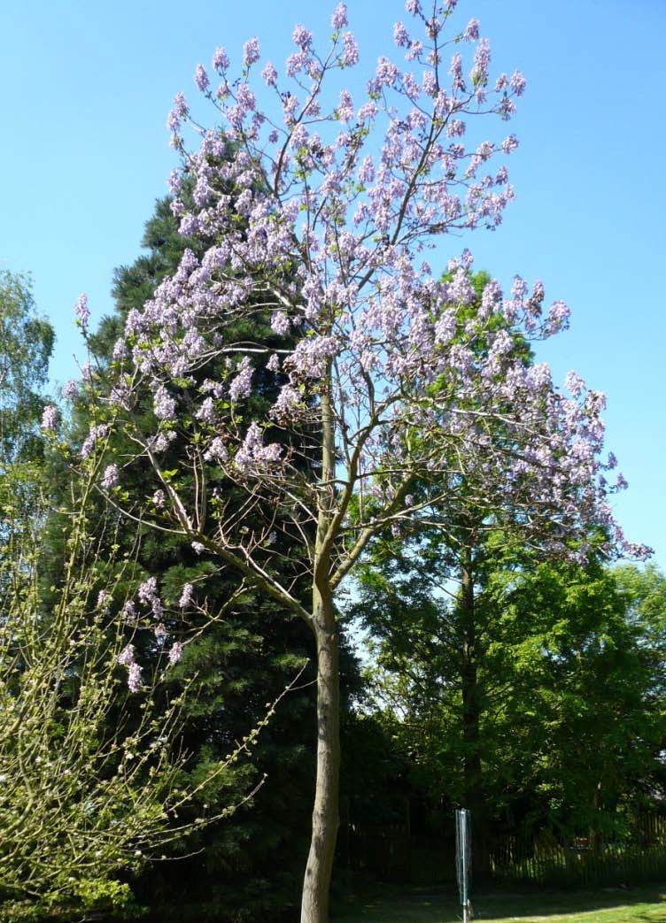
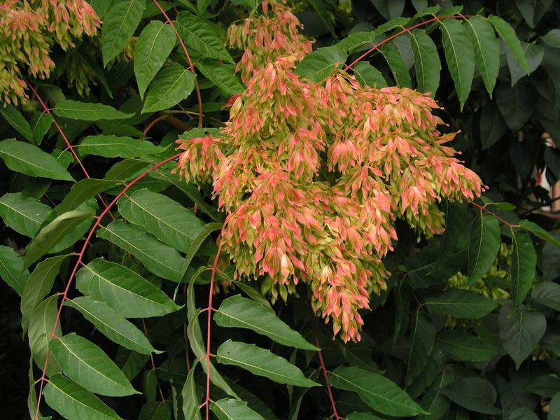
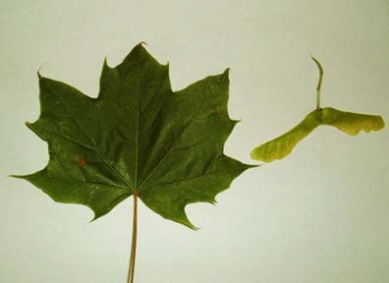
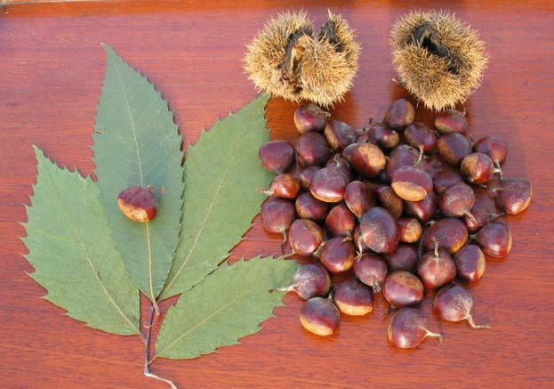
Why worry about invasive species?
Tend to crowd out & replace native species
  60% originated as cultivated species
  Are responsible for ~50% of threats to rare species
IES
Photo by Meneerke bloem
IES
Peatcher
Notes:
Presenter
2013-03-14 16:53:10
--------------------------------------------
Experts estimate that 50,000 alien species have been introduced to the U.S. Threaten natives --typically as predators or competitors for food or habitat
Alien species implicated in 68% of all fish extinctions that occurred between 1900 and 2000
From left: Princess Tree, Tree of heaven (upper), and Norway maple (lower, leaf and samara) – highly invasive, yet commonly planted street trees;
Lower Right – American Chestnut – native; populations decimated by an invasive fungus that was transported here along with a cultivated variety of Asiatic chestnut

Slide 7
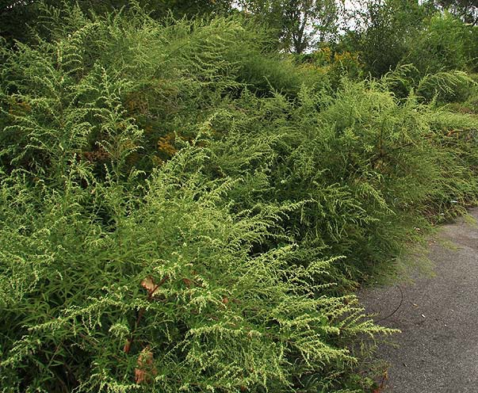

Why worry about invasive species?
Tend to crowd out /replace native species
Can severely damage ecosystem health
Photo by Andrew Nelson
Photo by Huw Williams
Notes:
Presenter
2013-03-14 16:53:10
--------------------------------------------
One key way that invasive species degrade ecosystems is by decreasing biodiversity.
If one looks closely at the image of the mugwort (left), you can see goldenrod (yellow arrows) trying to grow underneath the large canopy of mugwort. Sometimes goldenrod may get to be tall enough to reach the light, but it is still fighting with mugwort for nutrients and space. While the image at right shows goldenrod in abundance, it is easy to see other species (colored arrows) readily growing nearby and beneath it, since it does not form a dark canopy like mugwort. Other ways invasives damage ecosystem health:
--Decrease habitat value for wildlife – provide food (and sometimes shelter) for fewer species of animals
--sometimes directly harm native animals (e.g. black swallow wort/monarch butterflies);
--often change soil chemistry to be less favorable for native plants
--aquatic ones can severely damage fish habitats, ultimately causing tremendous economic damage for fishing industries

Slide 8
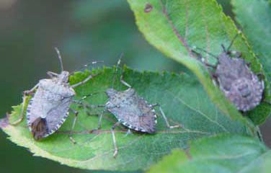
Why worry about invasive species?
Tend to crowd out /replace native species
Can severely damage ecosystem health
Harm human activities (agriculture, forestry, fisheries, recreation)
– $137 billion/ year in damages and pest control costs
(Pimentel, 2000)
$37 million loss to mid-Atlantic apple production in 2010 alone
USDA
Notes:
Presenter
2013-03-14 16:53:10
--------------------------------------------
Invasive species introductions cost you money.
Pimentel ‘s study estimated it costs the U.S. $137 billion/year to “fix” or at least mitigate their negative impacts and in attempts to control these species
Brown marmorated stink bugs are a relatively recent threat to NY (and other northeast & midwest) orchards. They cause tremendous damage to fruit tree crops, though they also attack other fruit and vegetable crops.

Slide 9
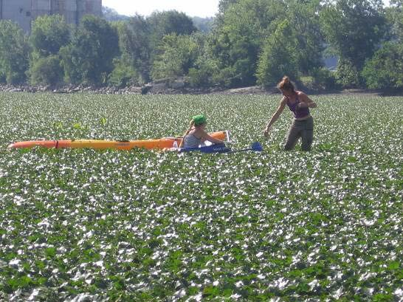
What is this a picture of?
Photo by Kara Goodwin
Photo courtesy of IES
Notes:
Presenter
2013-03-14 16:53:11
--------------------------------------------
A species that nearly anyone who has visited shallow waters along the Hudson River has seen is the invasive water chestnut. This species grows to such densities, that even kayaks often cannot get through the plant beds. It harms other forms of recreation on the Hudson River as well. Other impacts of this species are explored more in future lessons.

Slide 10
What makes invasive species so successful?
Notes:
Presenter
2013-03-14 16:53:11
--------------------------------------------
Ask students: What tends to make invasive species so successful?
They should remember some of the characteristics in the game that either helped or hurt them, depending on whether they were invasive or native.

Slide 11
Characteristics of Successful Invasives
Few natural enemies
  Predators
  Competitors
  Parasites and diseases
High reproductive rate
Long lived
Good dispersal
Generalists
Pioneer species
Notes:
Presenter
2013-03-14 16:53:11
--------------------------------------------
Review the characteristics, adding to the students’ answers anything they missed, or adding correct answers to this incomplete list.
** Remember that this list is more of a guideline of tendencies. Most invasive species demonstrate some-many but not all of these characteristics.

Slide 12
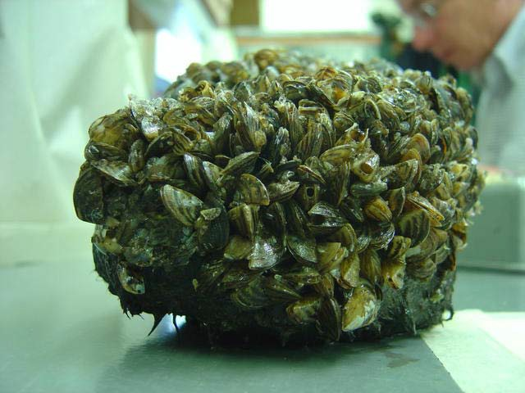
USDA
IES
IES
VA DGIF
Notes:
Presenter
2013-03-14 16:53:11
--------------------------------------------
Invasive species in the Hudson Valley and around the world will be explored further in future lessons. (Clockwise from top left – mile-a-minute vine, common reed, zebra mussels, kudzu)

