Slide 1
What makes invasive species so successful?
Notes:
Presenter
2013-11-26 14:59:20
--------------------------------------------
Ask students: What tends to make invasive species so successful?
They should remember some of the characteristics in the game that either helped or hurt them, depending on whether they were invasive or native.

Slide 2
Definitions
Non-native: Alien, outside its native range
  Exotic, introduced, weedy, non-indigenous
  Not normally part of ecosystem
  Established, self-sustaining population
‘10% rule’
~10% survive
~10% of these become invasive
Human activities involved
What is an invasive species? –one that is aggressive and threatens local biodiversity.
Notes:
Presenter
2013-11-26 14:59:20
--------------------------------------------
Non-native species are organisms that originated from a completely different ecosystem. Also called exotic, introduced, weedy, non-indigenous.
-They have been introduced, often through accidental or deliberate human activity, from some place else. They now occur outside their native range in established, breeding populations.
-Not all non-native species survive. EPA estimates that only 10% of introduced species survive and of these, only 10% become invasive
-No/few predators, competitors or diseases in new environment.
-Populations may grow very rapidly, taking over habitats, out-competing native species

Slide 3
Common Characteristics of Successful Invasives
Few natural enemies
  Predators
  Competitors
  Parasites and diseases
High reproductive rate
Long lived
Good dispersal
Generalists
Pioneer species
Notes:
Presenter
2013-11-26 14:59:21
--------------------------------------------
-Review the characteristics, adding to the students’ answers anything they missed, or adding correct answers to this incomplete list.
-“Pioneer species” are those that are first to establish themselves in an environment after a disturbance (e.g. bulldozing).
** Remember that this list is more of a guideline of tendencies. Most invasive species demonstrate some-many but not all of these characteristics.

Slide 4
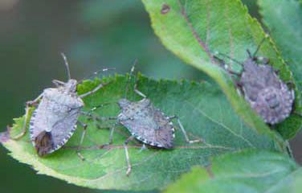
Why worry about invasive species?
Tend to crowd out /replace native species
Can severely damage ecosystem health
Harm human activities (agriculture, forestry, fisheries, recreation)
– $137 billion/ year in damages and pest control costs
(Pimentel, 2000)
$37 million loss to mid-Atlantic apple production in 2010 alone
USDA
Notes:
Presenter
2013-11-26 14:59:21
--------------------------------------------
-Invasive species introductions cost you money. Pimentel ‘s 2000 study estimated it costs the U.S. $137 billion/year to “fix” or at least mitigate their negative impacts and in attempts to control these species
-Brown marmorated stink bugs (in picture) are a relatively recent threat to NY (and other northeast & midwest) orchards. They cause tremendous damage to fruit tree crops, though they also attack other fruit and vegetable crops.

Slide 5
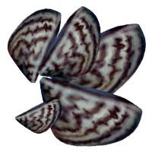
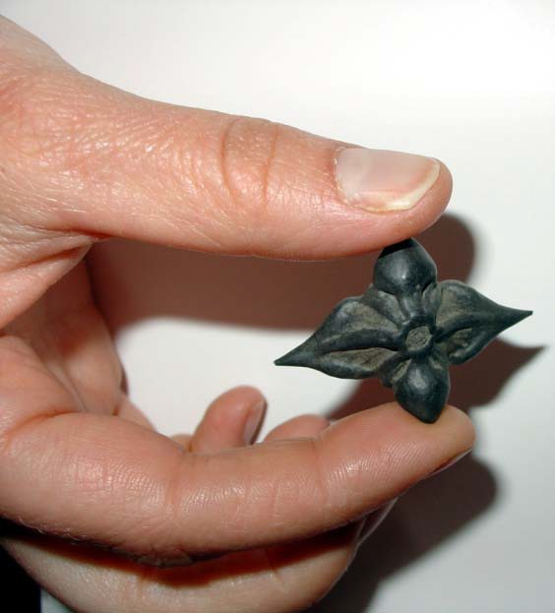
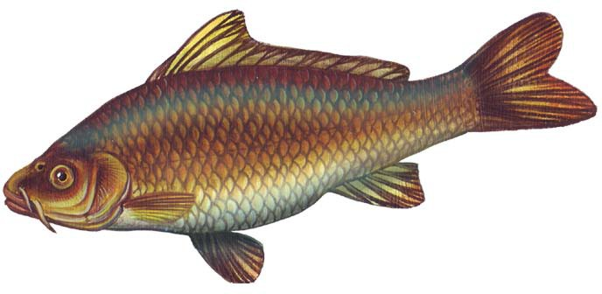
Zebra mussels
There are more than 100 invasive species in the Hudson River, including many of our most familiar plants and animals
Seed from water chestnut plant
Carp
Notes:
Presenter
2013-11-26 14:59:21
--------------------------------------------
Example of invasives in the Hudson River:
Water chestnut (bottom left): form dense floating mats of vegetation limiting light available to other aquatic vegetation.
Carp (bottom right): several Asian carp species are considered invasive. They consume large amounts of plankton. They also have been known to strike boaters when they leap out of the water.
Zebra Mussel (upper right): We’ll talk extensively about these.

Slide 6
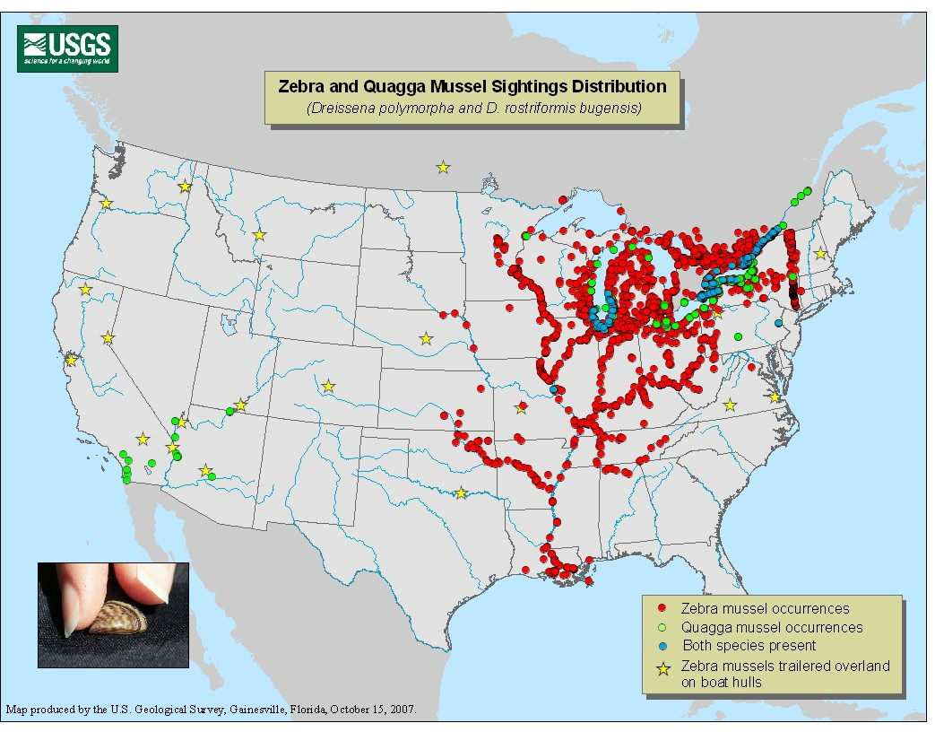
Extent of zebra mussels in the US
Notes:
Presenter
2013-11-26 14:59:21
--------------------------------------------
Extent of zebra mussel invasion in the United States. Zebra mussels most likely entered the Hudson River via the Great Lakes.

Slide 7

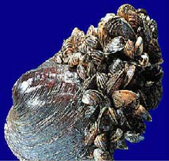

Life history
Filter feeders (plankton) Eaten by some fish, ducks, crayfish &crabs
Up to 700,000 /m²
Mature at 1 year Live 6 - 7 years
Growth
Filter Feeding:
1 liter water /day
USGS
40,000-
1,000,000 eggs
/year
Settle on hard surfaces
Settling:
10,000 /m³ /day
Larvae (Veliger) 500,000 / m³
95% die
200,000,000
sperm
Warm water, external fertilization
Notes:
Presenter
2013-11-26 14:59:21
--------------------------------------------
Life History of ZM -Gametes shed into water.
- The immature form settles on and affixes itself to hard surfaces.
-Mature quickly and live 6-7 years
-Prey item for few species in Hudson River (further discussed later)

