Slide 1
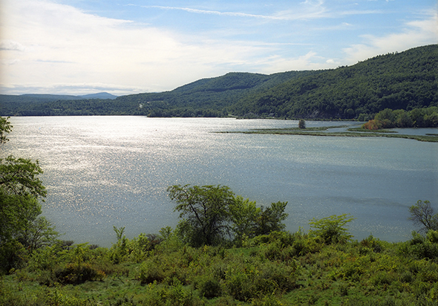
Modeling the interaction of
salinity and diatom populations
in the Hudson Estuary

Slide 2
Day 1: Graphing Salinity Data from HRECOS

Slide 3
Objectives: Day 1
Students will be able to construct a food web, showing relationships between organisms.
Students will be able to name abiotic factors, and show their interactions with biotic factors.
Students will be able to accurately plot data and calculate averages.
Students will be able to identify and explain cyclical patterns from graphed data.

Slide 4
Brainstorm!
What organisms live in the Hudson River?
List as many as you can!

Slide 5
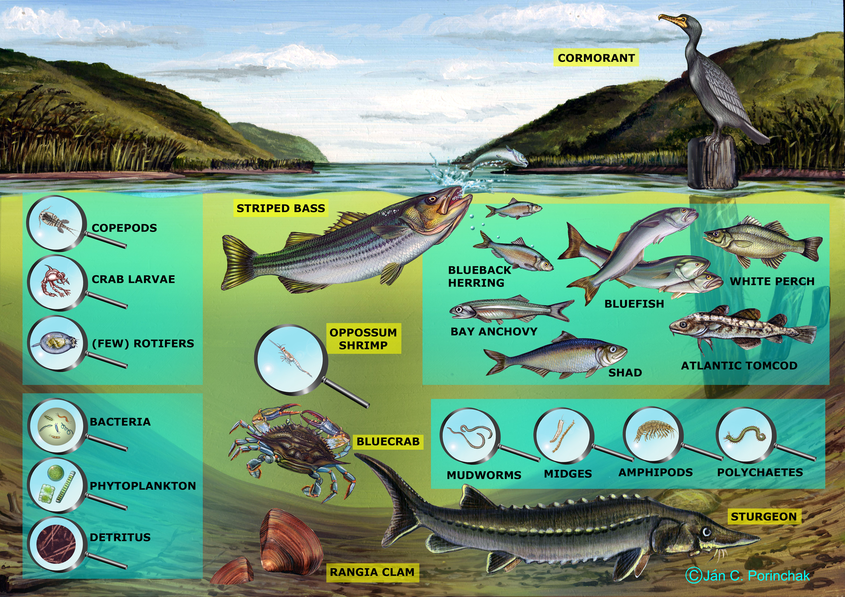
Report Out
After sharing your answers, how many organisms were you able to list?
Which are producers?
Which are consumers?
Which are decomposers?
Notes:
http://www.caryinstitute.org/sites/default/files/public/downloads/curriculum-project/BRACKISH_CHANNEL_no_arrows_copy.jpg
Teacher can use graphic to prompt more answers if needed. After generating a robust list of organisms, divide organisms equally between students. Have students draw their organisms on a magnet strip/Post-it and place it on the display surface.

Slide 6
Make a Food Web
Working with your classmates, draw arrows between your organisms to create a food web.
Notes:
Have students work cooperatively to show the connections between the organisms they’ve posted.
Extension/ scaffolding: Teacher can show students the food webs available at http://www.caryinstitute.org/educators/teaching-materials/hudson-river-ecology to generate ideas, check work, or provide more information.

Slide 7
Abiotic Factors
How many abiotic factors can you think of in this ecosystem?
Place these abiotic factors on your diagram.
Think of one way that changing each abiotic factor could affect the ecosystem.
Notes:
Scaffolding: If students struggle with generating ideas, teacher can provide a list of factors and ask students to place them on the diagram and describe how a selected one would move through or affect organisms. Possibilities include acidity, temperature, water depth, dissolved oxygen, salinity, and turbidity. Data on each of these parameters can be found on the HRECOS website (http://www.hrecos.org/) for further research.

Slide 8
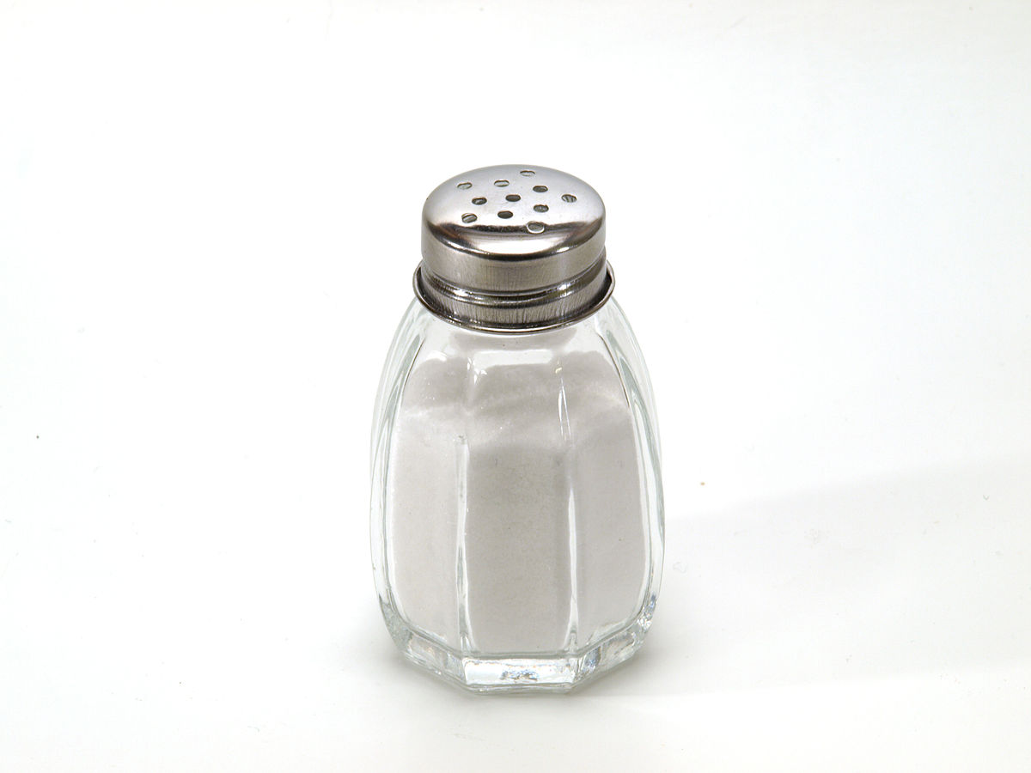
Salinity
Salinity is a measure of the amount of salt in
a given amount of water.
Salinity can be measured in units of PSU (Practical Salinity Unit). This is equivalent to parts per thousand or to g/L.
Notes:
Photo: http://www.flickr.com/photos/11939863@N08/3793288383/in/photostream/
Author
Dubravko Sorić SoraZG on Flickr

Slide 9
Graphing Salinity
Graph the data on salinity at your station over a two day period.
Use the data chart to calculate the average salinity at your station.
Does the salinity at your station change over time? If so, is there a pattern? What do you think might cause this pattern?
Notes:
Student answers may differ depending upon their assigned station. Review the idea of ocean tides as a class if necessary. An information sheet on tides in the Hudson is available at the Cary Institute website at http://www.caryinstitute.org/sites/default/files/public/downloads/curriculum-project/Tides_in_the_Hudson_I_2_pages.pdf.

Slide 10
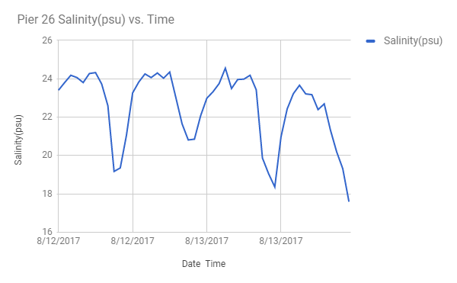
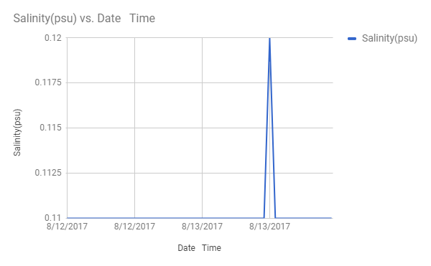
HRECOS Data
Sample graph: Pier 26 salinity by hour
August 12-13, 2017
Sample graph: Marist salinity by hour
August 12-13, 2017

Slide 11
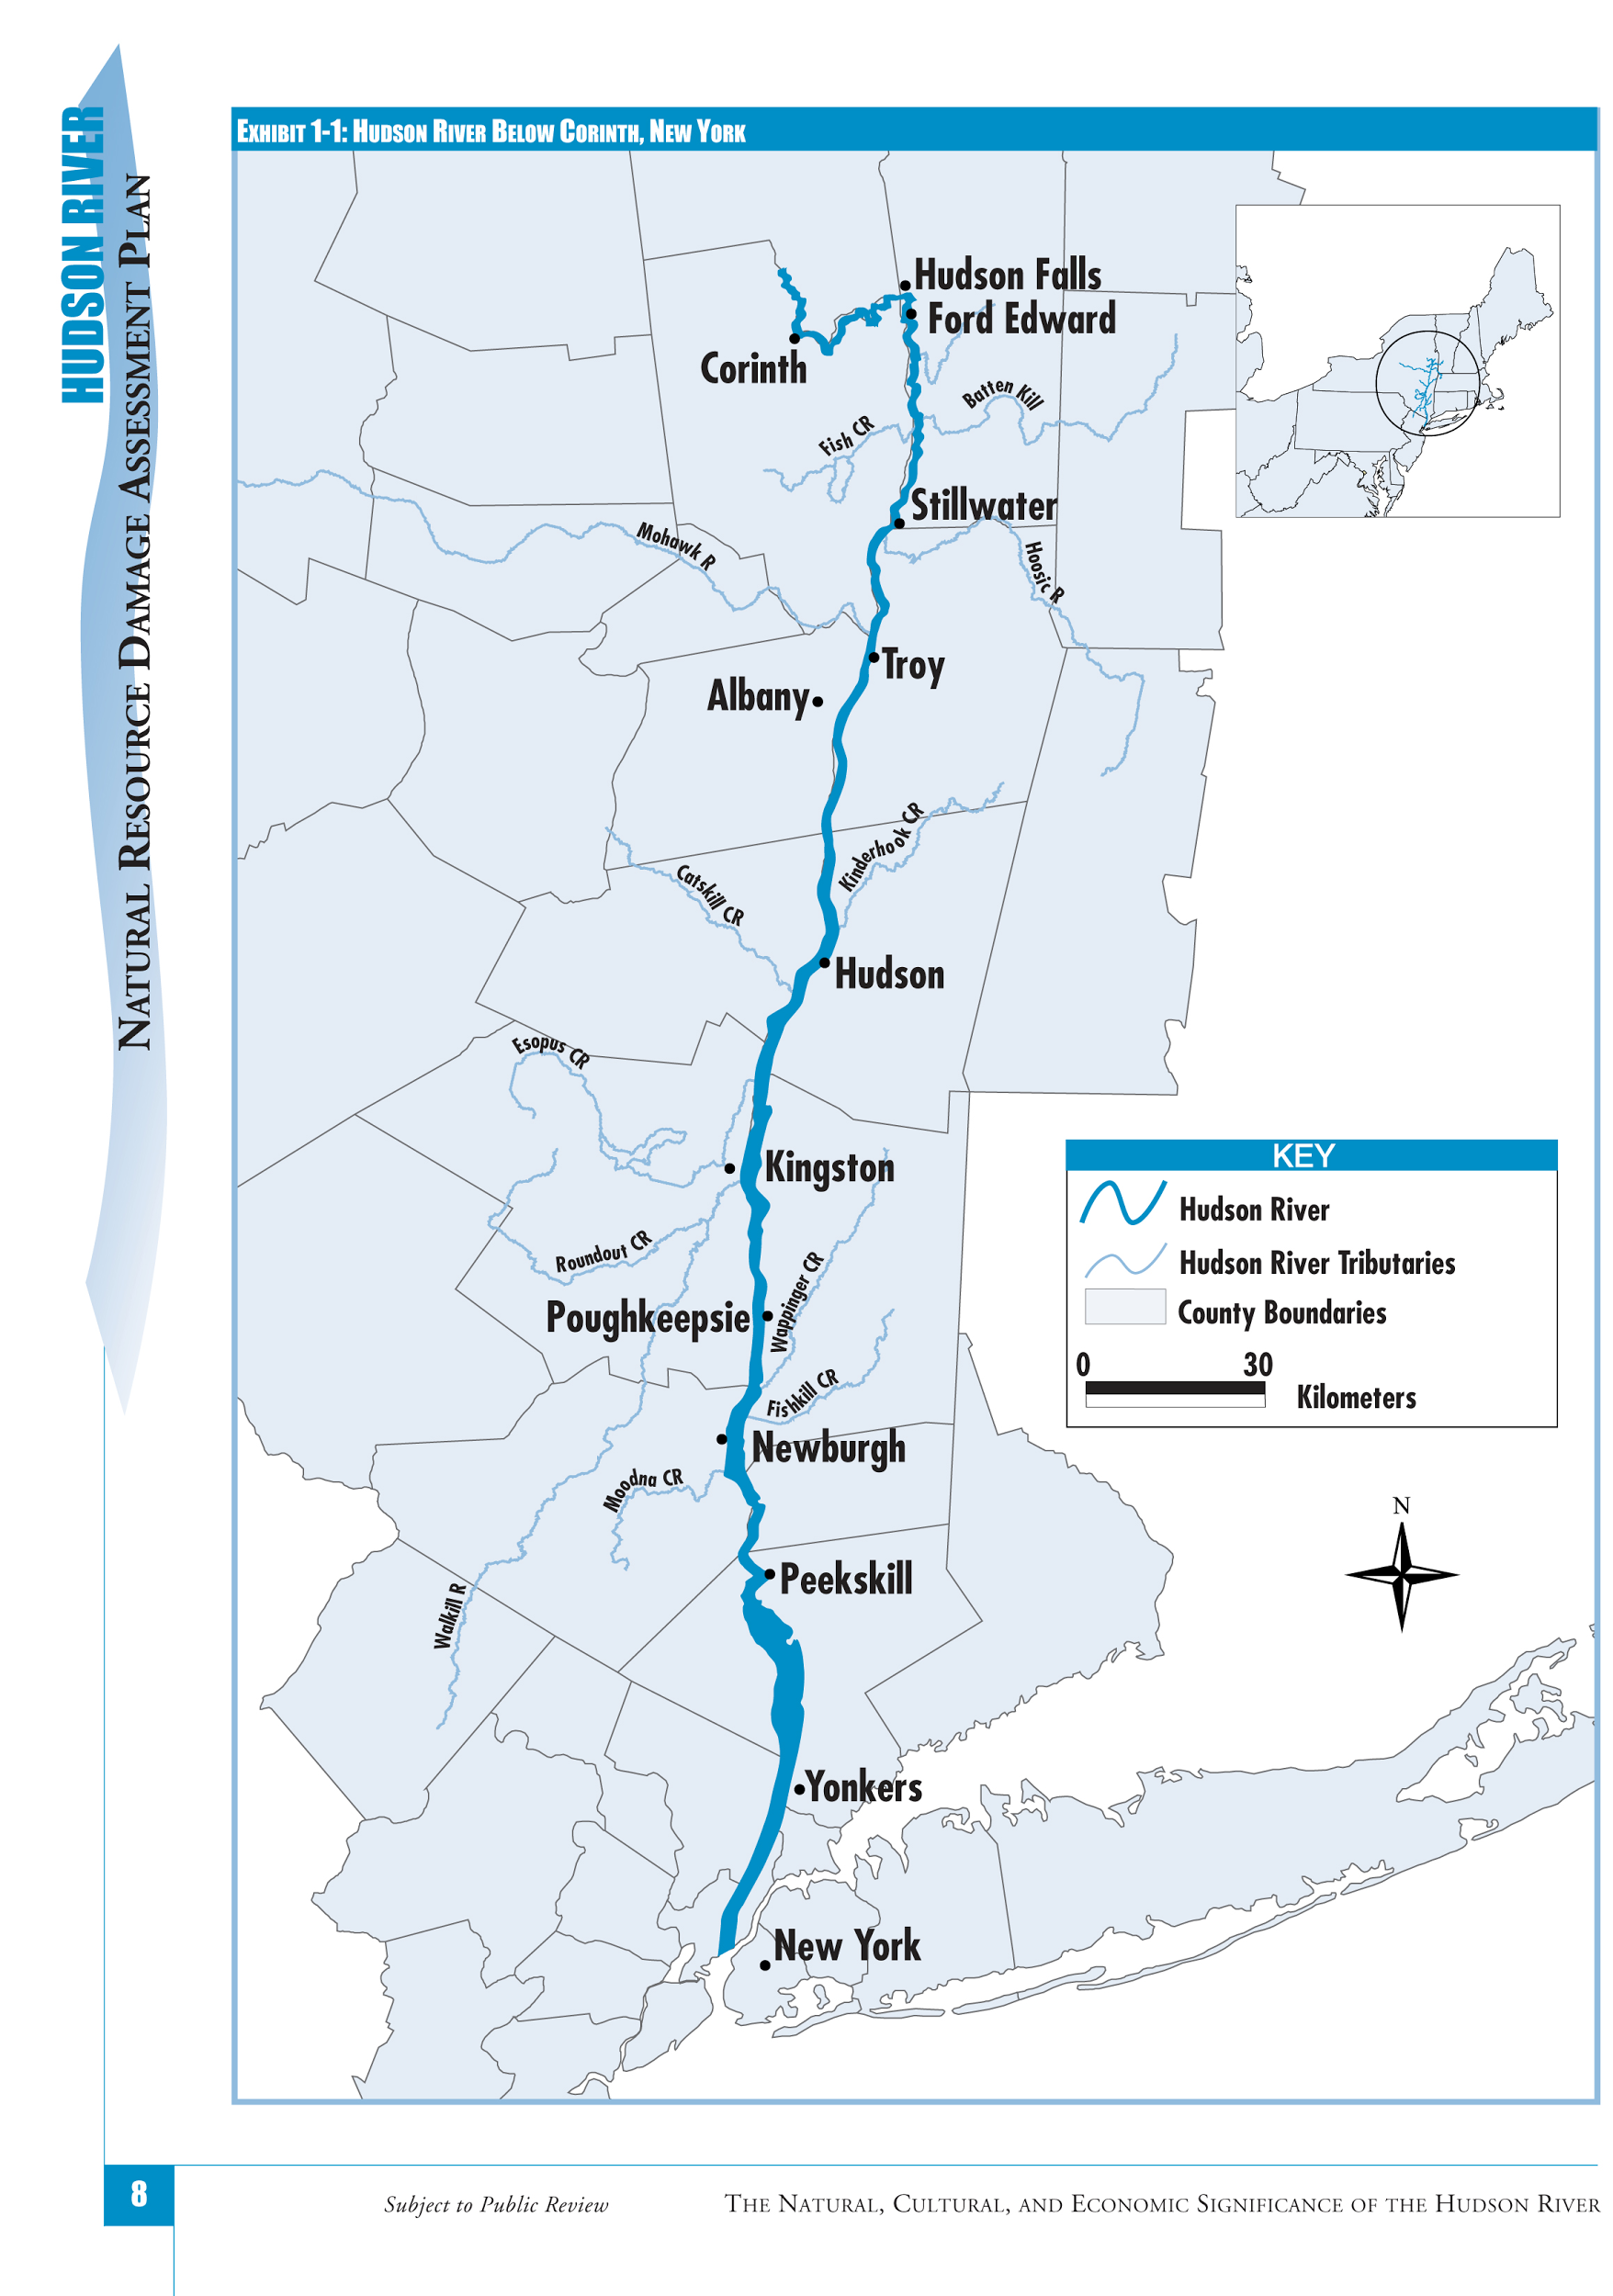
Salinity in the Lower Hudson River
Locate your station on the Hudson River map and place your graph at the station.
How do the salinity graphs change from the mouth of the river as you move north? What causes this change?

Slide 12
The Salt Front
The salt front is the leading edge of salt water entering an estuary. It can be located by finding the border between brackish and freshwater.
Where is the salt front located on your map of the Hudson River?

Slide 13
Freshwater and Saltwater
Think about the ecosystems on either side of the salt front.
How might these ecosystems differ?
Notes:
Discuss with students how freshwater and brackish ecosystems might differ. Discuss the adaptations that animals and plants would need to live in each. If students have completed the NYS Living Environment lab “Diffusion through a Membrane,” this discussion can be linked with what they observed of the movement of substances in and out of cells and the questions on the lab.
Brackish food web: http://www.caryinstitute.org/sites/default/files/public/downloads/curriculum-project/BRACKISH_CHANNEL_food_web.jpg
Freshwater food web: http://www.caryinstitute.org/sites/default/files/public/downloads/curriculum-project/FRESHWATER_CHANNEL_food_web_0.jpg

Slide 14
Day 2-3: Using HRECOS data to find and map Freshwater and Saltwater Diatoms
in the Hudson Estuary
Notes:
aka Diatoms of the Hudson Esturay OR Diatoms-on-Hudson
http://www.dec.ny.gov/docs/remediation_hudson_pdf/hrlpixphytop.pdf

Slide 15
Objectives: Day 2
Students will be able to follow directions to carry out diatom collection.
Students will be able to demonstrate proper use of a microscope.
Students will be able to produce accurate and detailed sketches of diatoms, including magnification and identification.
Students will be able to correctly place diatom species on Hudson River map using salinity data.
Students will be able to explain the relationship between salinity and the presence of certain species.
Students will be able to ask three questions that they have about the relationship between diatoms, salinity, and the Hudson River.

Slide 16
The Hudson Estuary contains floating communities of phytoplankton, comprised of diverse algae and other tiny photosynthetic organisms.

Slide 17
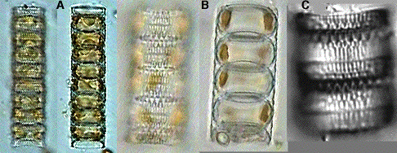
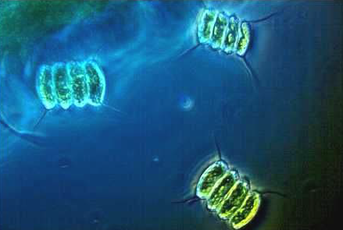
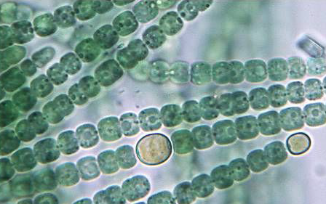
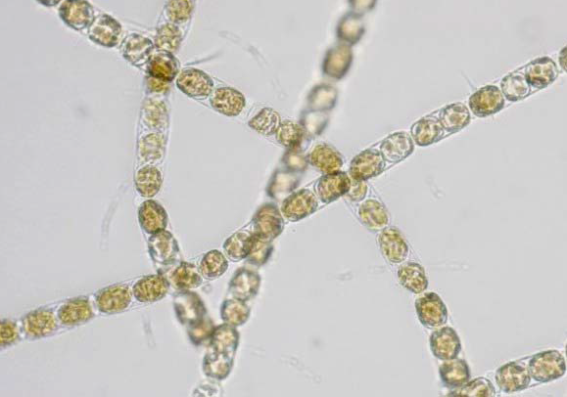
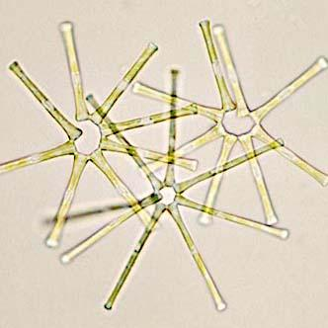
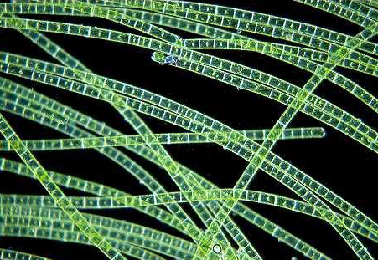
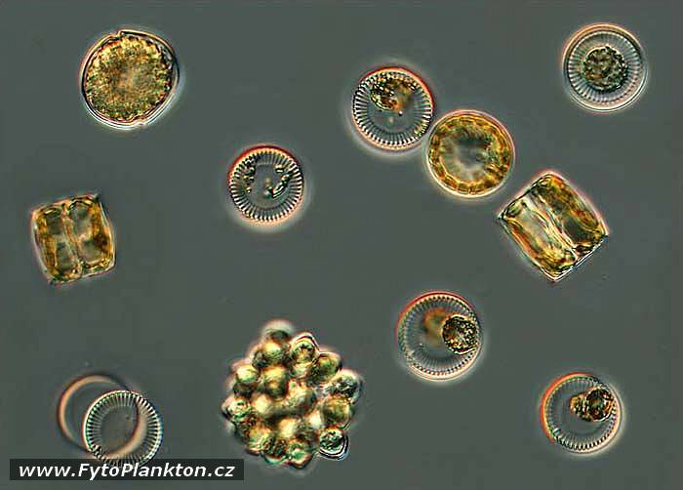
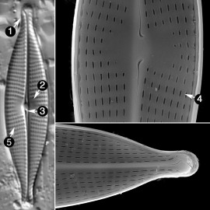
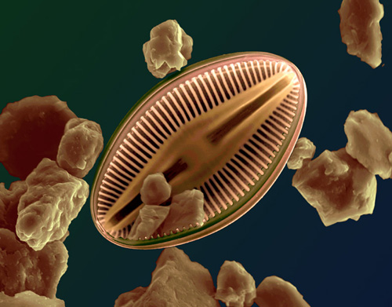
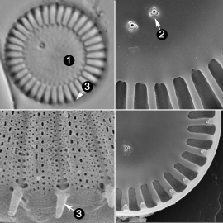
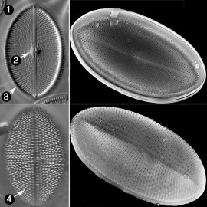
Bacilliariophyta aka diatoms dominate, especially in the winter when other phytoplankton populations are low. Click on each algae to learn more.
Notes:
NOTE: The presentation is sequential except for the viewing of the various algae.

Slide 18
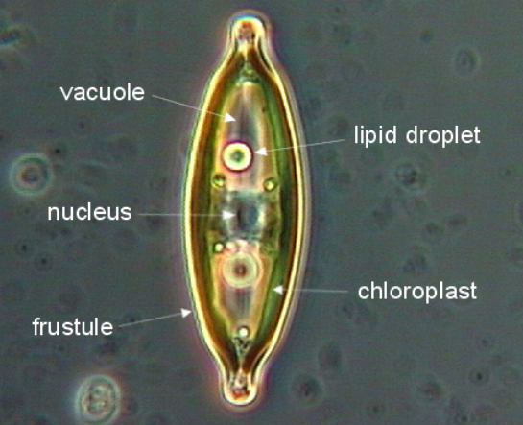
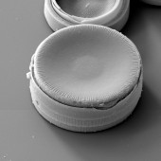
Diatoms are “algae in glass houses”
Diatoms have transparent silica cell walls that are formed in two pieces which fit together like a pillbox. Silica is the main component of glass, so diatoms are often referred to as “algae in glass houses.”
Notes:
Pennate SA Manual
Centric

Slide 19
Freshwater diatoms are generally pennate or centric
Pennate diatoms live in benthic zones but may be suspended in the water column. They can be somewhat motile. Centric diatoms are circular and are a part of the phytoplankton. They do not move on their own but can be moved by waves, etc.
Notes:
Pennate SA Manual
Centric diatoms of the US
pgs 7-8 http://docs.niwa.co.nz/library/public/1770054839.pdf
Coscinodiscophyceae, centric

Slide 20
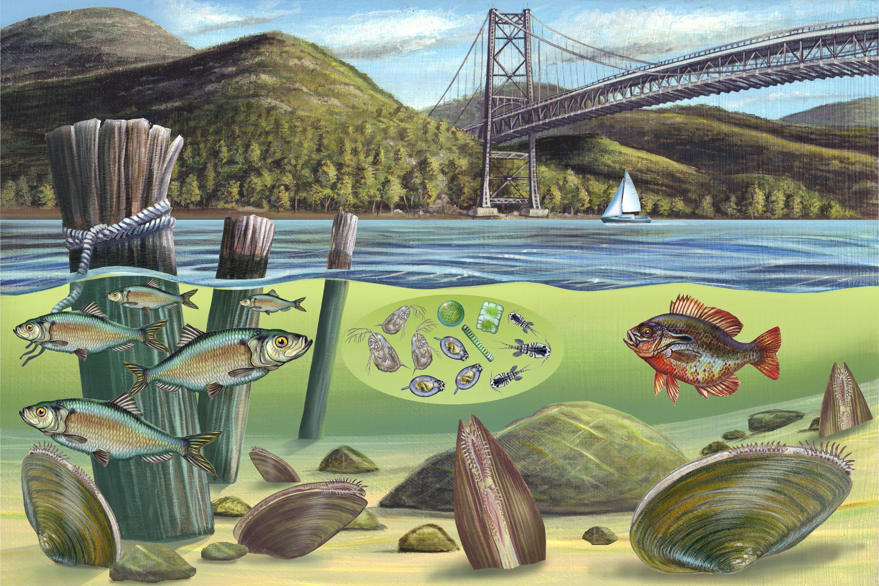
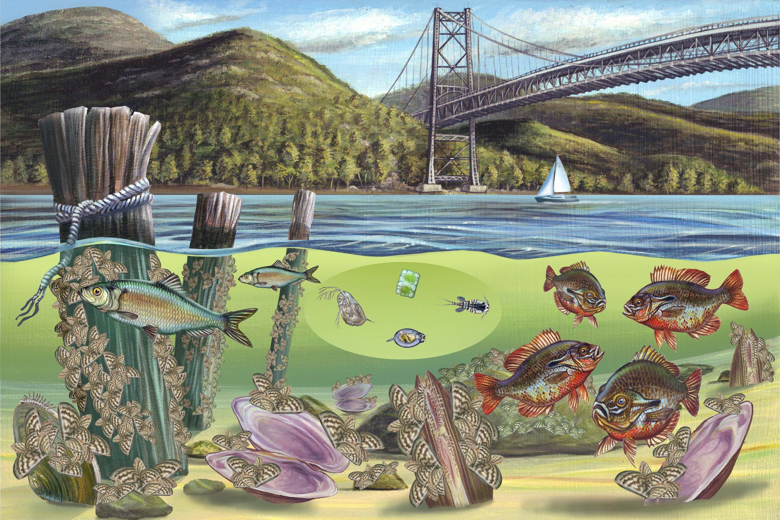
Diatoms are highly sensitive to abiotic factors so are often used as environmental indicators.
Before zebra mussels After zebra mussels
Invasive zebra mussels initially depleted Hudson Estuary phytoplankton levels by 85%
Notes:
Caraco, N. F., Cole, J. J., Raymond, P. A., Strayer, D. L., Pace, M. L., Findlay, S. E., & Fischer, D. T. (1997). Zebra mussel invasion in a large, turbid river: phytoplankton response to increased grazing. Ecology, 78(2), 588-602.

Slide 21
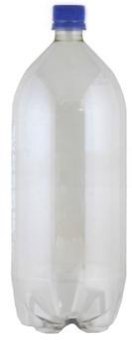
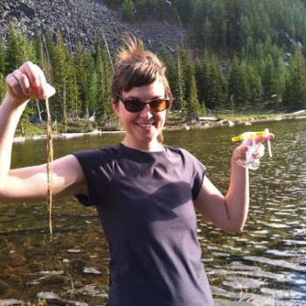
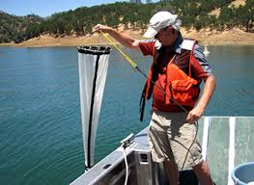
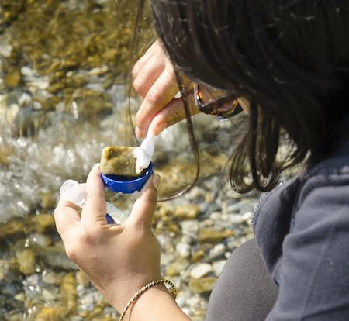
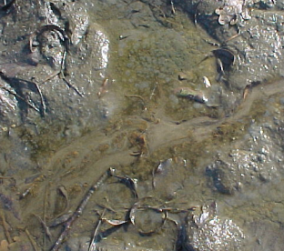
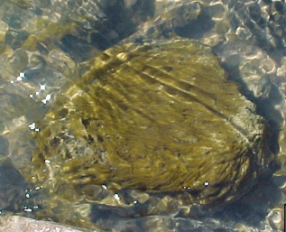
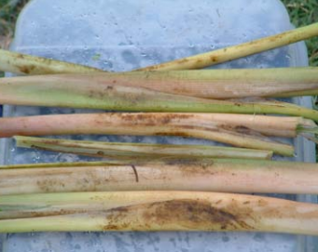
Collecting diatoms in the Hudson Estuary
…in floating phytoplankton:
…in benthic zones (in sediment or sublayers of water body):
OR
OR
String
Microplankton net
2 Liter bottle
Toothbrush Method
Notes:
2 liter bottle

Slide 22
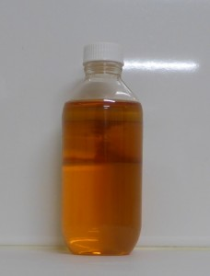
Preparing diatom samples for light microscope viewing
1. Separate a small amount of the collected sample and use for viewing under the microscope alive
2. Add Lugol’s solution to remaining collected sample until it is a dark yellow/light brown (“weak tea”) color
3. Allow the organisms to settle to the bottom over 16-24 hours. (Taylor, 2007)
http://microalgal.com.au/lugols-iodine/
Notes:
Lugol’s solution is from http://microalgal.com.au/lugols-iodine/

Slide 23
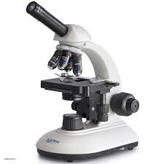
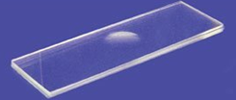
Identifying and recording diatom populations
Use a pipette to put a droplet of sample on the center of the slide and add a cover slip on top of the sample. For living samples, use concave slides so pennate diatoms may be seen moving For non-living samples, standard slides are fine.
View at low power magnification (10x eyepiece lens X 4x objective lens. Use coarse and then fine focus knob when you have found an object of interest
Center diatom(s) of interest and increase to medium or high power magnification
Refocus with the fine focus knob

Slide 24
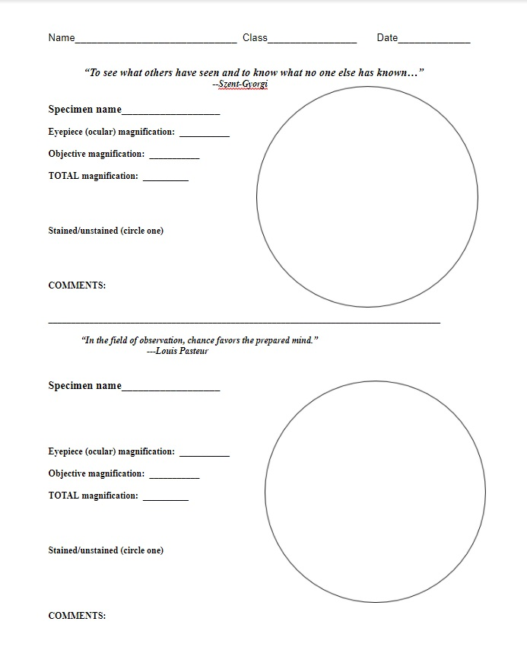
Identifying and recording diatom populations (continued)
Use the microscope drawing worksheet to draw what you see.
Use pencil to record a detailed drawing for each type of diatom you observe
Be sure to include the eyepiece, objective and total magnifications with the drawing.

Slide 25
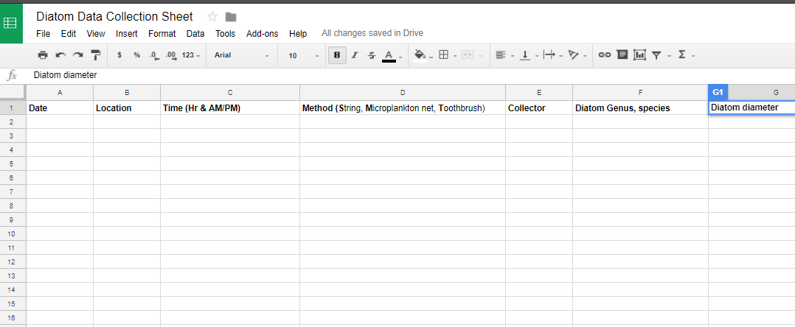
Identifying and recording diatom populations (continued)
Create a data table in Excel or Google Sheets to record your data.

Slide 26
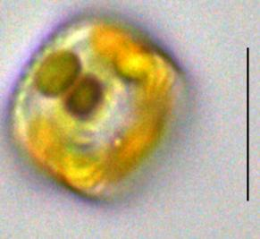
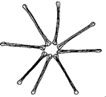
Identifying and recording diatom populations (continued)
Record the name of each diatom population and how many were counted to the data table.

Slide 27
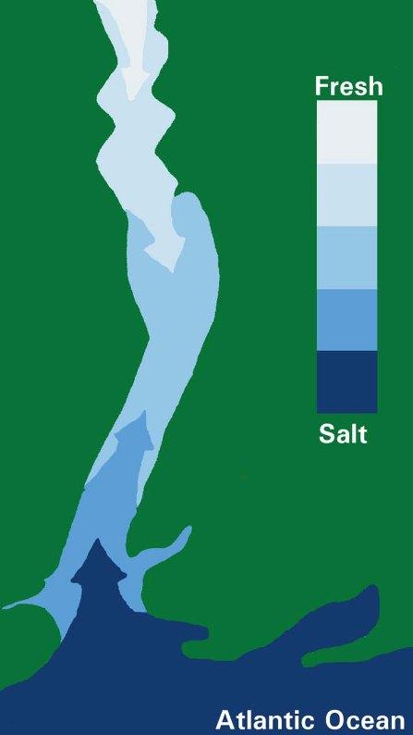
Mapping diatom populations (species, collection date and location) with salinity data and location
Add the collected data to the Hudson River Estuary Map/Model
Diatom population data tables will go here

Slide 28

Did your results match your hypothesis/es?
Notes:
http://www.dec.ny.gov/lands/66638.html

Slide 29
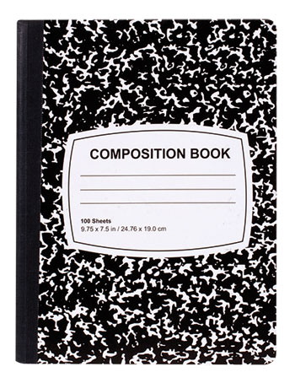
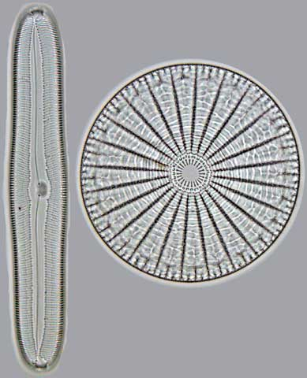
Questions (& answers) Diary: Write down 3 questions you have about the work we are doing (use your composition book)
Why do marine diatoms have a centric
shape and freshwater diatoms have a
pennate shape?
Why do diatoms have
glass walls…
What do diatoms tell us about
The environment they are in?
If fish eat diatoms how do they “eat” glass?
Which algae prefer saltwater
And why?
Notes:
Is there an advantage to having glass walls? WH

Slide 30
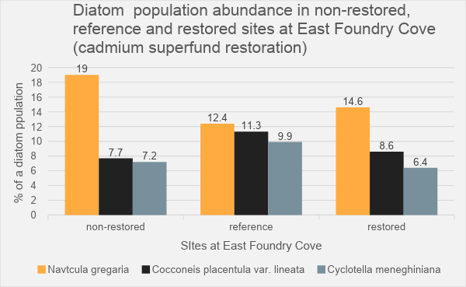
Notes:
Reference: Hallihan, B. H., & Roeder, D. R. (2011). Benthic Diatoms and Heavy Metals in East Foundry Cove and Constitution Marsh, NY, Post Superfund Restoration. Northeastern Naturalist, 18(1), 61-72.

