Slide 1
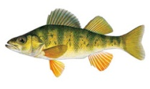
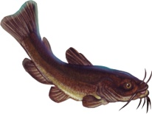
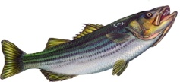
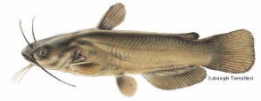
Yellow Perch (Perca flavescens)
Catfish (both Channel and White)
Native, small fish with colorful bands on each side.
Catfish are bottom-dwellers and very easy to identify because of their facial barbels that look like whiskers.
Average size and lifespan: 6-8 inches, 7 years
Habitat: Freshwater shorelines, brackish water, vegetated shallows, ponds, lakes, and streams.
Life cycle: Hatches from an egg, lives near where it hatched, often travels to deeper water in winter.
Feeding: Immature insects, larger invertebrates, worms, small fish, eggs of other fish.
Average size and lifespan: 12-16 inches, 15 -20 years
Habitat: Fresh and brackish water, in large rivers & estuaries.
Life cycle: Hatches from egg, grows up near where it hatched.
Feeding: Detritus, vegetation, small crustaceans & fish, invertebrates.
Year | 2001 | 2005 | 2008 | 2011
% lipid | 0.95 | 0.38 | 0.33 | 0.50
N (# samples) | 52 | 19 | 20 | 19
Year | 2001 | 2005 | 2008 | 2011
% lipid | 6.54 | 7.58 | 4.96 | 5.36
N (# samples) | 15 | 27 | 27 | 22
Striped Bass (Morone saxatilis)
Brown Bullhead (Ameiurus nebulosus)
A popular recreational fish, these anadromous fish live their adult lives in the ocean.
This bottom dweller has poor eyesight and also has “whiskers” like the catfish.
Average size and lifespan: 30-40 inches, up to 30 years
Habitat: Open water in rivers, estuaries, bays, and the ocean.
Life cycle: Hatches from an egg in freshwater, migrates to the ocean after 1-2 years, returns to fresh water to spawn when 4-7 years old.
Feeding: Herring, other fish, crustaceans, worms, squid.
Average size and lifespan: 8-12 inches, 6 -8 years
Habitat: Fresh and brackish water, lakes, ponds, streams, and rivers.
Life cycle: Hatches from an egg, grows up near where it hatched.
Feeding: Algae, plants, mollusks, insects, fish eggs, small fish.
Year | 2001 | 2005 | 2008 | 2011
% lipid | 3.55 | 4.54 | 5.45 | 3.37
N (# samples) | 251 | 250 | 214 | 130
Year | 2001 | 2005 | 2008 | 2011
% lipid | 4.17 | 2.45 | 1.27 | 1.31
N (# samples) | 23 | 19 | 21 | 21

