Slide 1

Water Weathering
WEATHERING, EROSION & DEPOSITION MODULE
Lesson 2 – PHYSICAL WEATHERING

Slide 2
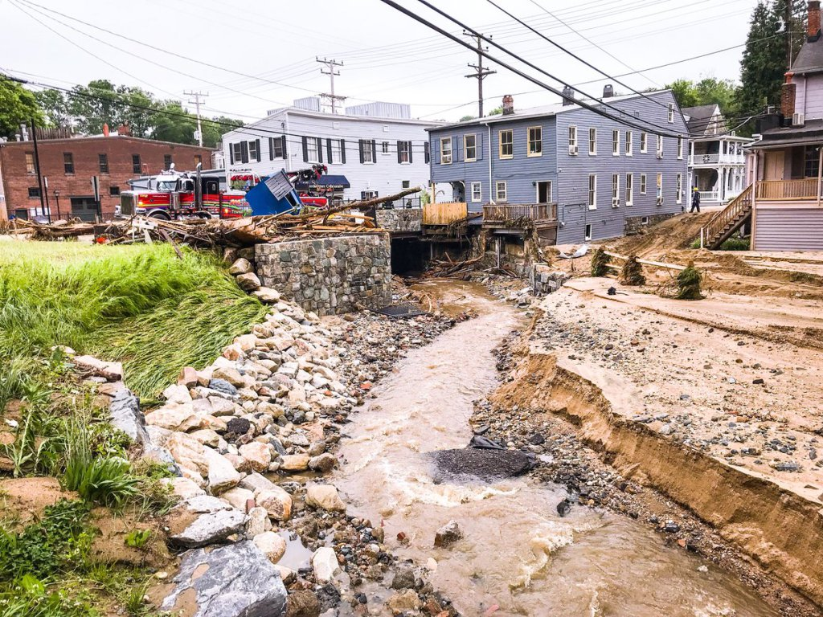

Slide 3
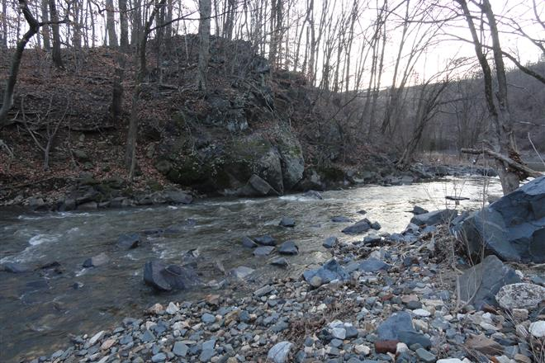

Slide 4
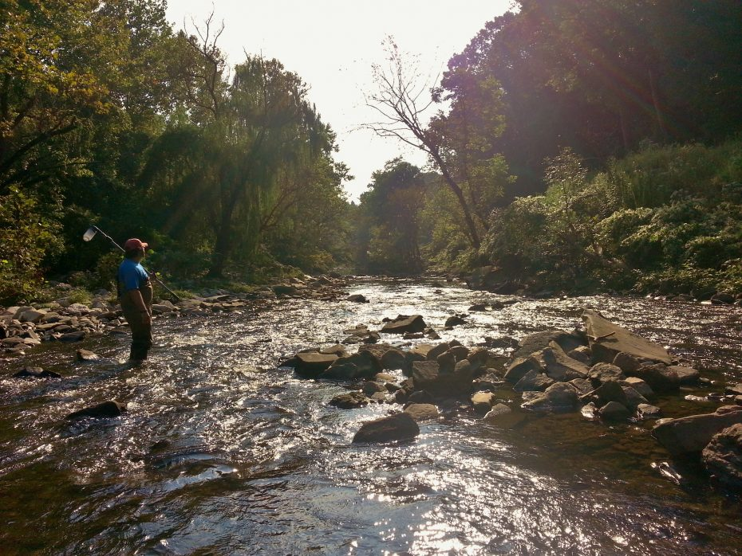

Slide 5
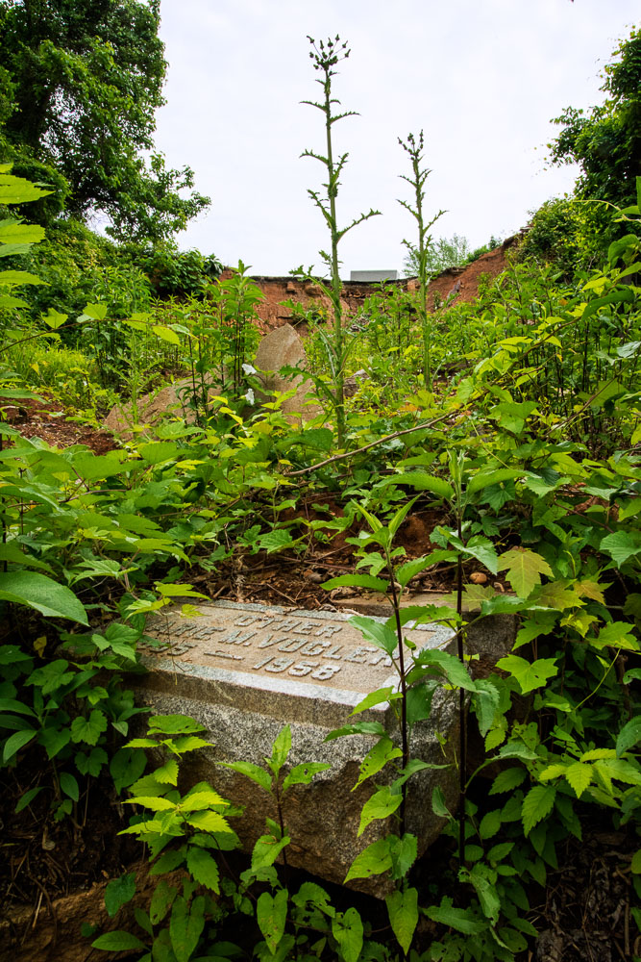

Slide 6
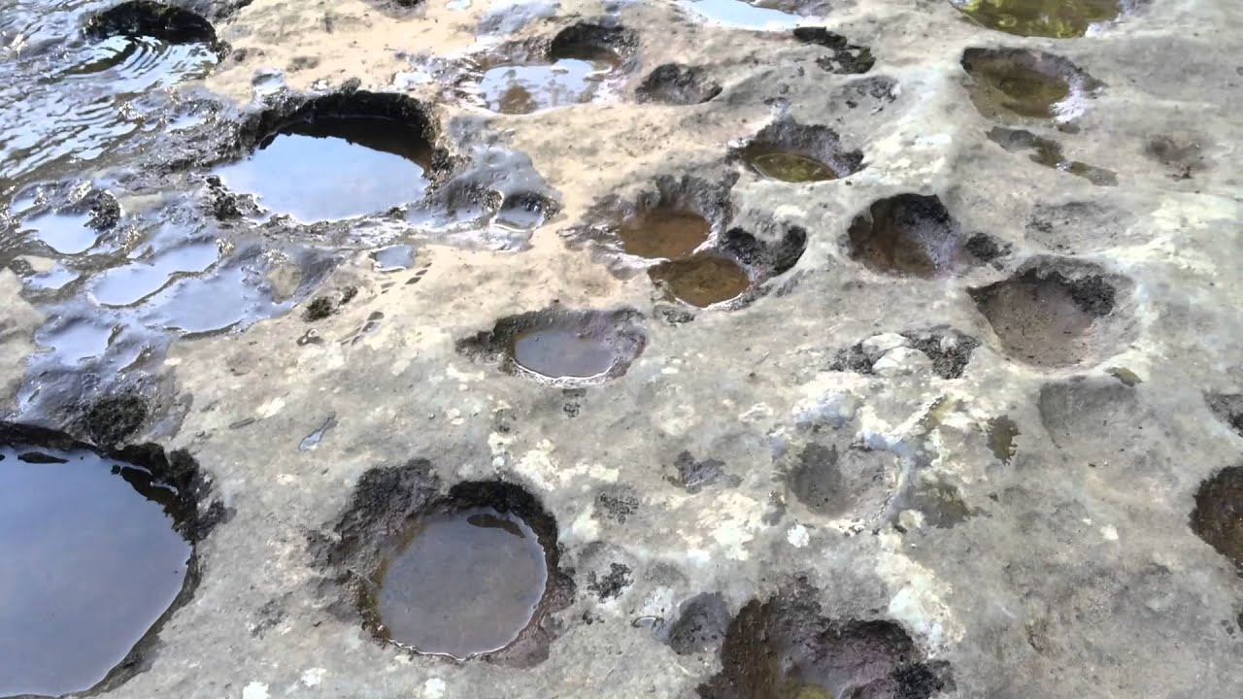
Notes:
Pothole river erosion https://www.youtube.com/watch?reload=9&v=gjXYKy72fp4

Slide 7
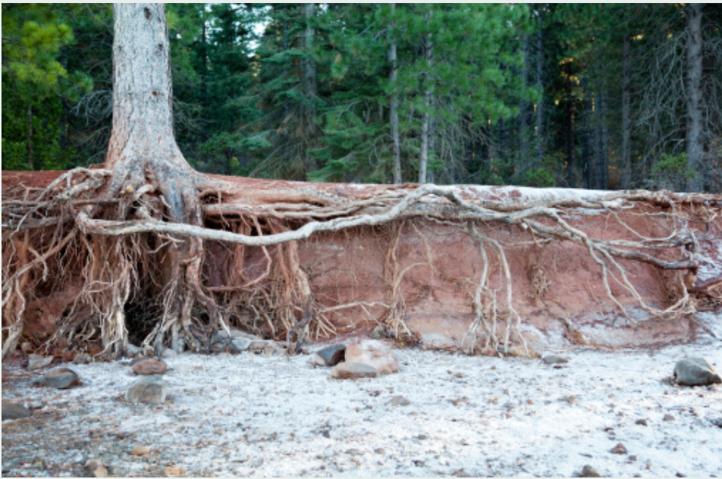
Notes:
Streambank erosion http://rockymountaincompost.com/main-types-water-erosion/

Slide 8
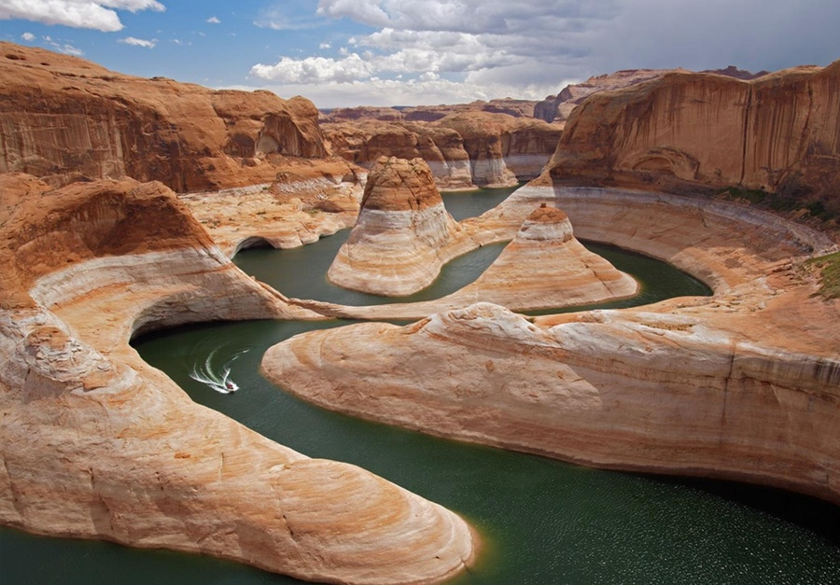
Notes:
Soil and rock erosion https://wbmfoundation.org/blog/soil-erosion-is-soil-degradation

Slide 9
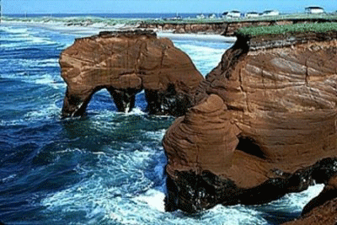
Notes:
Moving water erosion

