Slide 1
Zebra Mussels in the Hudson River
Cary IES

Slide 2
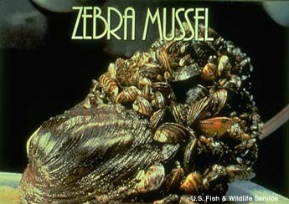
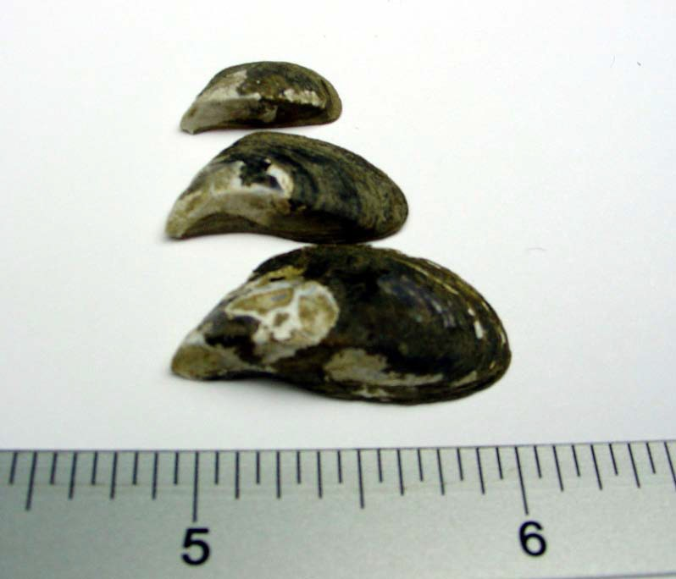
Zebra Mussels - Dreissena polymorpha
Native to SE Europe and W Asia
1985 via European ship’s ballast water to lake by Detroit
Spread through Great Lakes and Erie Canal
Live in fresh & brackish water
Cary IES
Notes:
Presenter
2013-03-22 16:29:13
--------------------------------------------
Alien animal in Hudson River
Zebra mussel native to SE Europe and W Asia Lives in FW and brackish water
Introduced from Europe in Lake St Claire in ballast water, spread through Great Lakes, Erie Canal to HR
One of the most dramatic examples of a successful invasion by an introduced species is the zebra mussel, Dreissena polymorpha. This native to southern Russia was introduced to the Great Lakes in 1985 or 1986 via ballast water from foreign ships. Since then, it has spread rapidly throughout the Great Lakes, into the Hudson River in NY state, and into many other freshwater habitats in the eastern U.S. (Figure 1a).

Slide 3
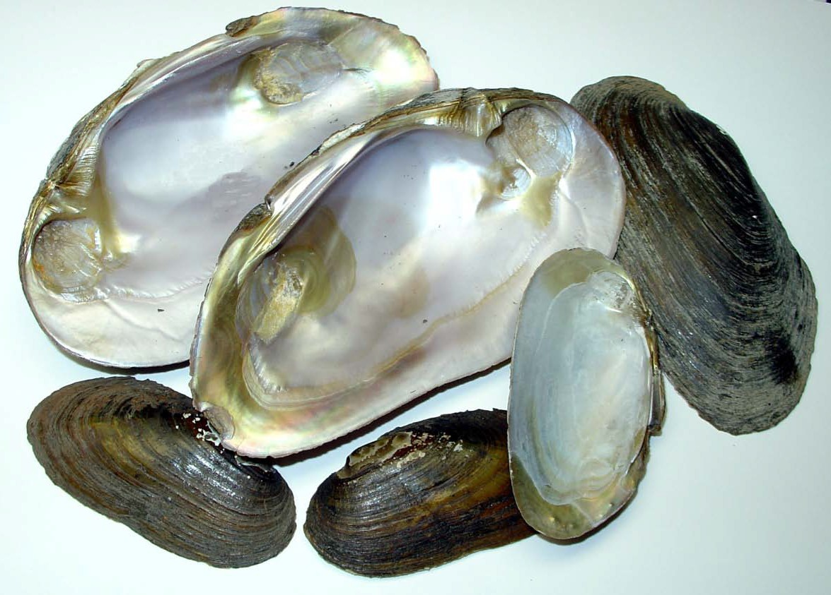
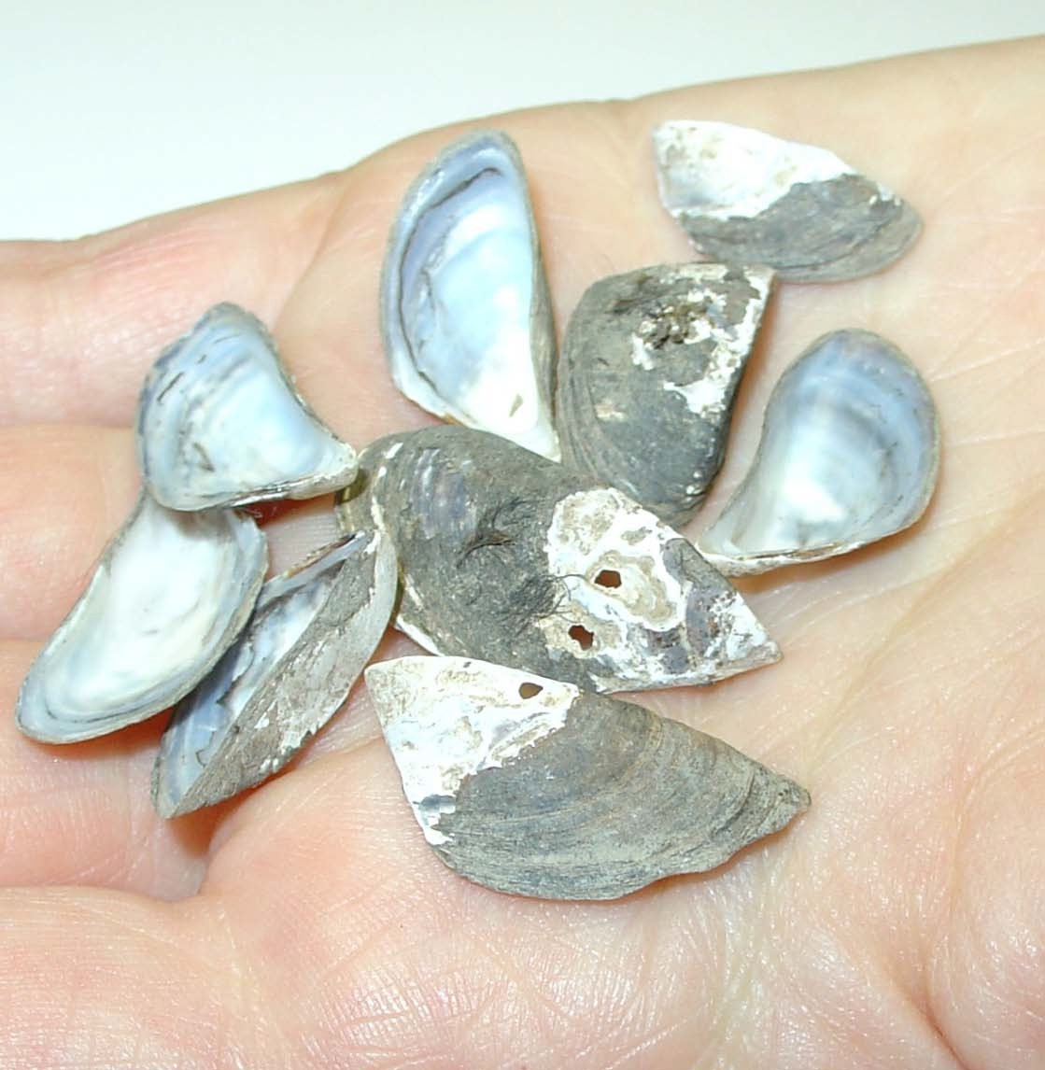
Invasive zebra mussels
Cary IES
Native pearly mussels
Cary IES

Slide 4
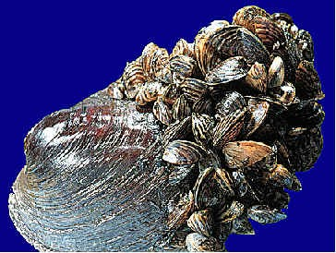
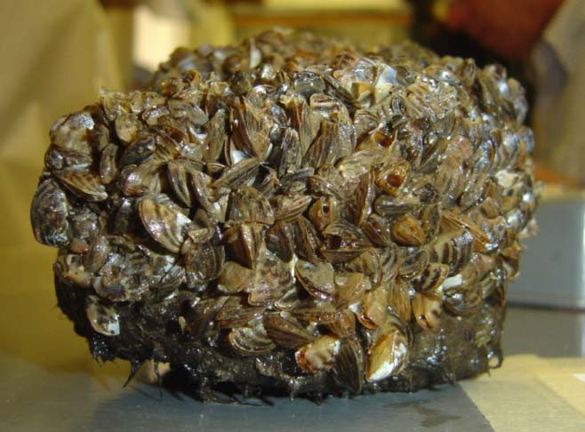
Zebra Mussels
Dreissena polymorpha
Life history
  Warm water, external fertilization
  Larvae, veligers
  Settle on hard surfaces
  Mature at one year
  Live 6 - 7 years
  Filter feeders, plankton
  Eaten by some fish, some ducks, crayfish and crabs
USGS
Cary IES
Notes:
Presenter
2013-03-22 16:29:13
--------------------------------------------
Filter feeders – strain phytoplankton and zooplankton from water Gamete shed into water, immature form, veiliger, settles on hard surfaces Mature quickly and live 6-7 years
Prey item for few species in HR

Slide 5
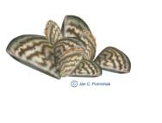

Growth
Up to 700,000 /m²
Filter Feeding:
1 liter water /day
40,000-
1,000,000
eggs /year
Settling:
10,000 /m³ /day
Veliger Larvae
500,000 / m³
95% die
200,000,000
sperm

Slide 6
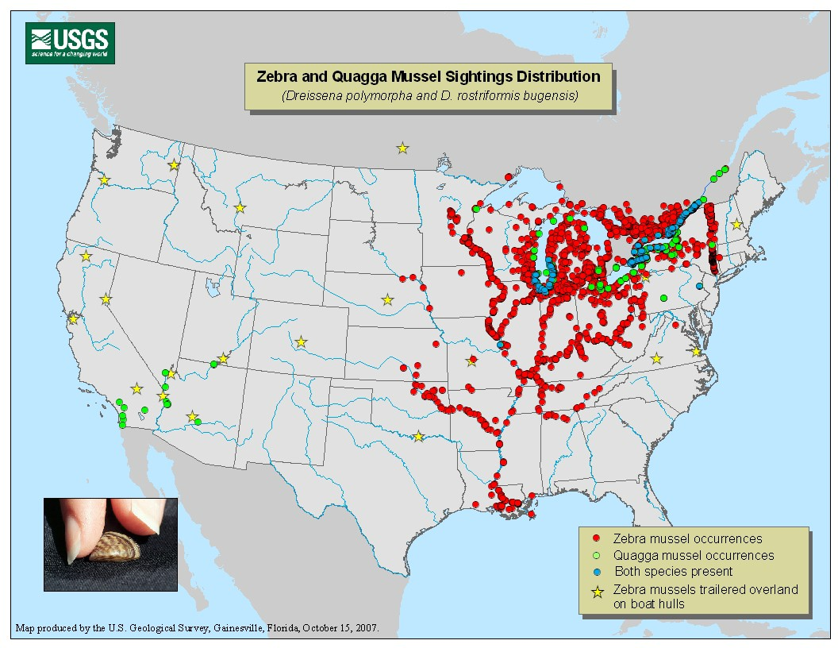
A map showing the distribution of zebra mussels and quagga mussels, another invasive. (USGS, 2007. Zebra Mussel Information: U.S. Distribution Maps, http://nas.er.usgs.gov/zebra.mussel/).

Slide 7
INCREASE
Change associated with zebra mussel invasion
Ecological Effects
250
200
150
100
50
0
-50
-100
DECREASE
phytoplankton
microzooplankton
native bivalves
macrozooplankton
deepwater benthos
American shad (YOY)
dissolved oxygen
littoral benthos
transparency
soluble P
redbreast sunfish YOY

