Slide 1

Agents of change
What caused each of these landforms to look the way they do?
WEATHERING, EROSION & DEPOSITION MODULE
Lesson 1 – AGENTS OF CHANGE

Slide 2
The Game
A picture will be projected on the screen.
Look at the picture and then decide which of the 4 agents of change you think had a hand in making it look the way it does.
Your choices are posted around the room. (Some will have more than one possible answer.)
Move to stand by that sign.
Group will share out your collective reasoning.

Slide 3
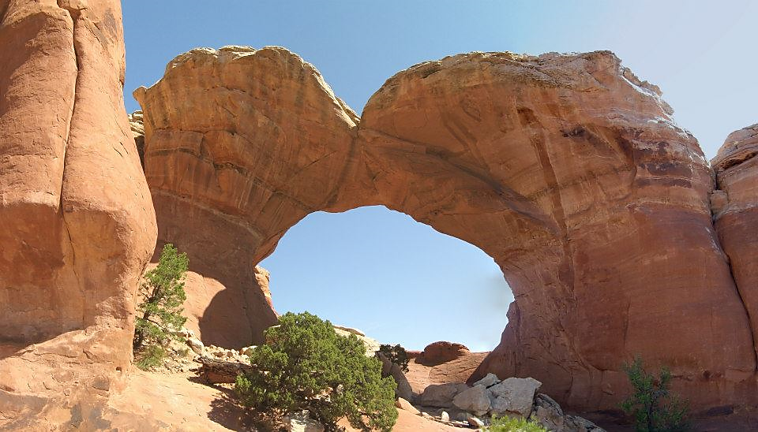
Arches National Park
Notes:
Mostly wind/friction with sand

Slide 4
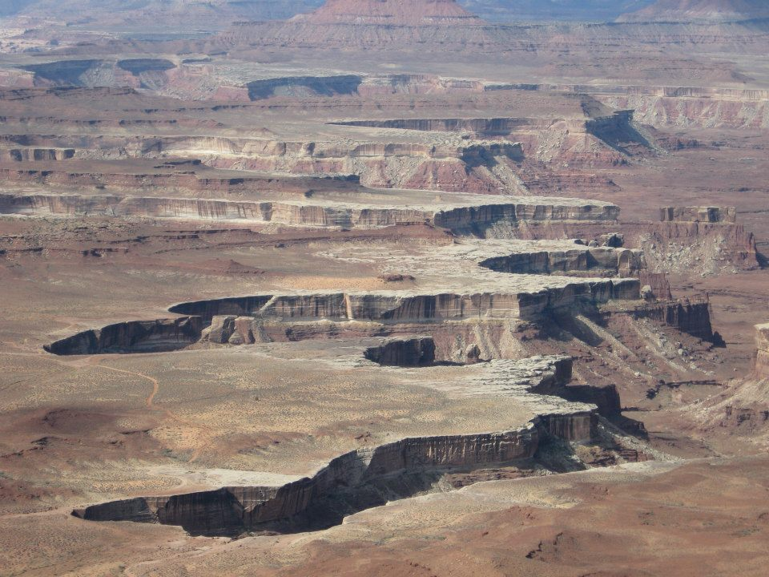
Canyonlands National Park
Notes:
Mostly water dissolving / friction of grains and gravity

Slide 5
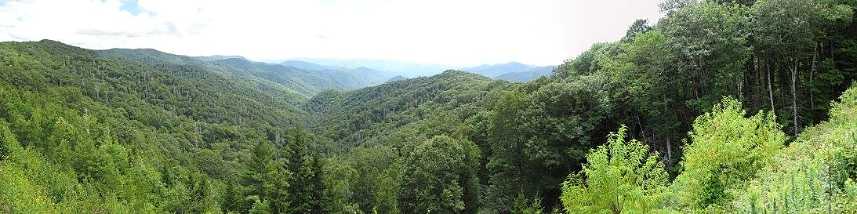
Smokey Mountain National Park
Notes:
Water erosion – friction, dissolving

Slide 6
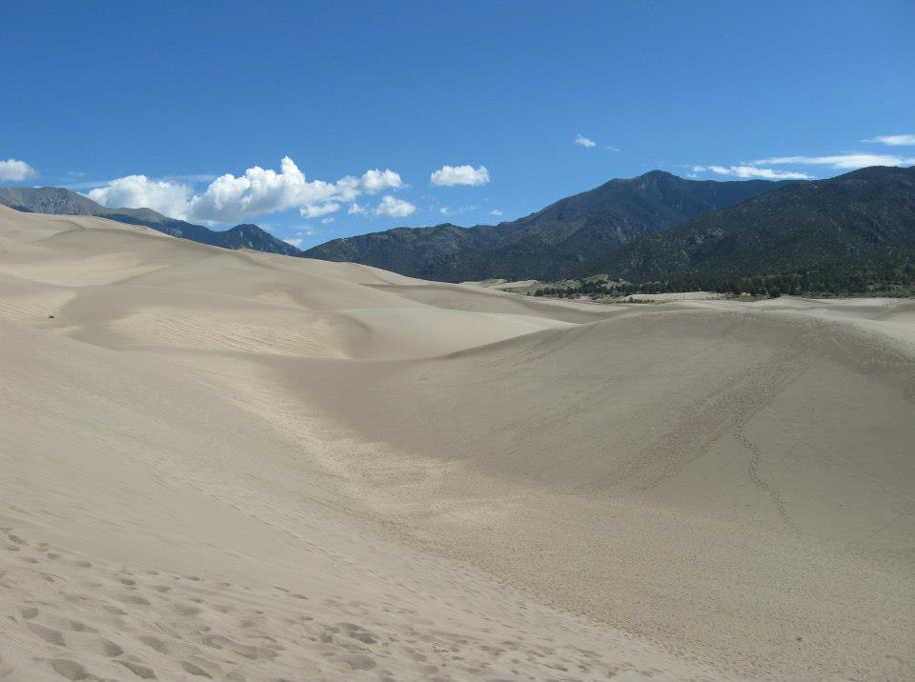
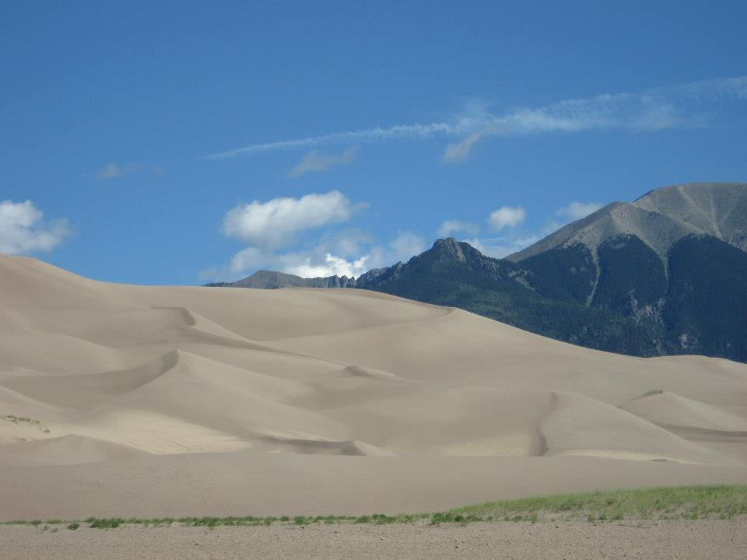
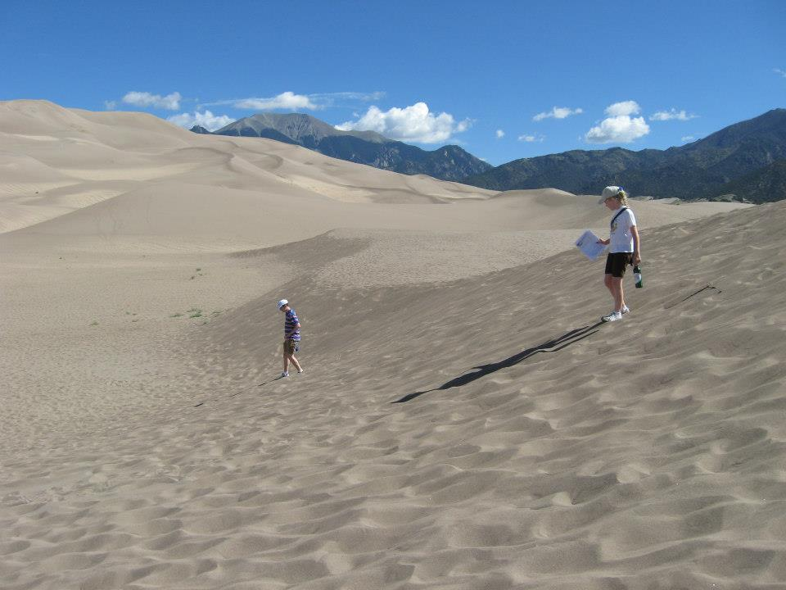
Great Sand Dunes National Park
Notes:
Mostly wind carrying sand

Slide 7
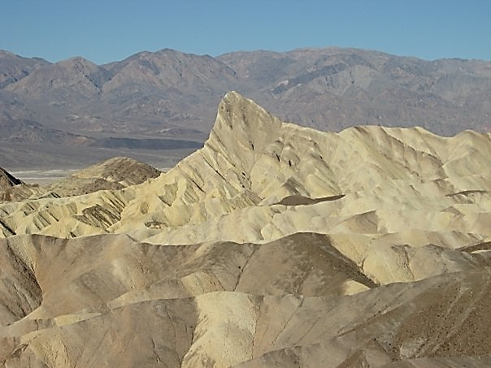
Death Valley National Park
Notes:
Mountains were changed mostly by water erosion.

Slide 8
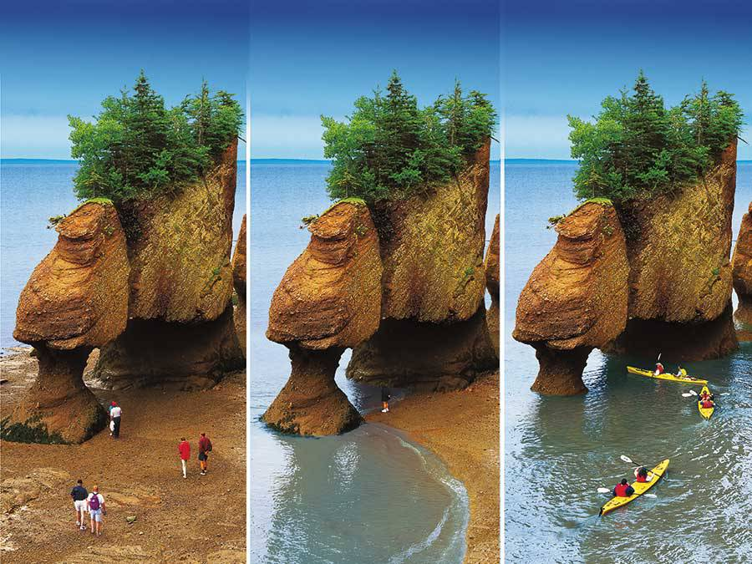
Bay of Fundy, Canada
Notes:
Water dissolving, impact with rock and friction of carried particles. Some freezing at the top.

Slide 9
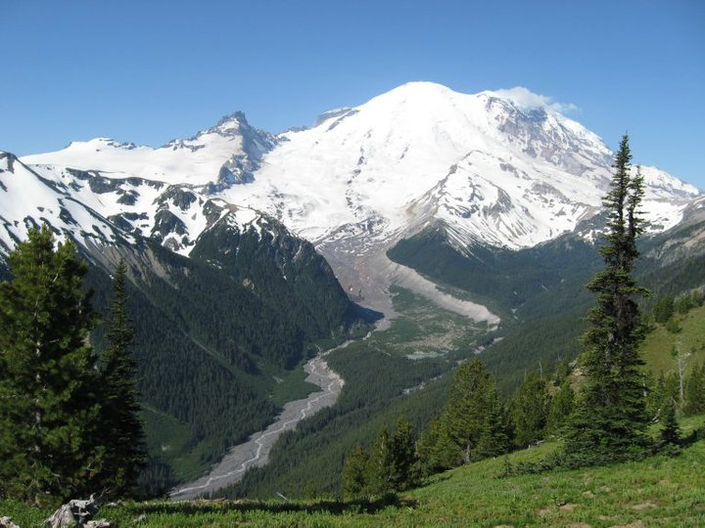
Mt. Rainier National Park
Notes:
Ice – Glacier in the center of the picture acts with friction to carve out valley. See hidden slide for glacier location

Slide 10
Mt. Rainier National Park
Glacier
Glacier
carved
valley
Notes:
Ice – Glacier in the center of the picture. See hidden slide for glacier location

Slide 11
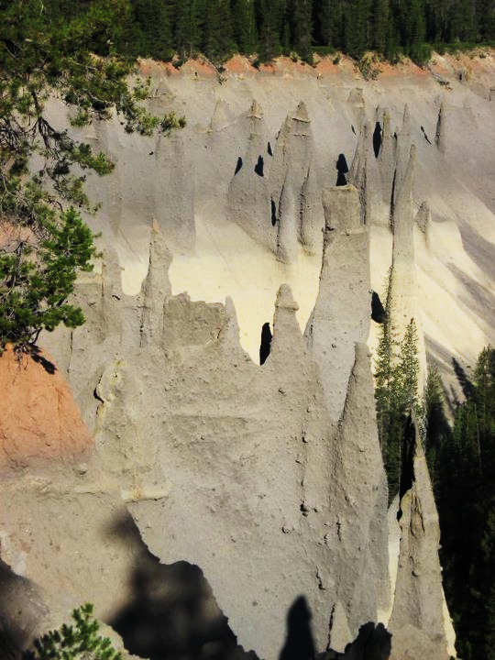
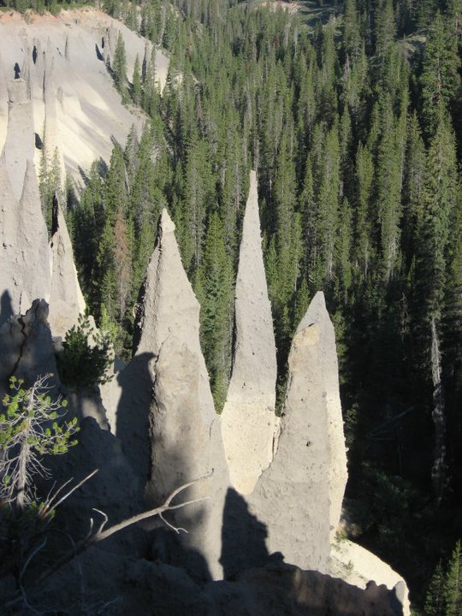
Pinnacles at crater Lake National Park
Notes:
Mostly erosion by water-dissolving materials

Slide 12
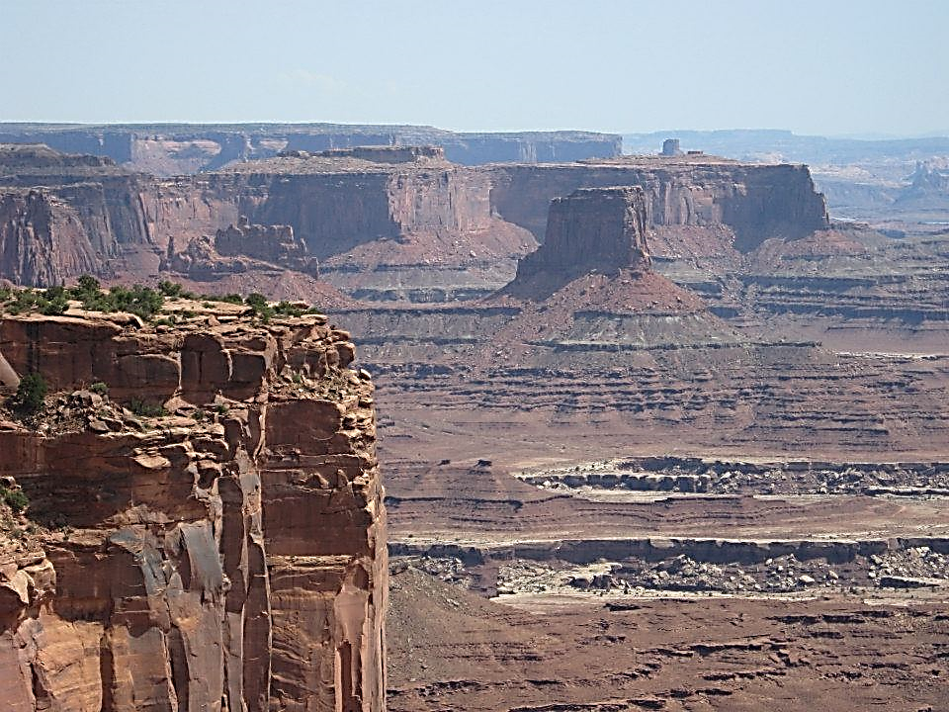
Canyonlands National Park
Notes:
Mostly water erosion and gravity and freezing-ice wedging braking at the tops.

Slide 13
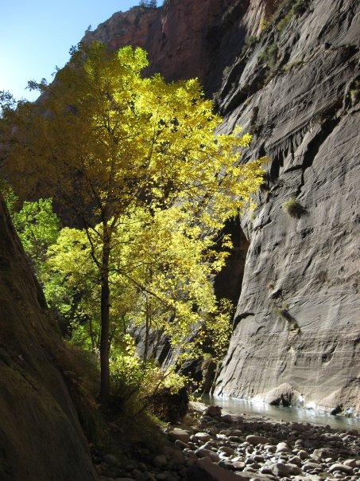
Zion National Park
Notes:
Gravity and Water erosion- friction and dissolving

Slide 14
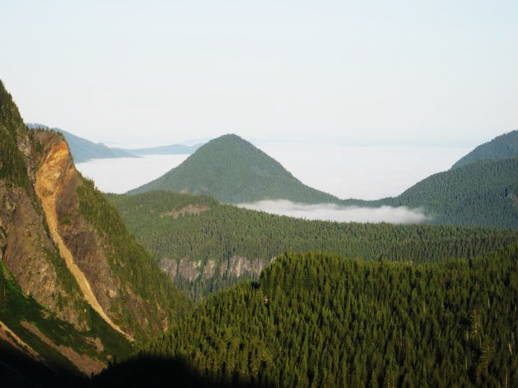
Mount Rainier National Park
Notes:
Ice—glacier cut U shaped valley (Friction)

Slide 15
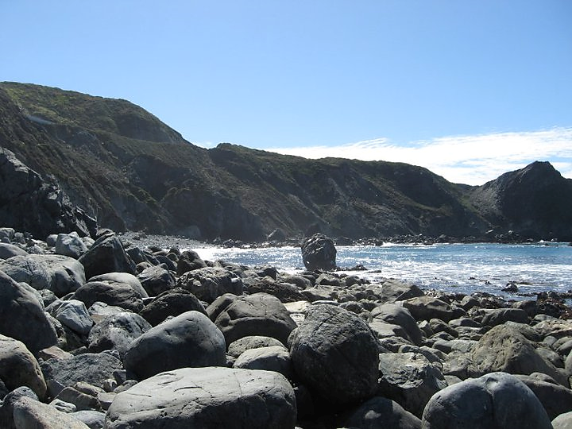
Pacific Coast Highway, California
Notes:
Gravity and water – friction ( tumbling of rocks and impact of smaller particles in water.) dissolving

Slide 16
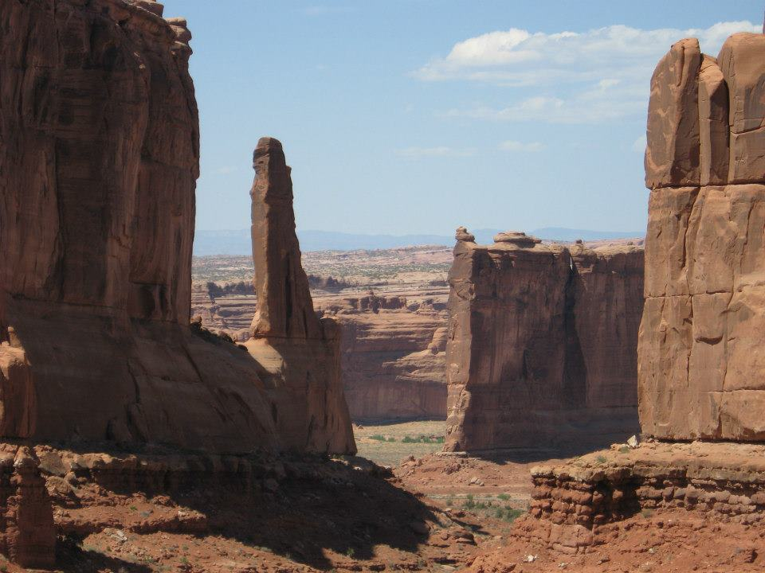
Arches National Park
Notes:
Mostly wind and gravity with some freezing-ice wedging breaking upper rocks.

