Slide 1

Baltimore Weathering and Deposition Photos
WEATHERING, EROSION & DEPOSITION MODULE
Lesson 2 – PHYSICAL WEATHERING

Slide 2
BALTIMORE WEATHERING AND DEPOSITION PHOTOS

Slide 3
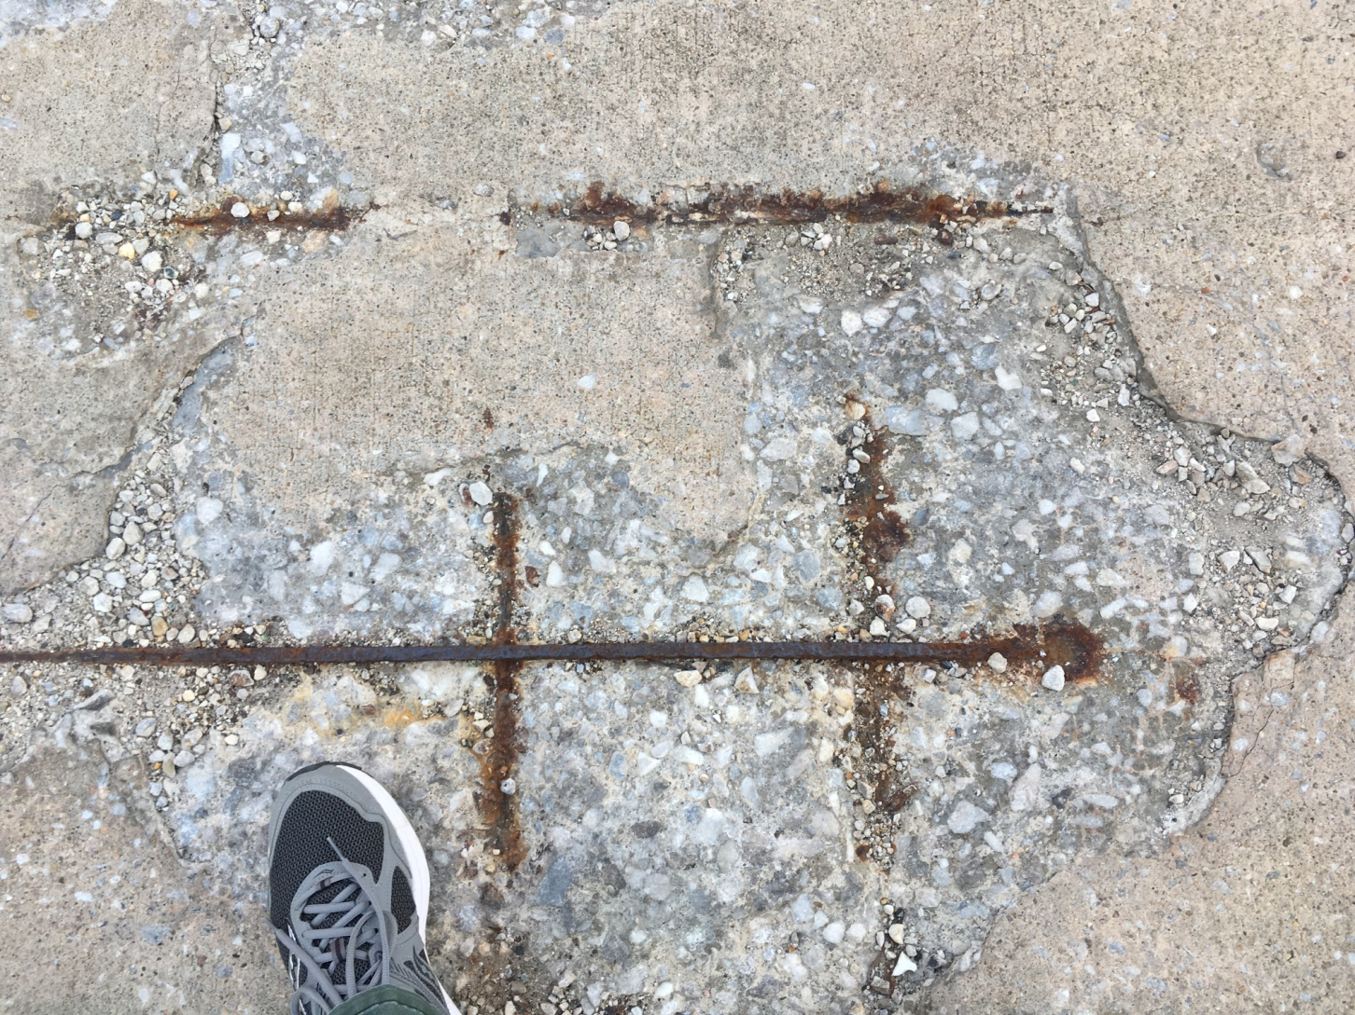
1

Slide 4
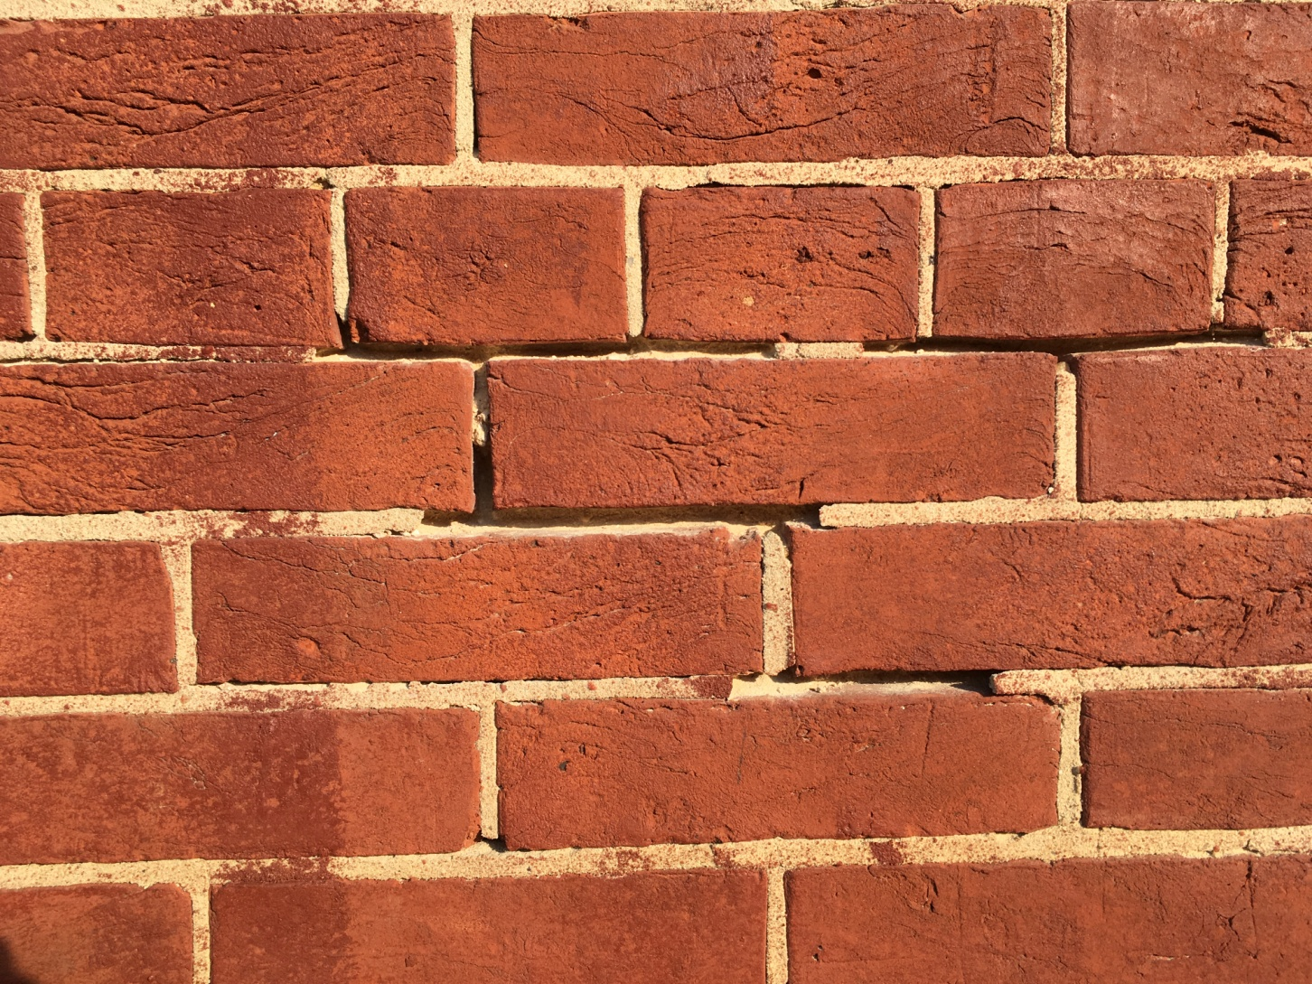
2

Slide 5
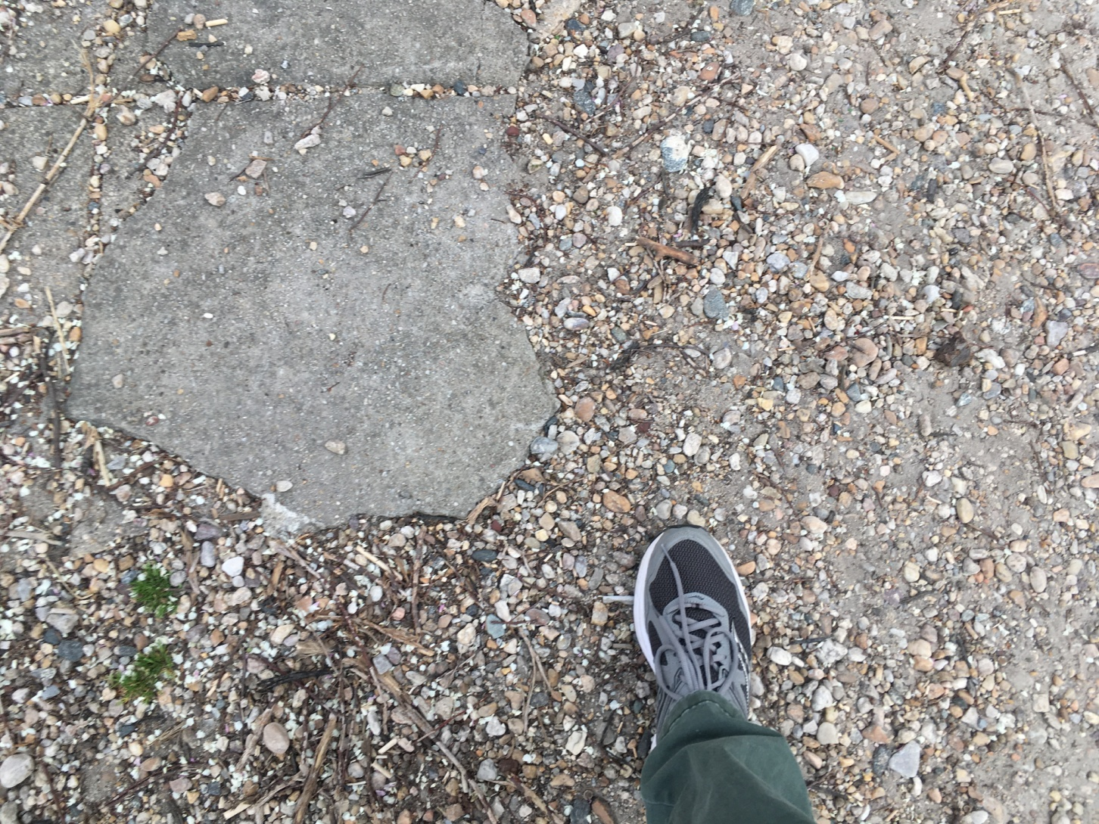
3

Slide 6
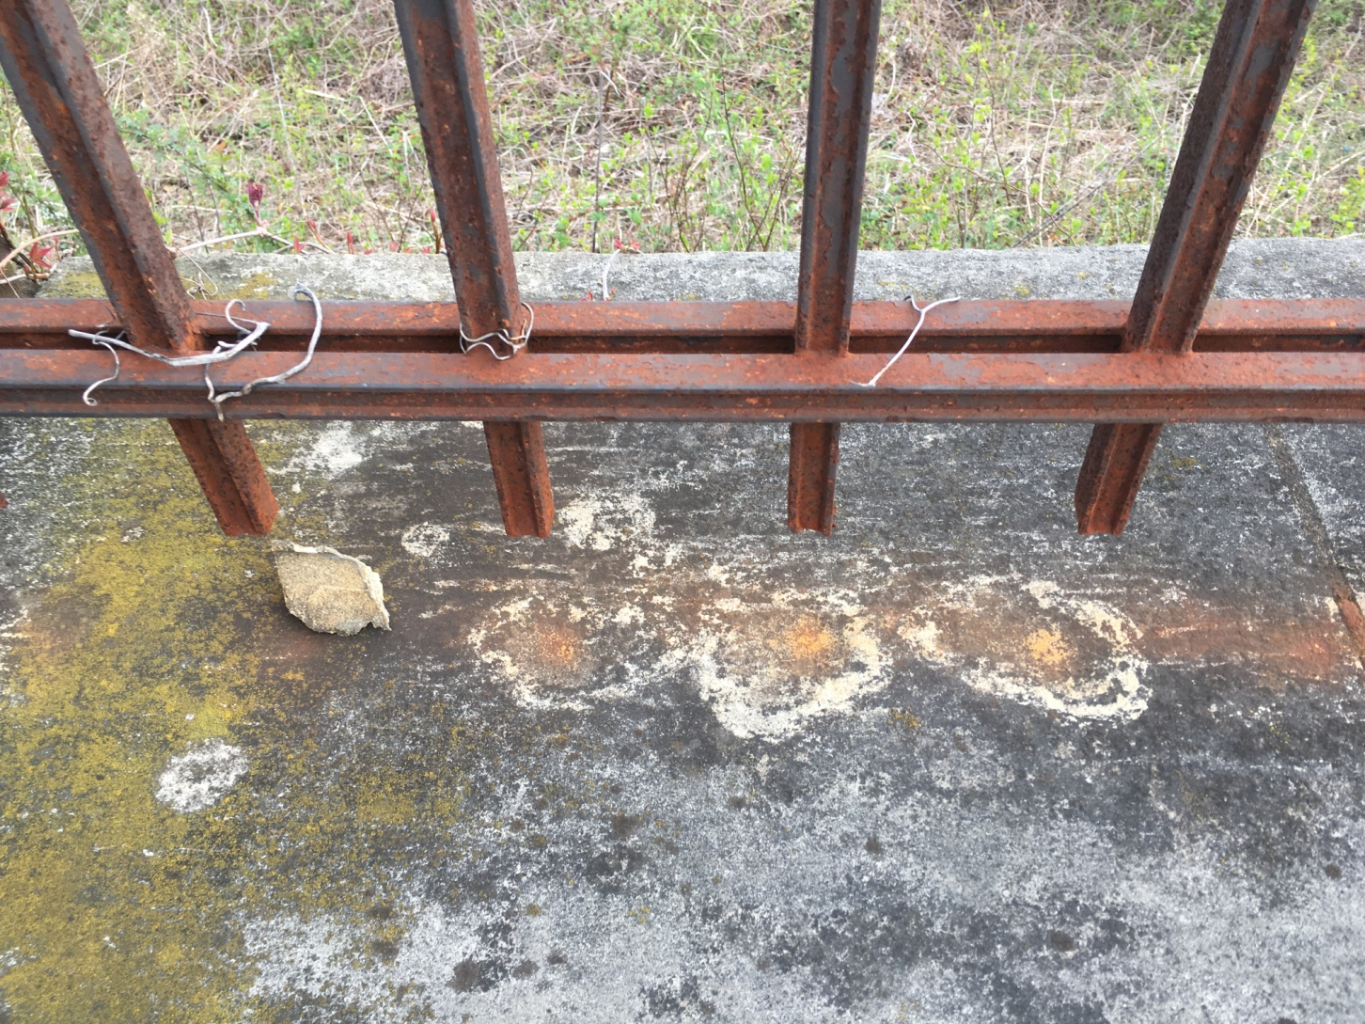
4

Slide 7
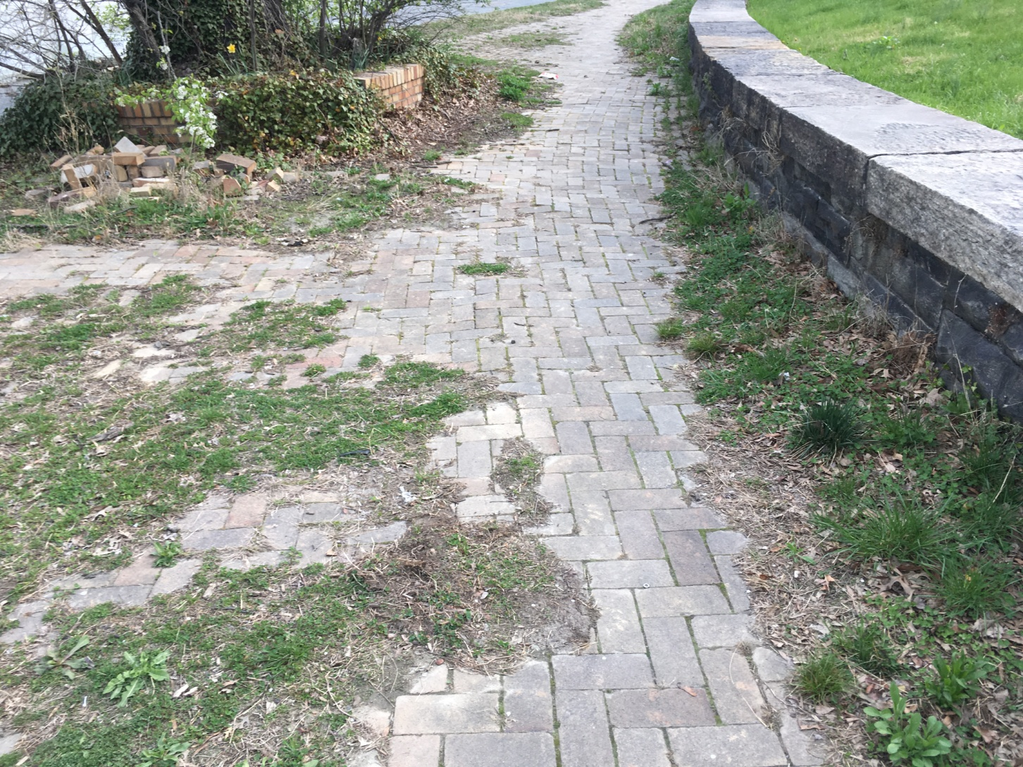
5

Slide 8
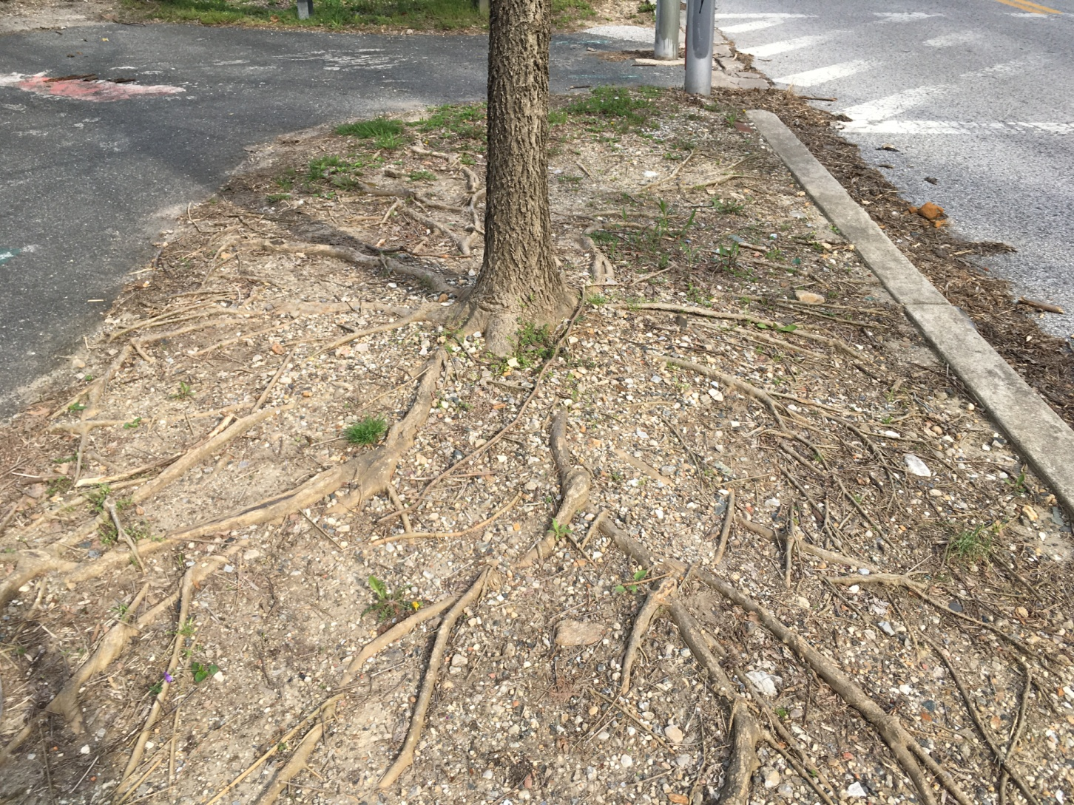
6

Slide 9
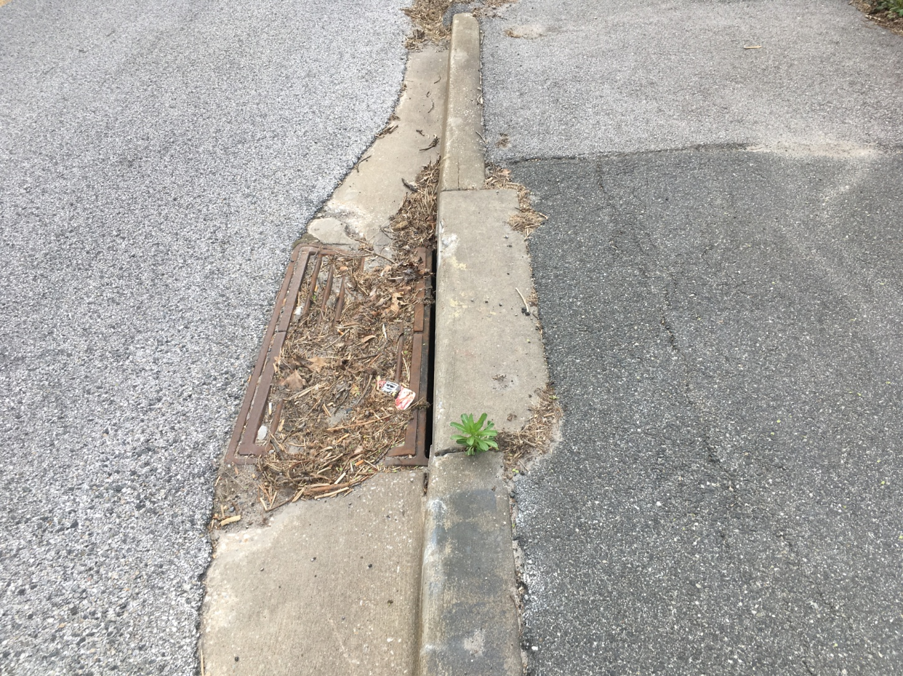
7

Slide 10
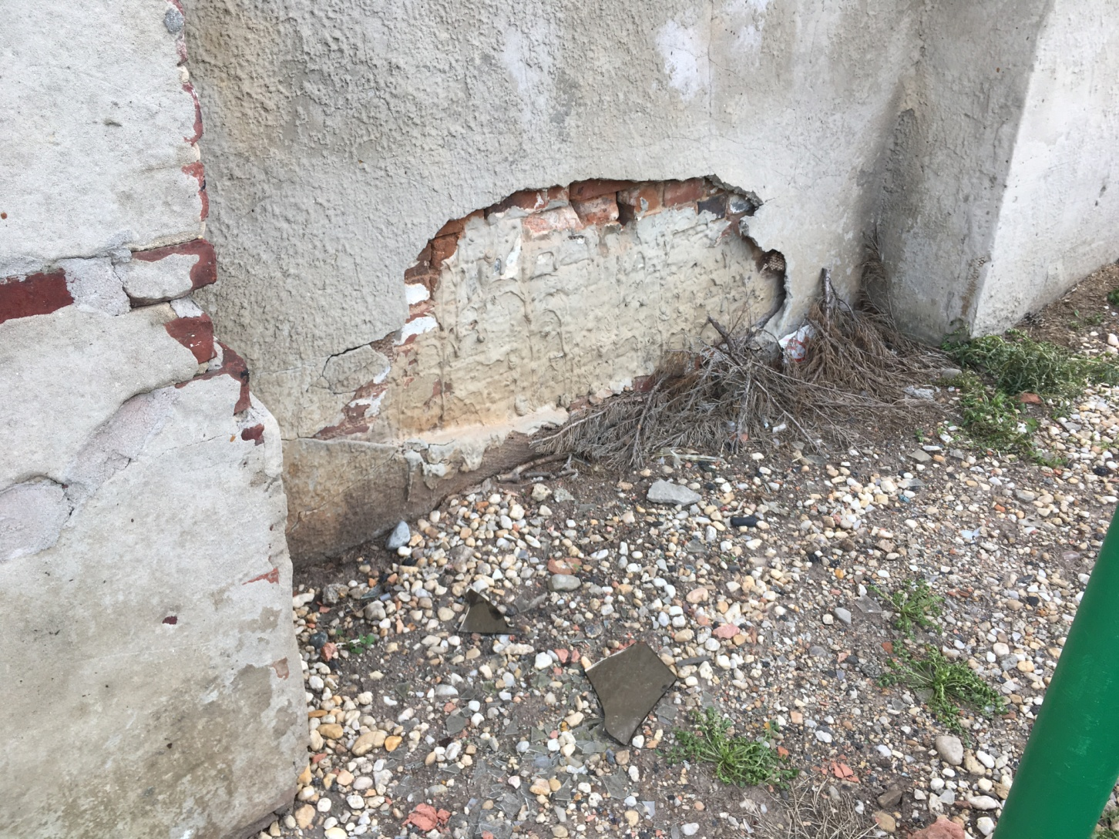
8

Slide 11
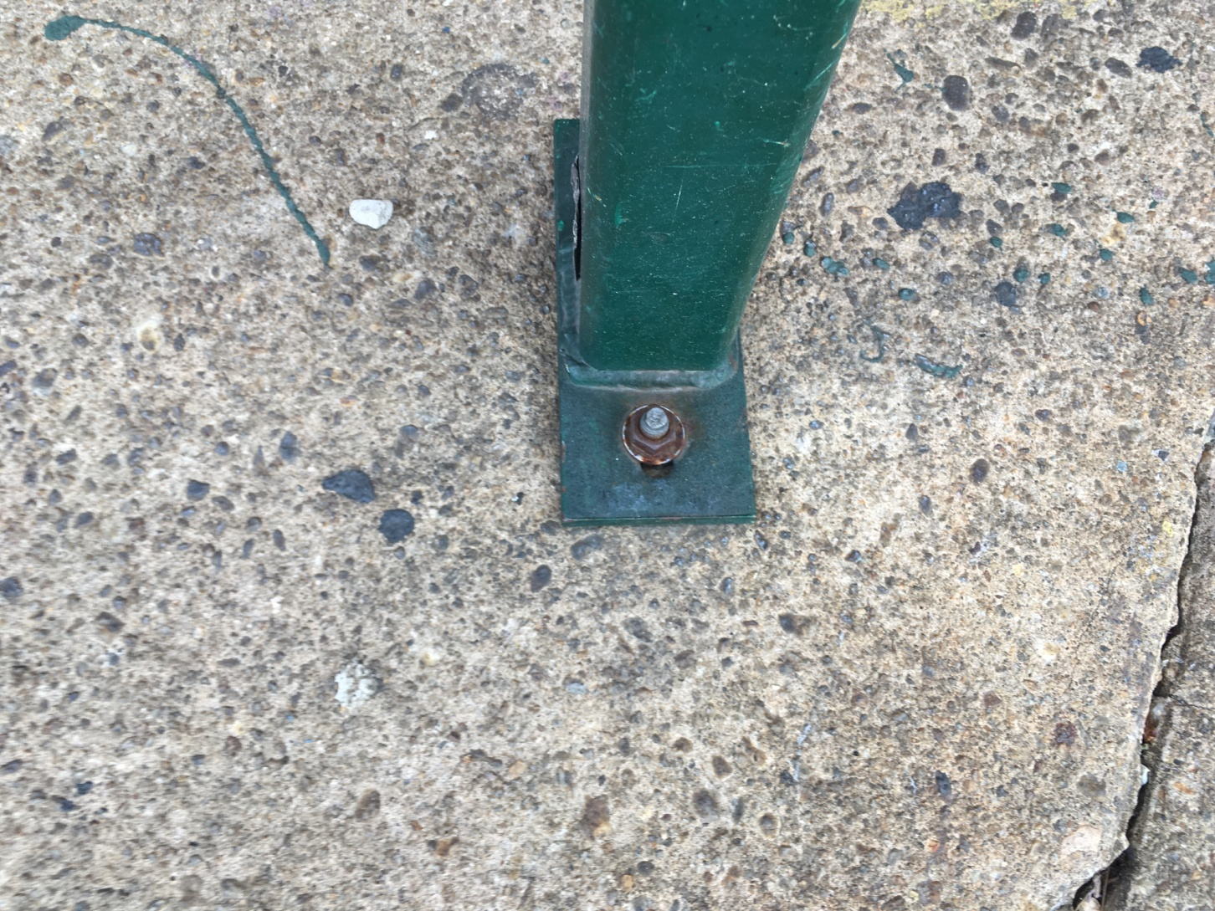
9

Slide 12
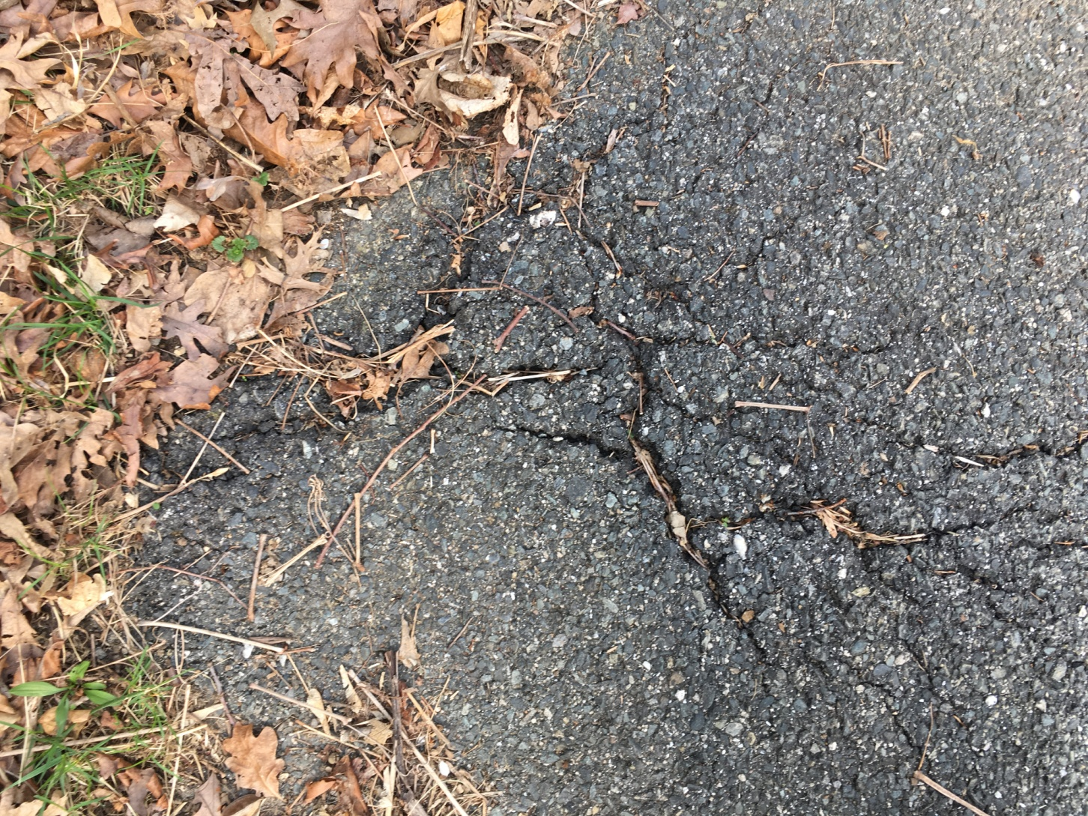
10

Slide 13
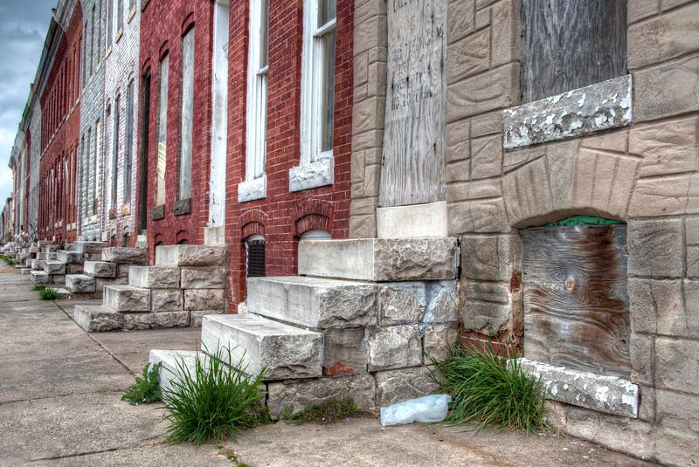
11

Slide 14
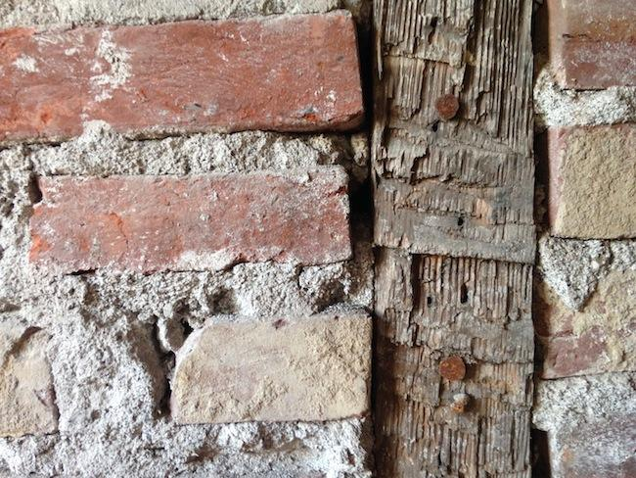
12

Slide 15
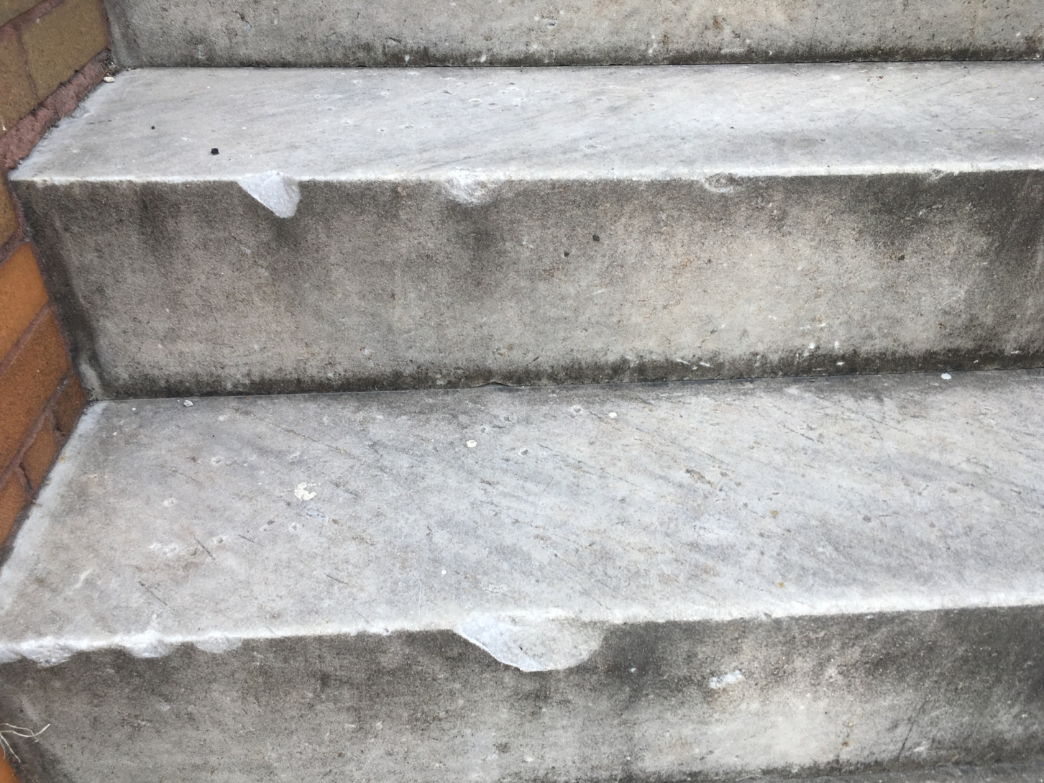
13

