Slide 1

Watersheds in the Baltimore Region
WEATHERING, EROSION & DEPOSITION MODULE
Lesson 4 – WEATHERING AND WATER QUALITY

Slide 2
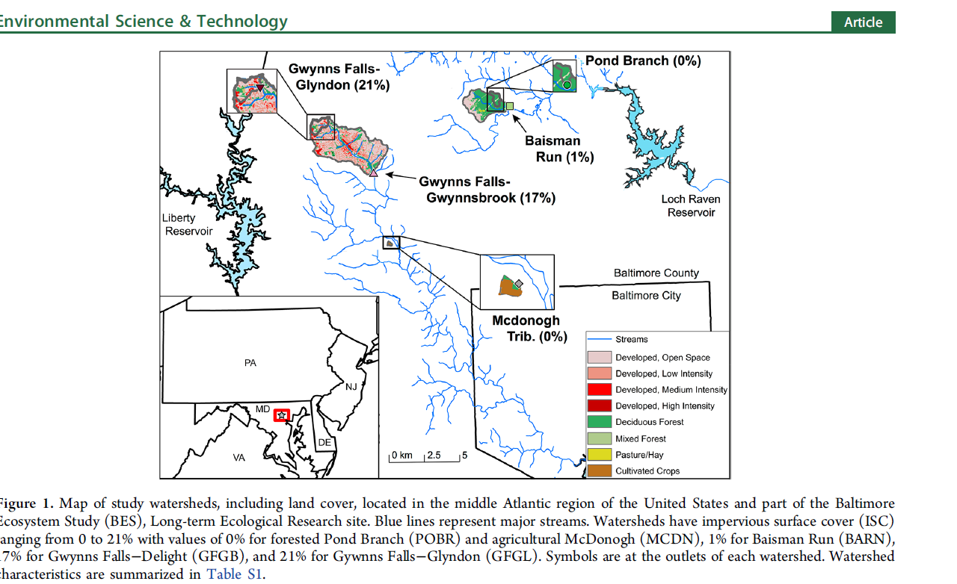
Exploring Local Data
Source: Bird, Darcy L., PM Groffman, CJ Salice, J Moore. (2018). Steady-State Land Cover but Non-Steady-State Major Ion Chemistry in Urban Streams. Environmental Science and Technology. 14:31:55

Slide 3
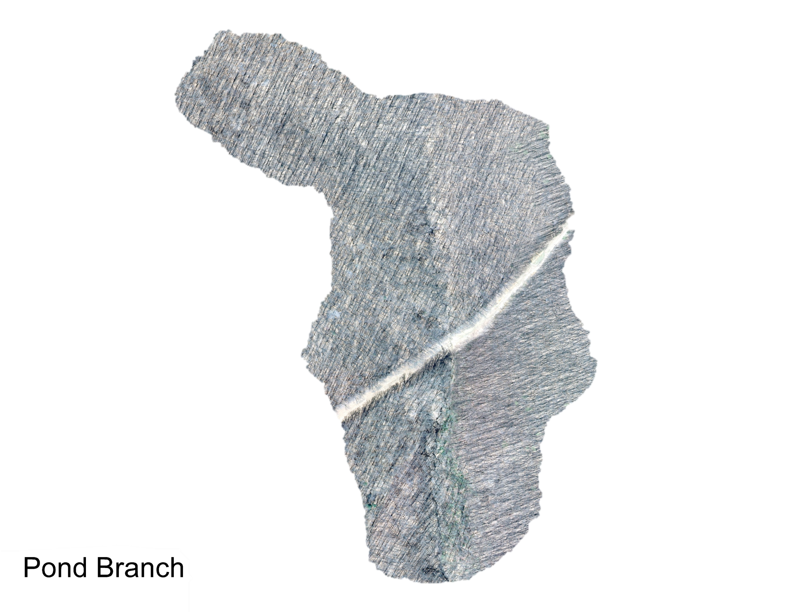
Pondbranch

Slide 4
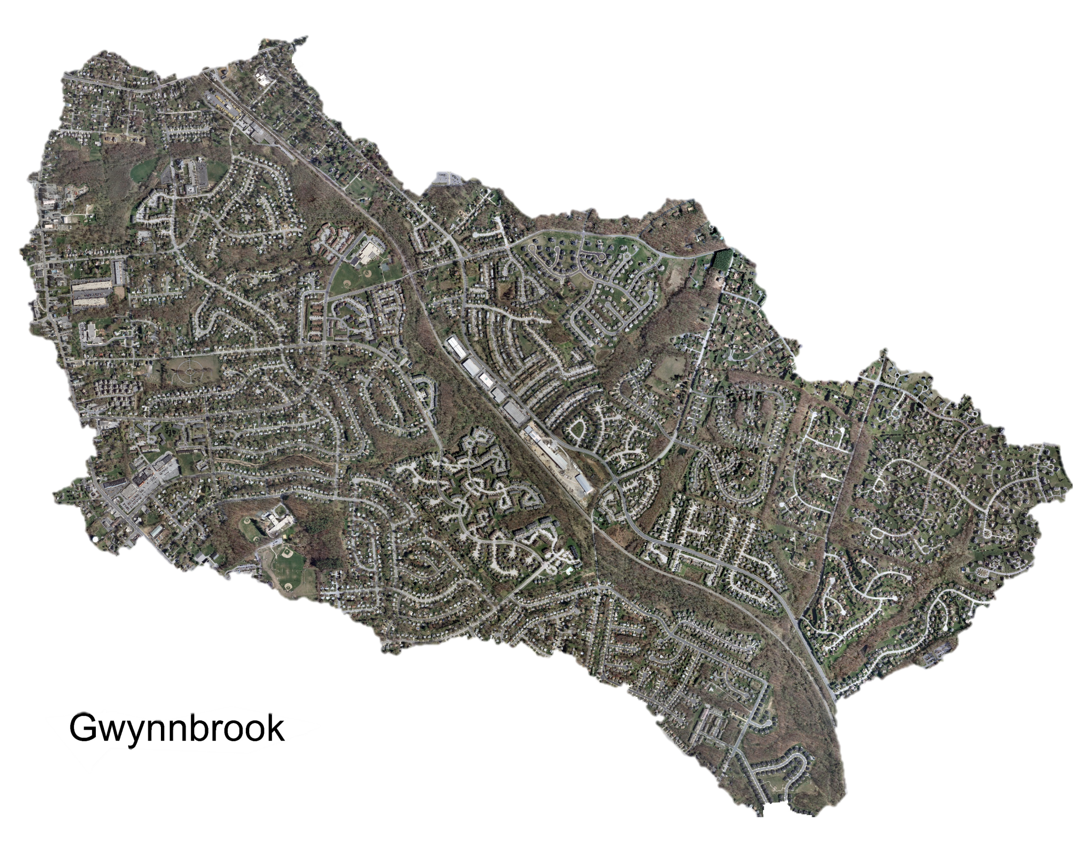
Gwynnbrook

Slide 5
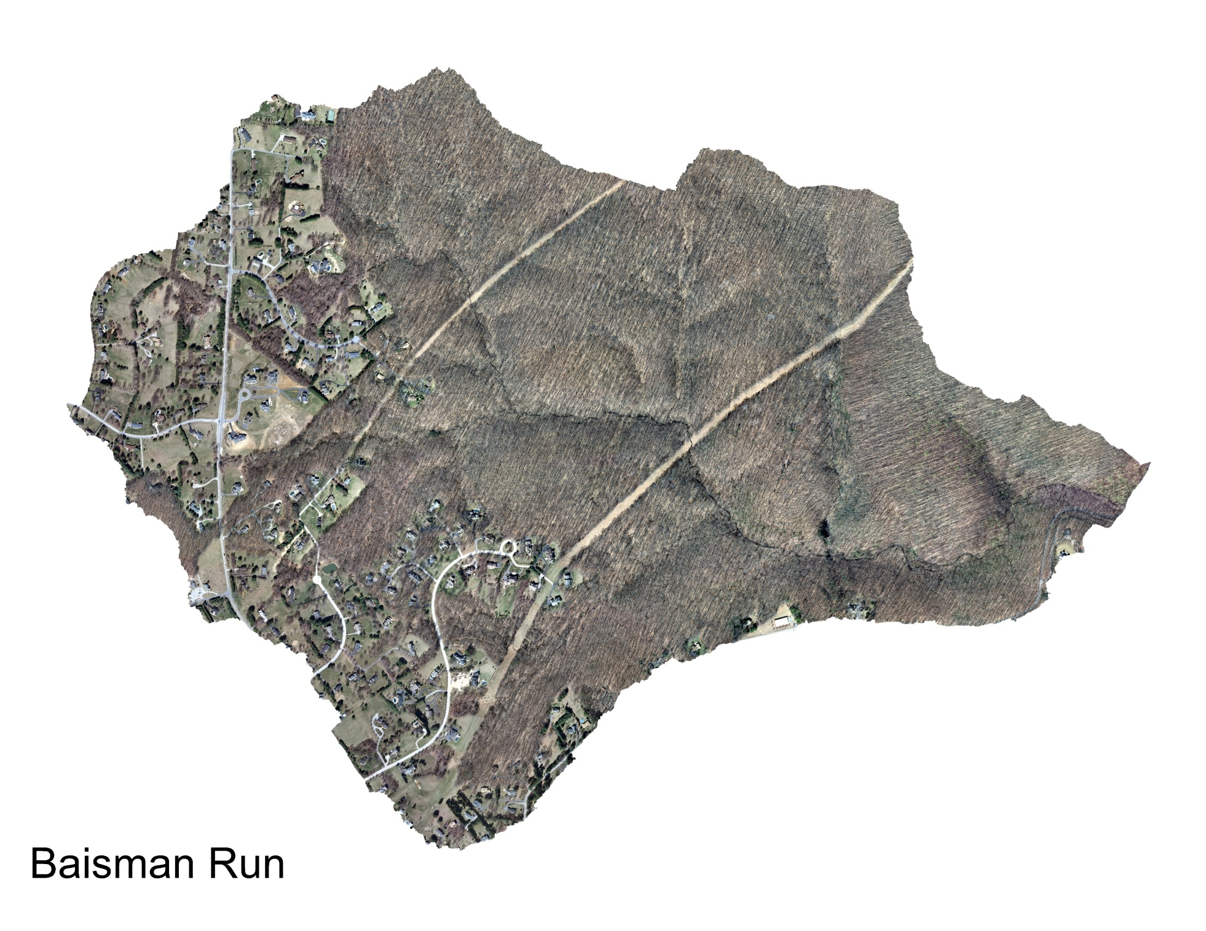
Baisman

Slide 6
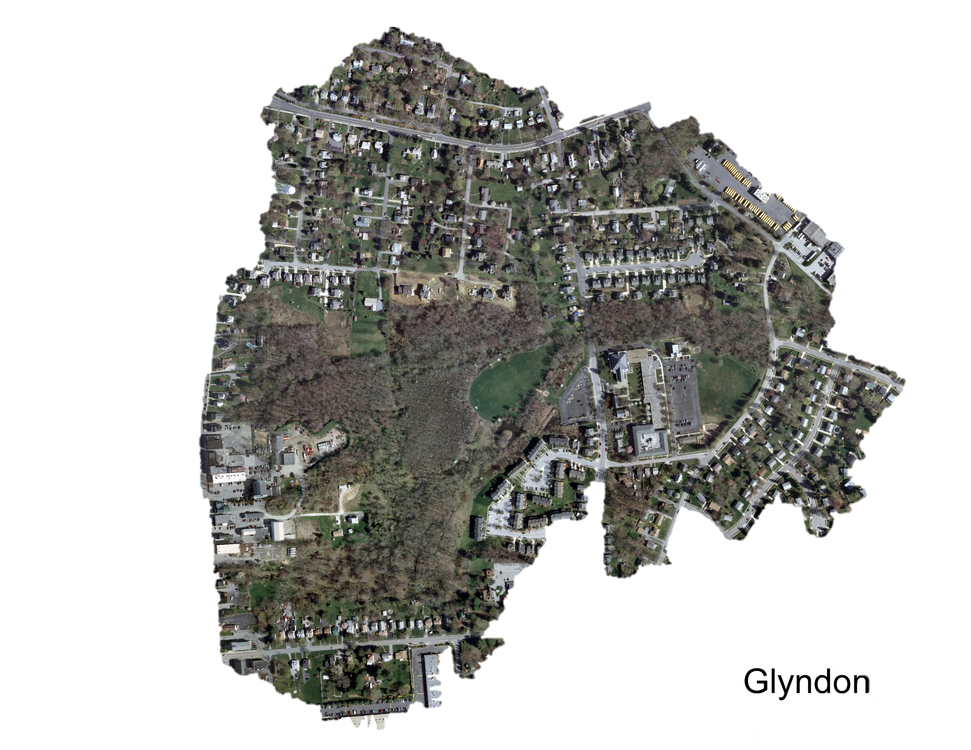
Glyndon

Slide 7
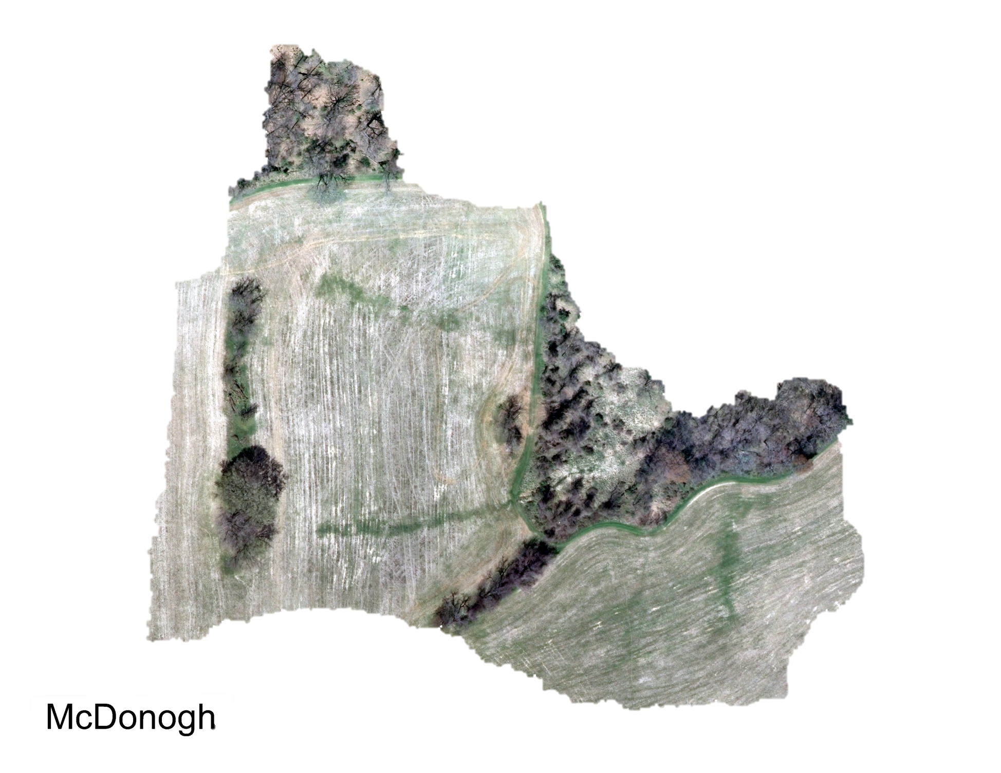
McDonogh

