Slide 1

Maryland Landforms and Weathering
Examples of Geology & Chemistry Shaping Landforms in Maryland
By: Martin F. Schmidt, Jr.
WEATHERING, EROSION & DEPOSITION MODULE
Lesson 5 – WEATHERING, EROSION, AND DEPOSITION IN THE LOCAL ENVIRONMENT

Slide 2
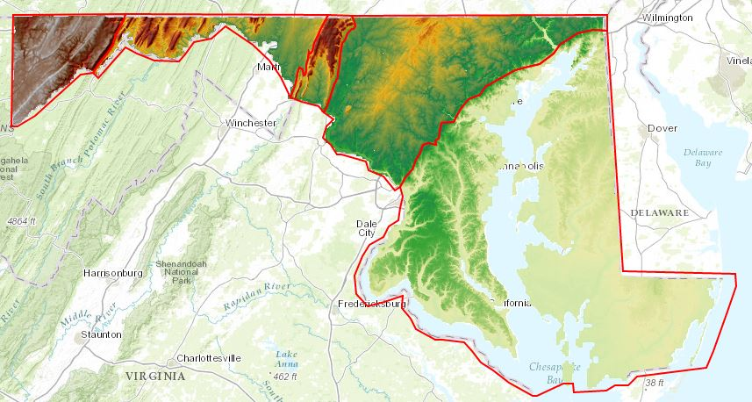
A map for orientation
These are the physiographic provinces of Maryland - areas of similar landforms, because they have similar rocks and geologic structures within them.
Blue Ridge
Piedmont
Valley & Ridge
Allegany Plateau
Coastal Plain

Slide 3
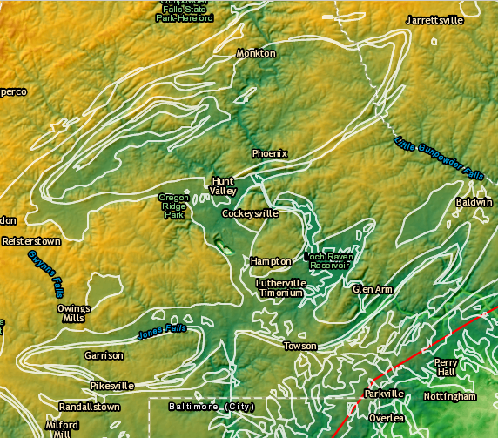
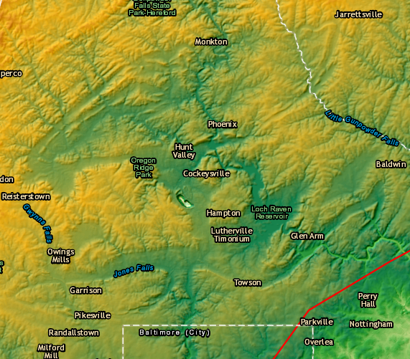
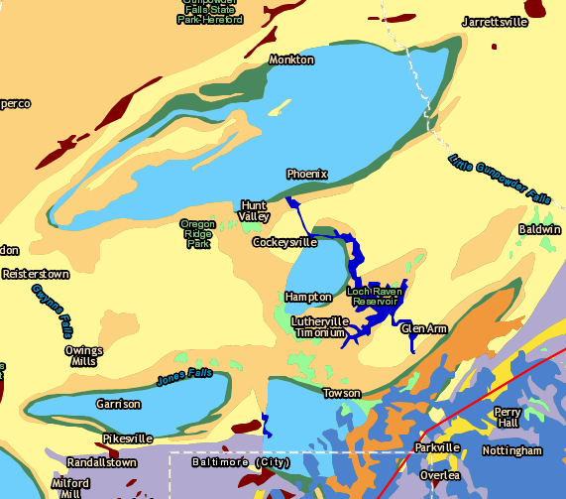
Piedmont rocks & topography
Use the map to examine rocks and topography.
Elevations in the area north of Baltimore. Greens are lower and yellows are higher.
Geologic map of this area.
Geologic units outlined in white and overlaid on elevations.
Can you see places where the white lines also outline differences in elevation, showing the weathering of the rocks forms the topography?

Slide 4
Piedmont rocks & topography
Key to the rock names and types.
Baltimore Gneiss is blue.
Cockeysville Marble is tan.
Loch Raven Schist is yellow.
Setters Quartzite is green.

Slide 5
Piedmont rocks & topography
The Cockeysville Marble is calcite and so dissolves slowly in rainwater & groundwater - so it creates valleys.
Meanwhile, the adjacent Setters Quartzite is quite resistant, often making a ridge next to the marble.
Schist & gneiss are moderately resistant.

Slide 6
Looking for a pattern
Rocks that weather slowly, especially when pushed up by plate tectonics, will remain high as mountains while less resistant rocks wear away to make valleys.
Because of its stable atomic bonding, quartz is both physically hard and chemically stable.
So, quartz weathers very slowly.
Sand, sandstone, and quartzite rocks are made largely of quartz.
So can we see evidence of quartz-rich rocks making mountains in Maryland?

Slide 7
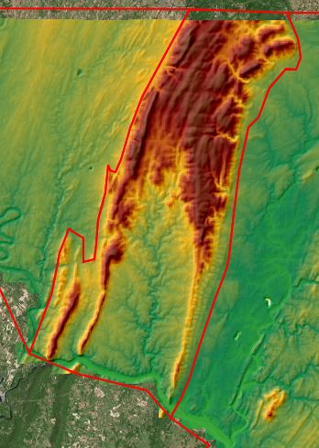
Blue Ridge rocks & topography
Blue Ridge topography.

Slide 8
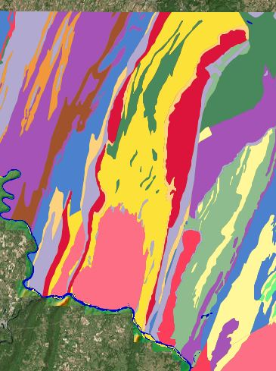
Blue Ridge rocks & topography
Blue Ridge geology.

Slide 9
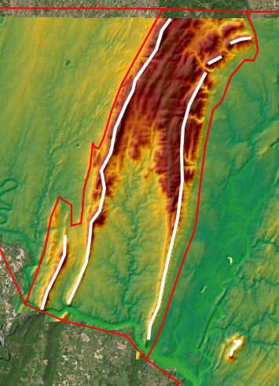
Blue Ridge rocks & topography
Blue Ridge topography with mountains marked.

Slide 10
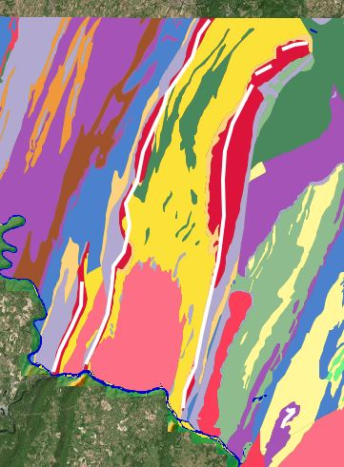
Blue Ridge rocks & topography
Blue Ridge geology with mountains marked.
Are there particular rock units that seem to be responsible for the ridges?
Slow weathering of 3 bands of resistant Weverton Quartzite shown in red make the 3 main ridges of the Blue Ridge.
Less resistant limestones and shales make the Frederick Valley to the east, and the Hagerstown Valley to the west.
Resistant Sugarloaf Quartzite makes Sugarloaf Mountain.

Slide 11
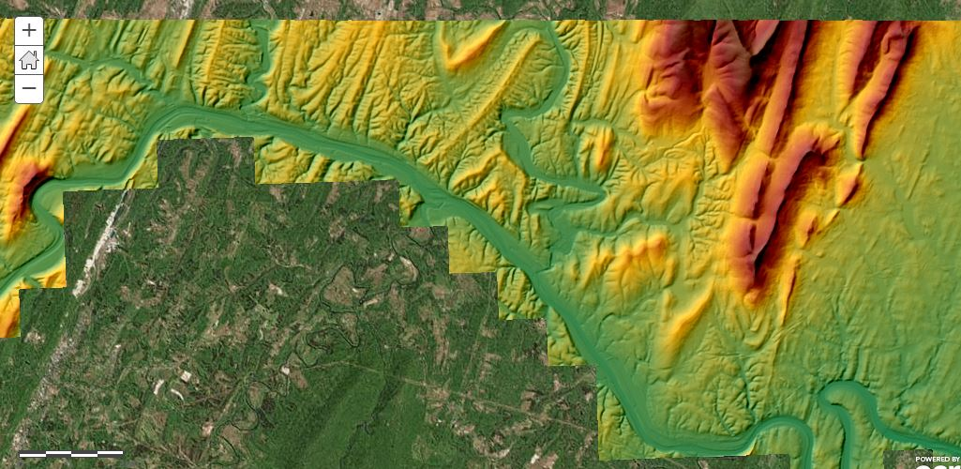
Valley & Ridge rocks & topography
Eastern Valley & Ridge topography.
Cockeysville Marble is less resistant, while the adjacent Setters Quartzite is more resistant, compared to other Piedmont rocks. Schist & gneiss are fairly resistant.

Slide 12
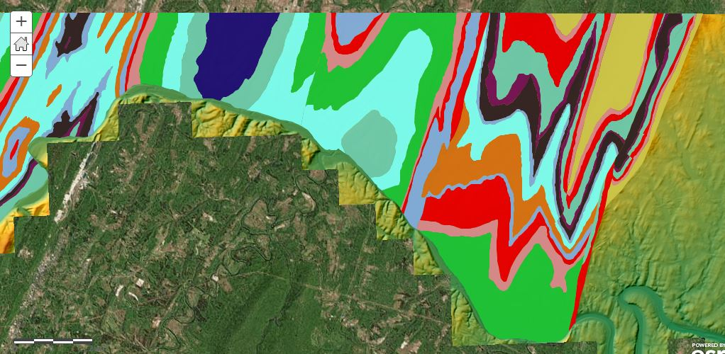
Valley & Ridge rocks & topography
Eastern Valley & Ridge geology. Reds are mainly sandstones.
Cockeysville Marble is less resistant, while the adjacent Setters Quartzite is more resistant, compared to other Piedmont rocks. Schist & gneiss are fairly resistant.

Slide 13
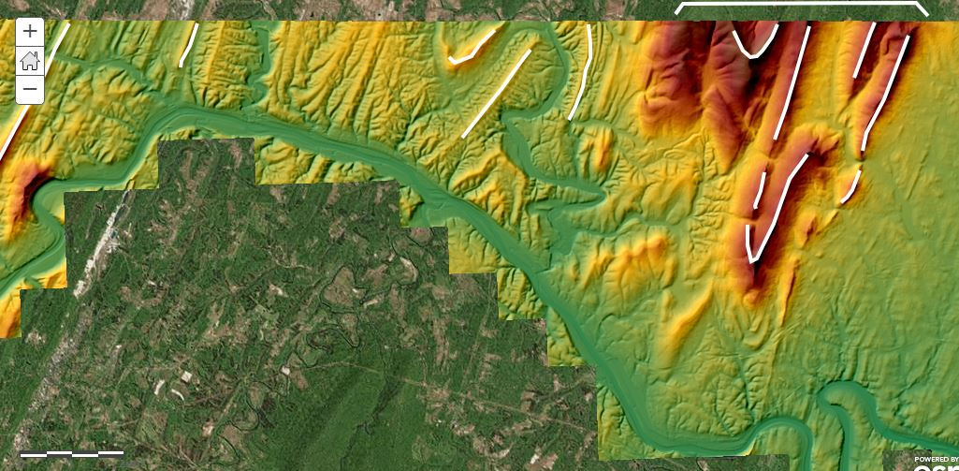
Valley & Ridge rocks & topography
Eastern Valley & Ridge topography with mountains marked.
Cockeysville Marble is less resistant, while the adjacent Setters Quartzite is more resistant, compared to other Piedmont rocks. Schist & gneiss are fairly resistant.

Slide 14
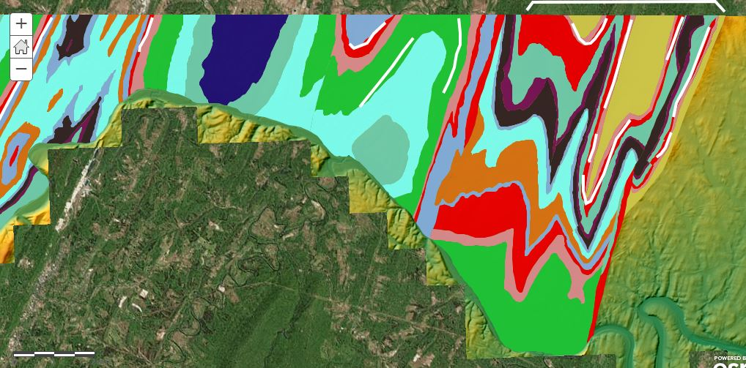
Valley & Ridge rocks & topography
Eastern Valley & Ridge geology with mountains marked.
Cockeysville Marble is less resistant, while the adjacent Setters Quartzite is more resistant, compared to other Piedmont rocks. Schist & gneiss are fairly resistant.
Are there particular rock units that seem to be responsible for the ridges?

Slide 15
Valley & Ridge rocks & topography
Sandstones are more resistant than shales and limestones and make the higher mountains.
Eastern Valley & Ridge geology with mountains marked.
Cockeysville Marble is less resistant, while the adjacent Setters Quartzite is more resistant, compared to other Piedmont rocks. Schist & gneiss are fairly resistant.
Smaller layers of sandstone within larger units of other rocks can still make ridges.
This sandstone unit makes hills here rather than major mountains.

Slide 16
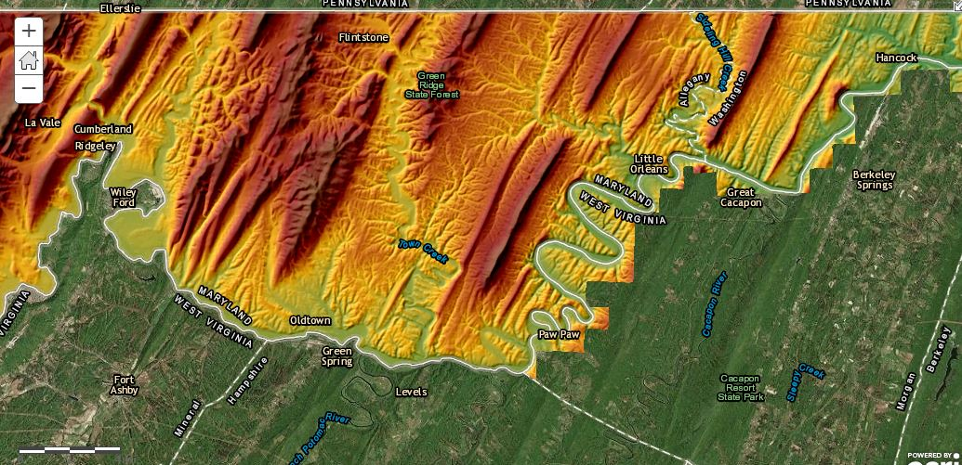
Valley & Ridge rocks & topography
Western Valley & Ridge topography.
Cockeysville Marble is less resistant, while the adjacent Setters Quartzite is more resistant, compared to other Piedmont rocks. Schist & gneiss are fairly resistant.

Slide 17
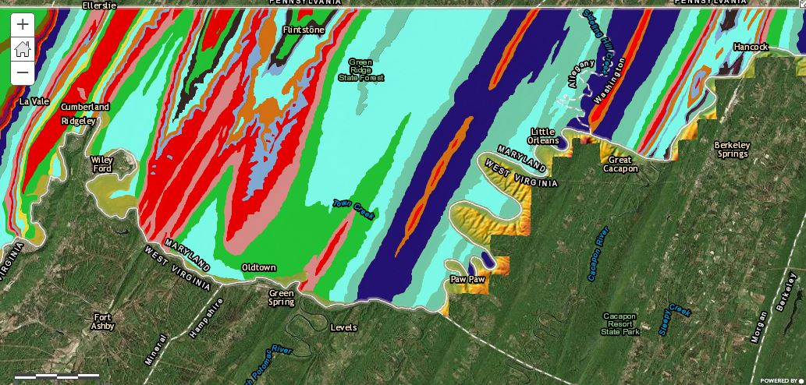
Valley & Ridge rocks & topography
Western Valley & Ridge geology. Reds are mainly sandstones.
Cockeysville Marble is less resistant, while the adjacent Setters Quartzite is more resistant, compared to other Piedmont rocks. Schist & gneiss are fairly resistant.

Slide 18
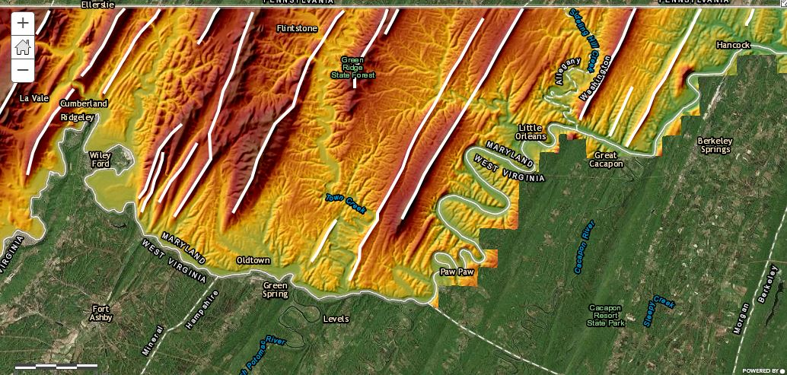
Valley & Ridge rocks & topography
Western Valley & Ridge topography with mountains marked.
Cockeysville Marble is less resistant, while the adjacent Setters Quartzite is more resistant, compared to other Piedmont rocks. Schist & gneiss are fairly resistant.

Slide 19
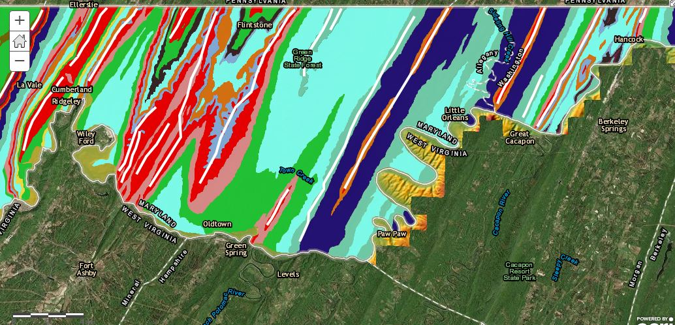
Valley & Ridge rocks & topography
Western Valley & Ridge geology with mountains marked.
Cockeysville Marble is less resistant, while the adjacent Setters Quartzite is more resistant, compared to other Piedmont rocks. Schist & gneiss are fairly resistant.
Are there particular rock units that seem to be responsible for the ridges?

Slide 20
Valley & Ridge rocks & topography
Smaller layers of sandstone within larger units of other rocks can still make ridges.
Western Valley & Ridge geology with mountains marked.
Cockeysville Marble is less resistant, while the adjacent Setters Quartzite is more resistant, compared to other Piedmont rocks. Schist & gneiss are fairly resistant.
These mountains are just capped with sandstone, but that's enough to form ridges.
Sandstones are more resistant than shales and limestones and make the higher mountains.

Slide 21
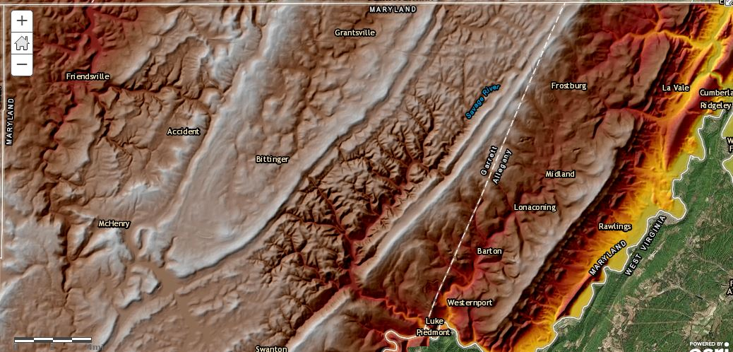
Plateau rocks & topography
Plateau elevations.
Cockeysville Marble is less resistant, while the adjacent Setters Quartzite is more resistant, compared to other Piedmont rocks. Schist & gneiss are fairly resistant.

Slide 22
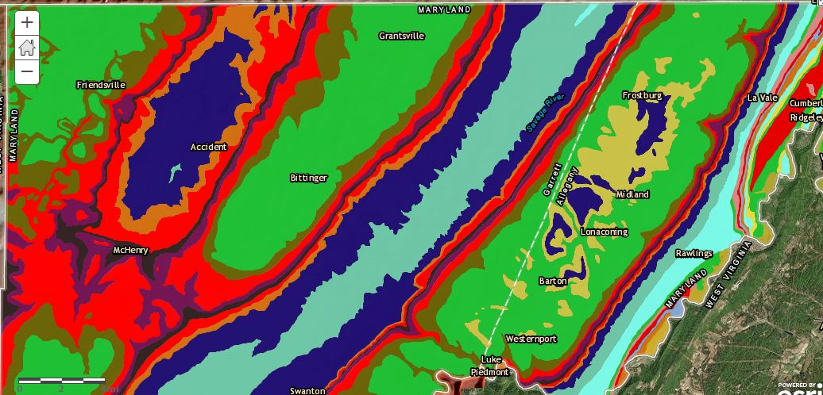
Plateau rocks & topography
Plateau geology. Reds are mainly sandstones.
Cockeysville Marble is less resistant, while the adjacent Setters Quartzite is more resistant, compared to other Piedmont rocks. Schist & gneiss are fairly resistant.

Slide 23
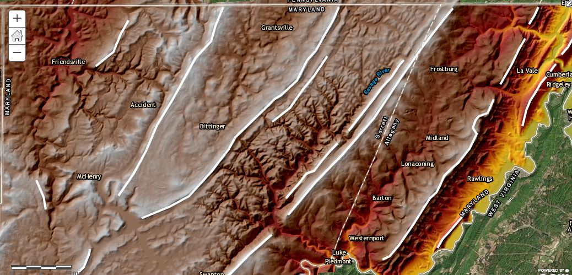
Plateau rocks & topography
Plateau elevations with mountains marked.
Cockeysville Marble is less resistant, while the adjacent Setters Quartzite is more resistant, compared to other Piedmont rocks. Schist & gneiss are fairly resistant.

Slide 24
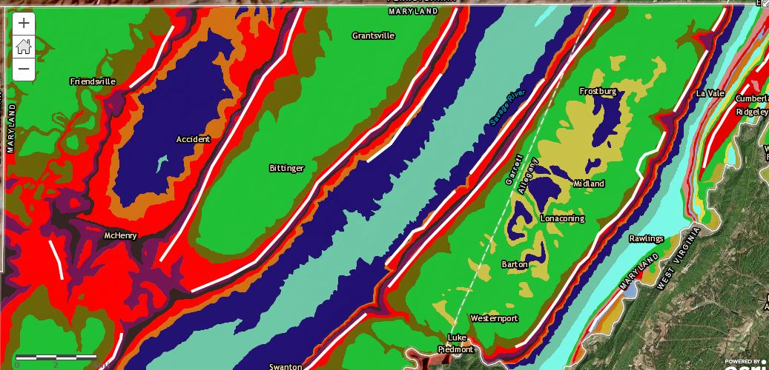
Plateau rocks & topography
Plateau geology with mountains marked.
Are there particular rock units that seem to be responsible for the ridges?
Cockeysville Marble is less resistant, while the adjacent Setters Quartzite is more resistant, compared to other Piedmont rocks. Schist & gneiss are fairly resistant.

Slide 25
Plateau rocks & topography
Again, sandstones are more resistant than shales and limestones and make the higher mountains.
Plateau geology with mountains marked.
Cockeysville Marble is less resistant, while the adjacent Setters Quartzite is more resistant, compared to other Piedmont rocks. Schist & gneiss are fairly resistant.
This broad area of sandstones makes a wider area of high ground cut by a river - now dammed to make Deep Creek Lake - rather than a ridge.

Slide 26
Yes, there is a pattern!
Chemistry of rocks has a significant influence on the landforms we live on!
In our area, rocks with quartz = SiO2 such as sandstone and quartzite often make hills and mountains because of quartz's chemical properties.
Rocks like limestone and marble wear away because they are made of calcite = CaCO3, which dissolves slowly in rainwater and groundwater.
Rocks like shale and siltstone are physically soft and wear away fairly easily. True also for Coastal Plain sediments.
Most metamorphic rocks in much of the Piedmont are fairly resistant felsic silicates.

