Slide 1
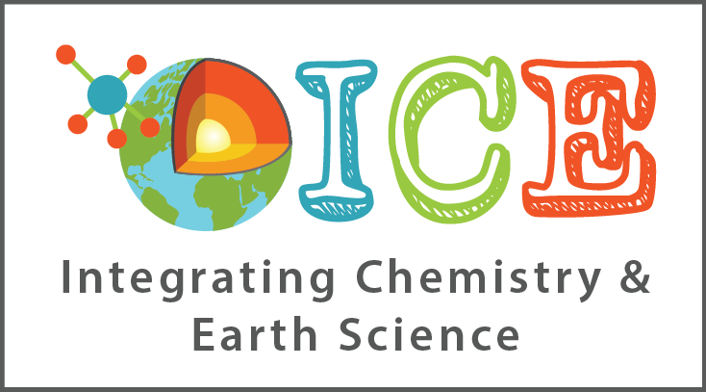
HOW HIGH WERE BALTIMORE’S MOUNTAINS
By: Martin F. Schmidt, Jr.
WEATHERING, EROSION & DEPOSITION MODULE
Lesson 6 – Landforms and Physical Deposition

Slide 2
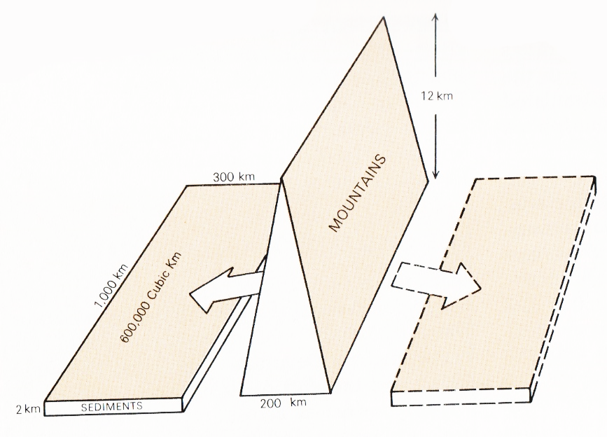
What do sediment volumes tell us about the size of the mountains they came from?
Suppose a relatively narrow mountain range like the highlands of the Acadian Orogeny erode to make sediments on each side.
But erosion proceeds simultaneously with uplift, so the mountains need never have been so high.
Total volume requires mountains 1000 km x 200 km x 12 km high -
7 kilometers higher than Mt Everest!
Sediments from the Acadian Orogeny are called the Catskill sediments, and they have this volume in what today are the Plateau and Valley & Ridge provinces.
Assumed equal volume on other side.
Diagram and information from Evolution of the Earth by Dott & Batten, 3rd ed., p. 312.

