Slide 1

EXAMPLES OF ROCK AND MINERAL DEPOSITION
By Martin f. Schmidt, Jr.
WEATHERING, EROSION & DEPOSITION MODULE
Lesson 7 – CHEMICAL DEPOSITION

Slide 2
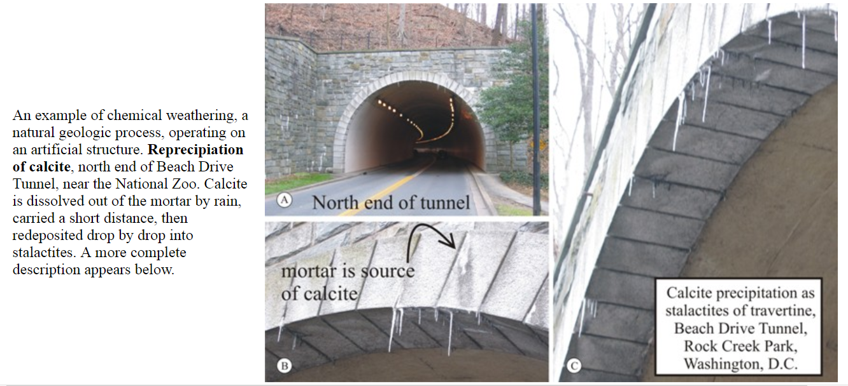
Local Calcium Carbonate ‘Rock’ Formation
Photos and information by Callan Bentley.

Slide 3
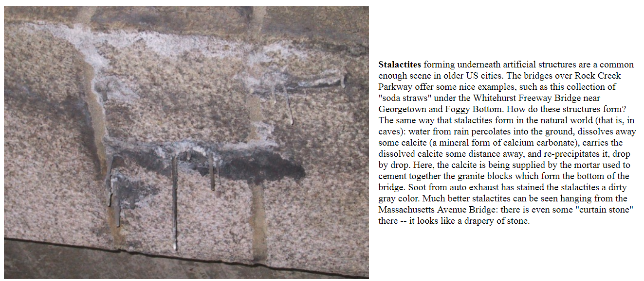
Local Calcium Carbonate ‘Rock’ Formation
Photo and information by Callan Bentley.

Slide 4
Oregon Ridge Iron
Weathering and interacting rock chemistries have produced iron deposits in Maryland.
CO2 dissolves in falling rain, making it acidic.
More CO2 is added to groundwater by bacteria, increasing the acidity. The groundwater dissolves iron from the metamorphic rock.
Rainwater collects below the surface as groundwater, like a sponge full of water.
Groundwater flows downhill to the marble in the valley.
Calcite neutralizes the acid so the iron can't stay in solution - deposits out as iron nodules people can use as an iron source.
Hill of metamorphic rock containing iron.
Valley of marble = calcite = CaCO3
More

Slide 5
Weathering as refinery
This process has made the iron deposits in Baltimore County at Oregon Ridge and Cromwell Valley.
Conveniently, the marble also is used in the furnaces to further refine the iron ore.
This provided iron for plows and tools.
A similar process makes "bog iron" in the Maryland Coastal Plain - in this case the CO₂ escapes in the air, making the water less acid, so the iron deposits out.
The iron deposits are often oxidized to these minerals:
hematite = Fe₂O₃ goethite = FeO(OH)
limonite = FeO(OH) · nH₂O
Notes:
This is mainly “interesting information” after going over it, focus on the formation of minerals for students to note.

Slide 6
Iron oxides can cement sediments
Iron oxides can also deposit between grains of sediment to make rock.

Slide 7
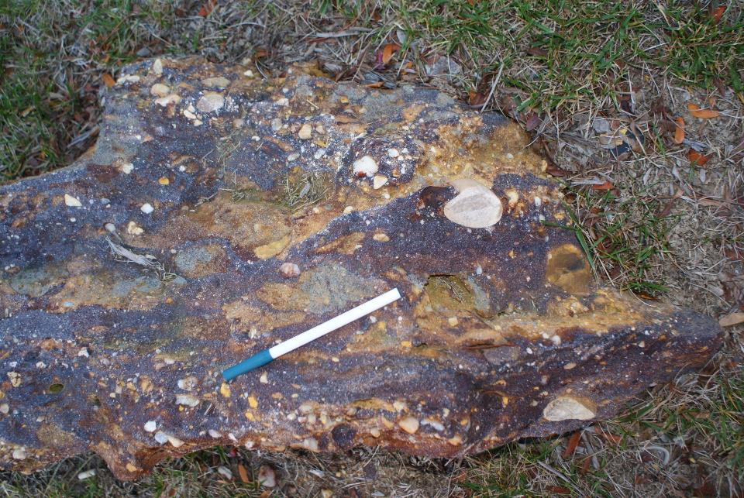
Iron-cemented conglomerate
530
Notes:
The following slides are all examples of different Maryland rocks formed by this process. Show as many or few as work in your class.

Slide 8
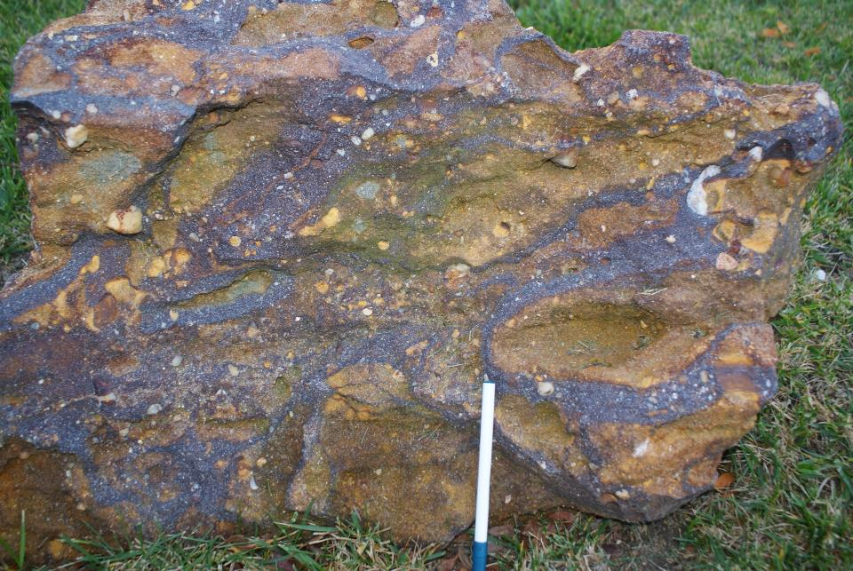
Iron-cemented conglomerate
531

Slide 9
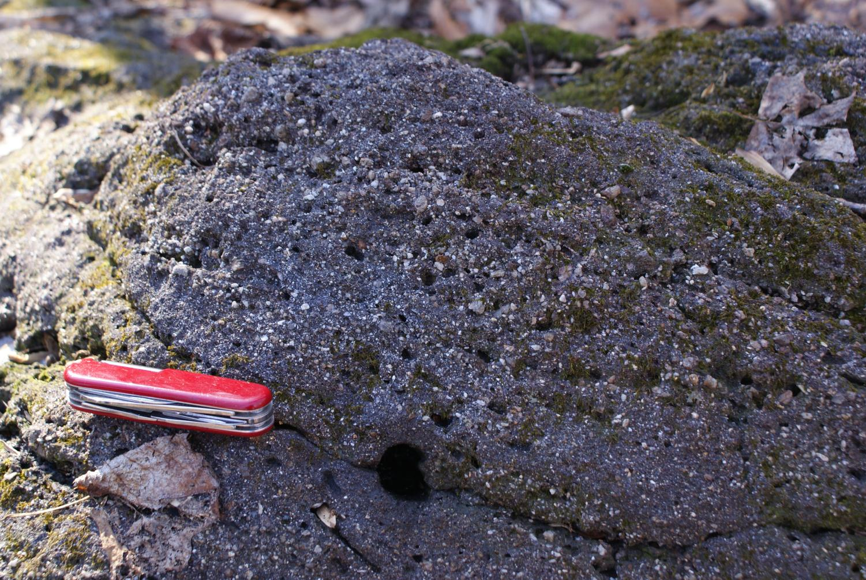
Iron-cemented sandstone, Elk Neck State Park, MD
4694

Slide 10
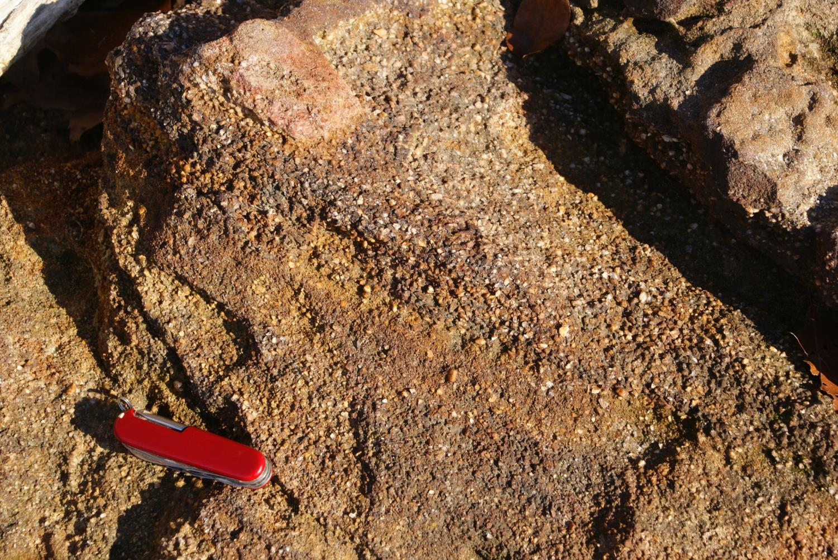
Iron-cemented sandstone, Elk Neck State Park, MD
4715

Slide 11
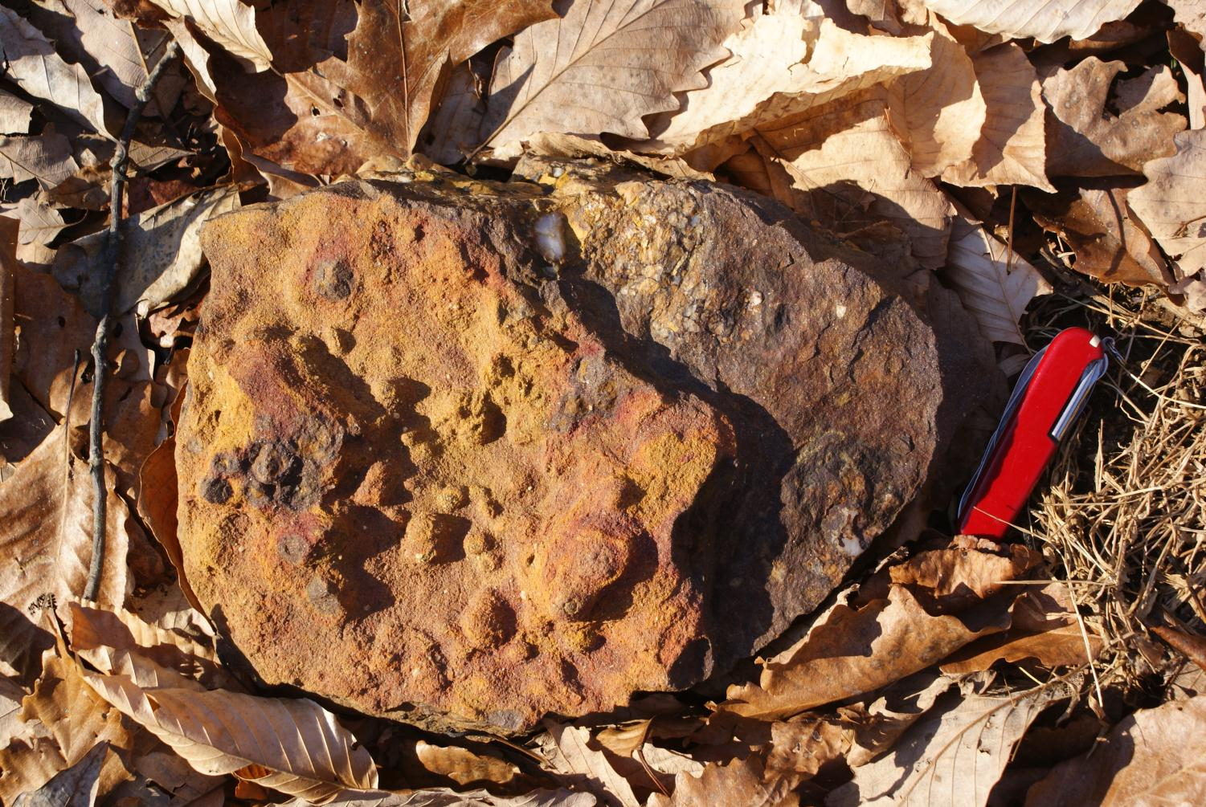
Iron-cemented sandstone, Elk Neck State Park, MD
4696

Slide 12
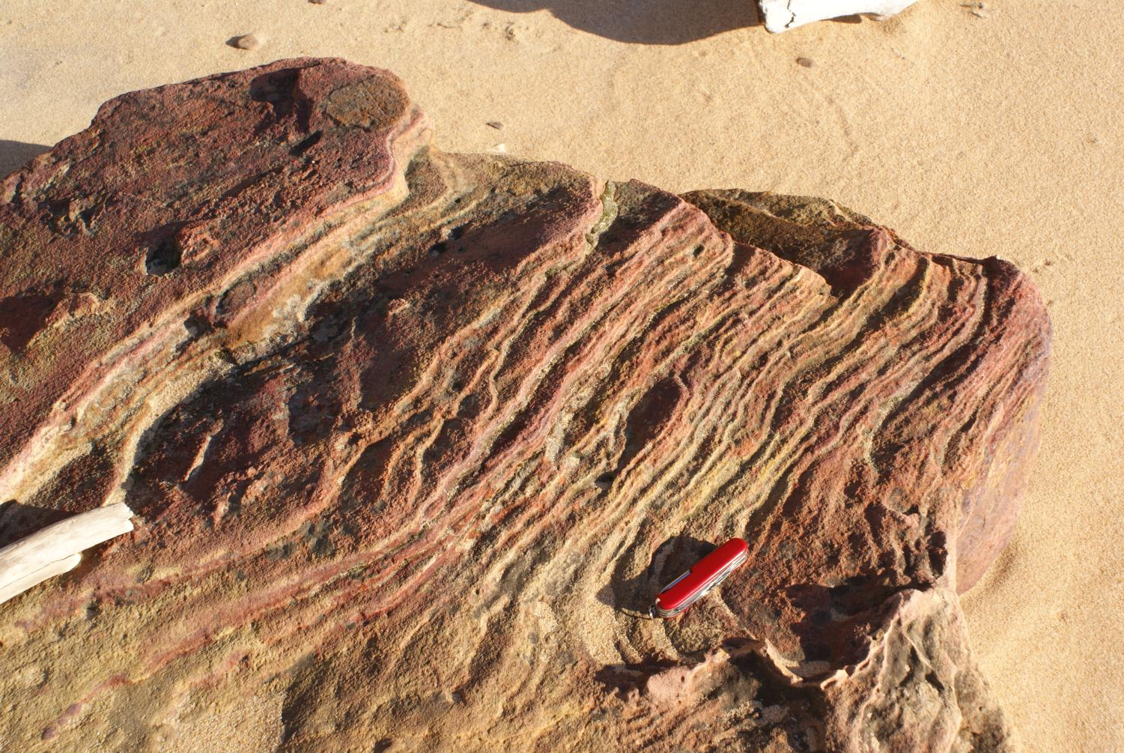
Iron-cemented sandstone, Elk Neck State Park, MD
4716

Slide 13
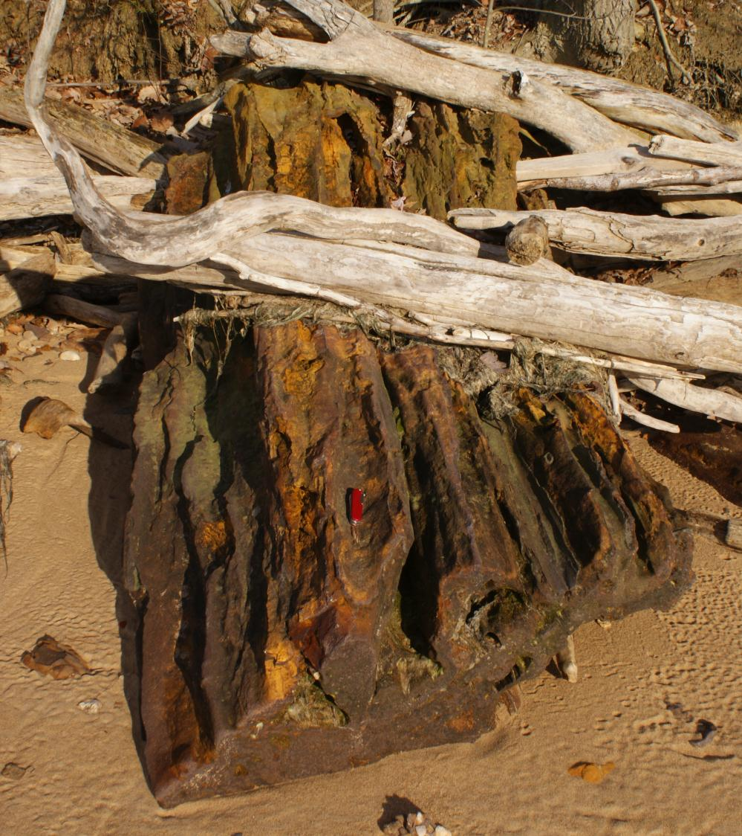
Iron-cemented sandstone, Elk Neck State Park, MD
4738

Slide 14
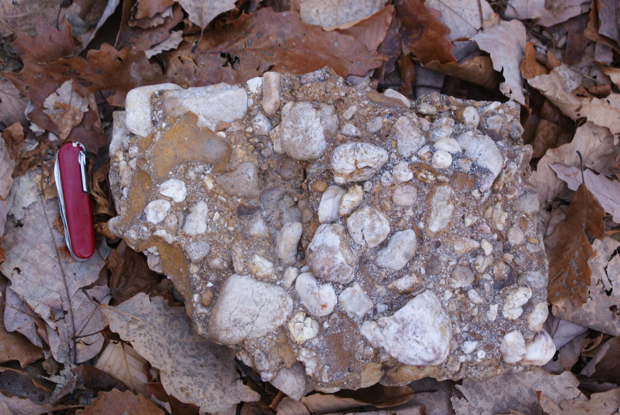
Iron-cemented conglomerate, Elk Neck State Park, MD
4697

Slide 15
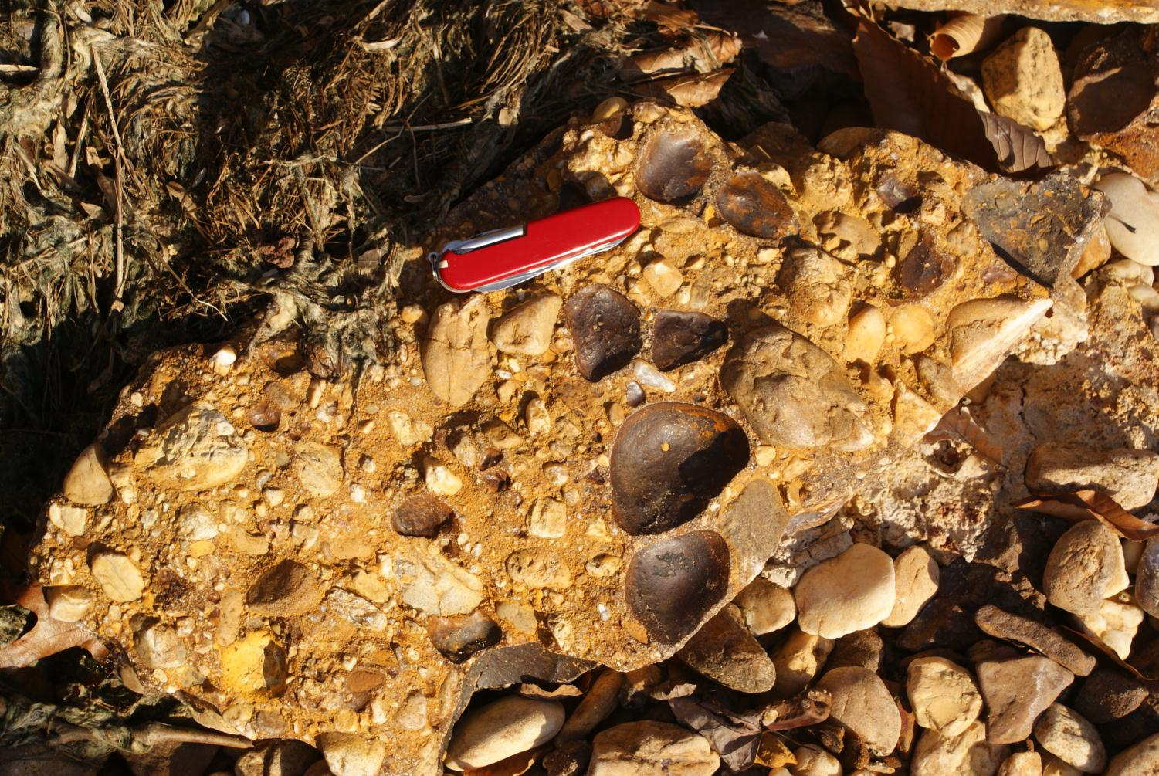
Iron-cemented conglomerate, Elk Neck State Park, MD
4757

Slide 16
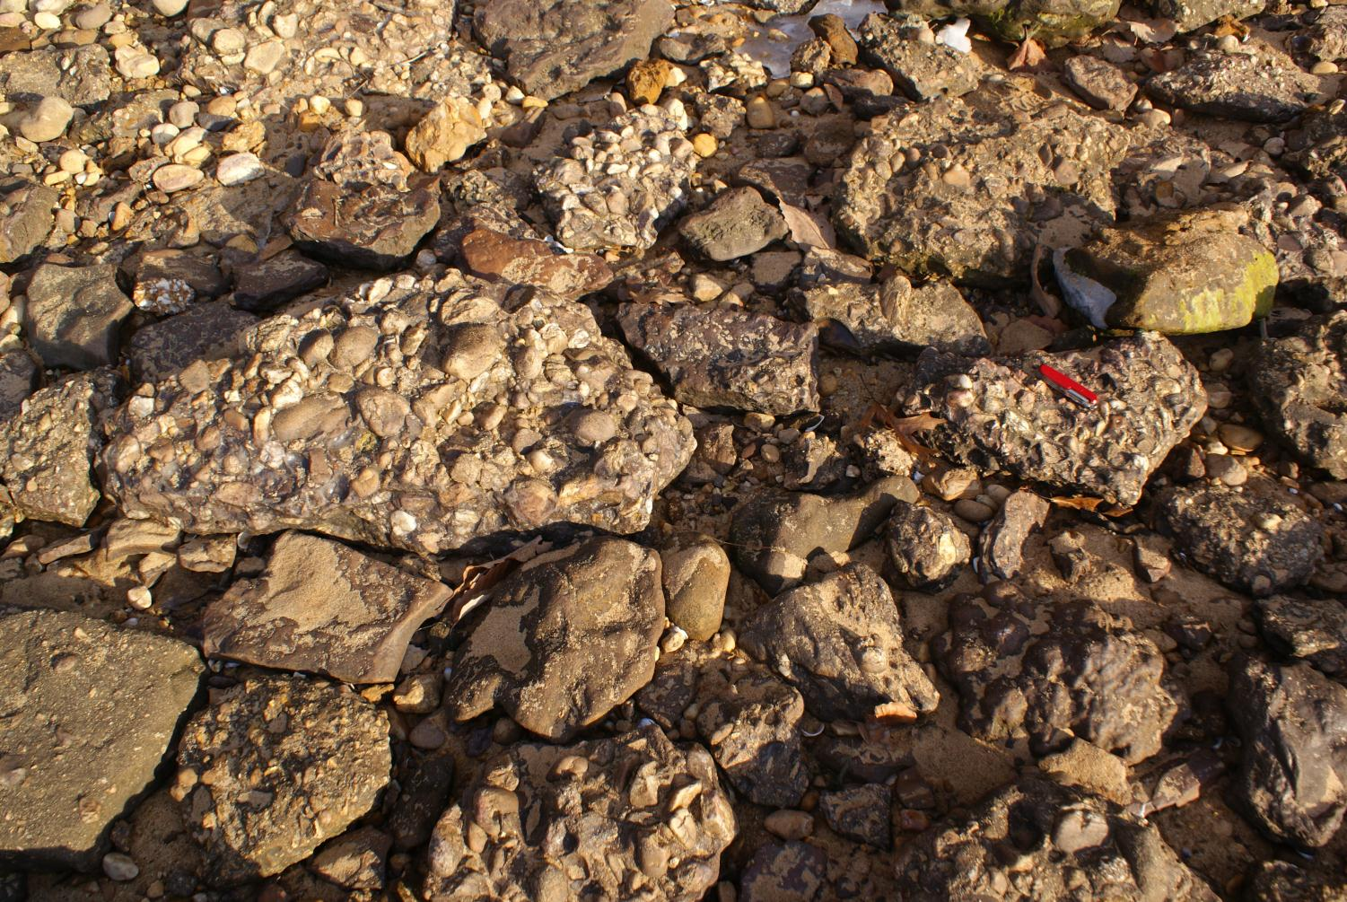
Iron-cemented conglomerate, Elk Neck State Park, MD
4756

